Slide 1
Create Your Own
Bidirectional Revit Structure
Stress Analysis Integration Link
Jeremy Tammik, Autodesk Inc.
Consulting Analyst

Slide 2

About the Presenter
Overview
Jeremy Tammik
Developer Technical Services
EMEA
Autodesk SARL
Jeremy worked with Autodesk from 1988 until 1994 as a technology evangelist responsible for European Developer Support before the inception of the Autodesk Developer Network ADN. He was a co-founder of the AutoCAD Developer Group Europe and a prolific author around AutoCAD application development. He left Autodesk to work as an HVAC application developer, and then rejoined in 2005 to work in the AEC group of the ADN DevTech team.
Jeremy studied mathematics and physics in Germany (Dipl. Math.), has four children, is a vegetarian, likes theatre improvisation and sports, especially climbing, plays the flute, and is fluent in five European languages.
Notes:
It is my pleasure to work in for the Autodesk Developer Network, ADN, in the AEC workgroup.

Slide 3
Agenda
Overview
Overview
  Workflow
  Compare Architecture and Structure
  Physical versus analytical model
Requirements, Samples and Labs
  Explore and implement base functionality
Link
  Sample application
  Linking Revit with external analysis package
  Simulated using AutoCAD
Notes:
Our discussion here proceeds in three steps. First, look at the workflow and how it is supported by Revit Structure or RST. Secondly, walk through a series of labs related to extracting and analysing the data managed by RST. Finally, we will look at a sample application linking RST with an external application. In this case, the external stress analysis package is simulated by AutoCAD.

Slide 4
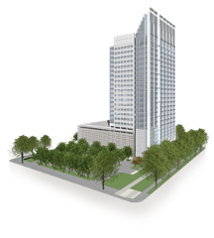

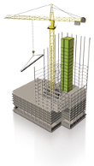


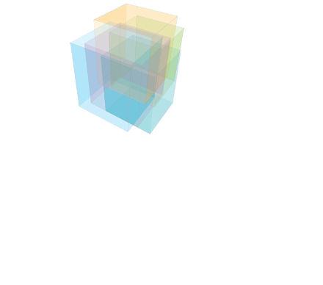



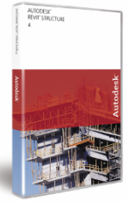
Completing the Building Information Model
Overview
  Building Information Modeling (BIM) – The creation and use of coordinated, internally consistent, computable information about a building project in design and construction
OWNERS
BUILDING
INFORMATION
MODELING
BUILDERS
ARCHITECTS
Focus
MEP SYSTEMS
ENGINEERS
STRUCTURAL
ENGINEERS
Image Courtesy of DDB Architectural International Ltd.
Notes:
4
Building information modeling (BIM) is the creation and use of coordinated, consistent, computable information about a building project in design that yields reliable digital representations of the building – representations used for design decision-making, production of high-quality construction documents, performance predictions, cost-estimating and construction planning, and, eventually, for managing and operating the facility. The focus of this presentation is on the structural part of it with Revit Structure.

Slide 5
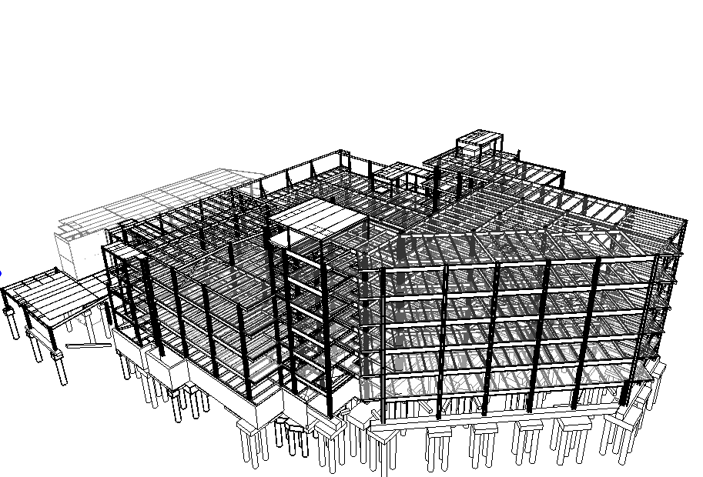
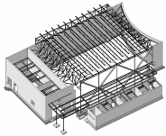
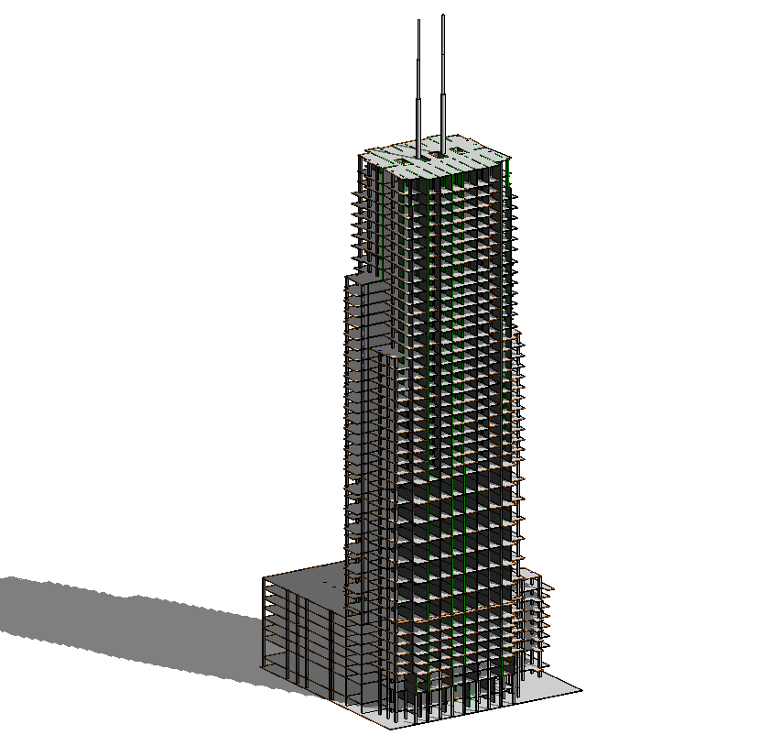
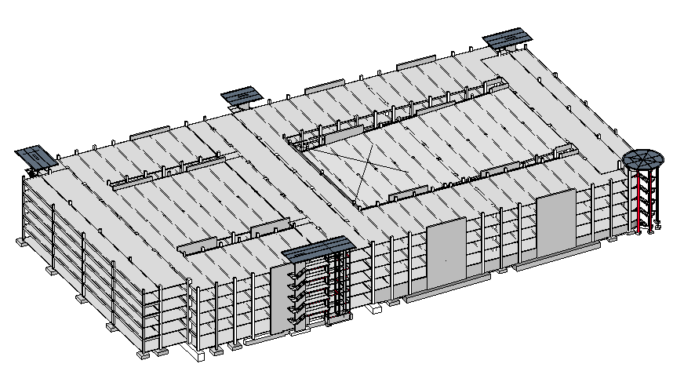
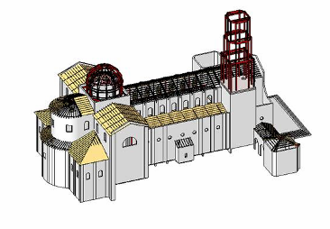
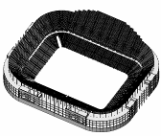
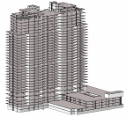
Revit Structure Target Projects
Overview
  Buildings -
  Any Type, any Size, any Complexity
  made of any kind of Materials
Notes:
5
Even if structural engineers can design any type of structures including bridges, tunnels, plants etc., RST focuses on building design. It does not mean that a user cannot design other type of structures, but the marketing that we do, the training and documentation materials that we provide are positioning RST on building design.

Slide 6
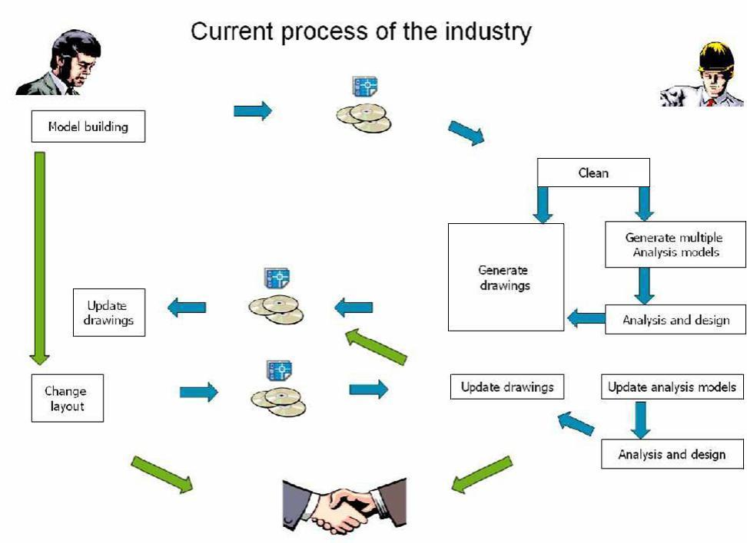
Current Analysis Process
Overview
Notes:
Currently, the analysis of a building involves a lot of manual data transfer with accompanying loss of information and additional cost. The aim of Revit and its building information model and Revit Structure and its linked physical and analytical model is to preserve more information, support communication between all parties involved, and reduce cost.

Slide 7
Structural Market Definition
Overview
Design
Drafter
Designer
Construction
Documentation
Fabrication
Engineer
Contractor
Steel Detailer
Structural
Analysis
Fabrication and
Shop Drawings
User Types
Industry Tasks
Coordination
Notes:
7
The structural industry is extremely fragmented. We segment is into 2 parts: design and fabrication. The design is composed of 2 tasks (analysis and construction drawings) done by 3 actors and the fabrication focuses on shop drawings.

Slide 8
Tasks and User Focus
Overview
Design
Drafter
Designer
Construction
Documentation
Fabrication
Modeling
Contractor
Steel Detailer
Engineer
Structural
Analysis
Fabrication and
Shop Drawings
Revit Structure Focus
Notes:
8
The focus that we have for RST is on the design part only where we do modeling for drawings and analysis. We do not do analysis.

Slide 9
Issues to Address
Overview
Problems addressed by Revit Structure
  Same information is duplicated for different tasks
  Lack of coordination tools
    Between drafters and engineers
    Between architects and engineers
  Lack of standard software modelling platform
How are these problems addressed?

Slide 10
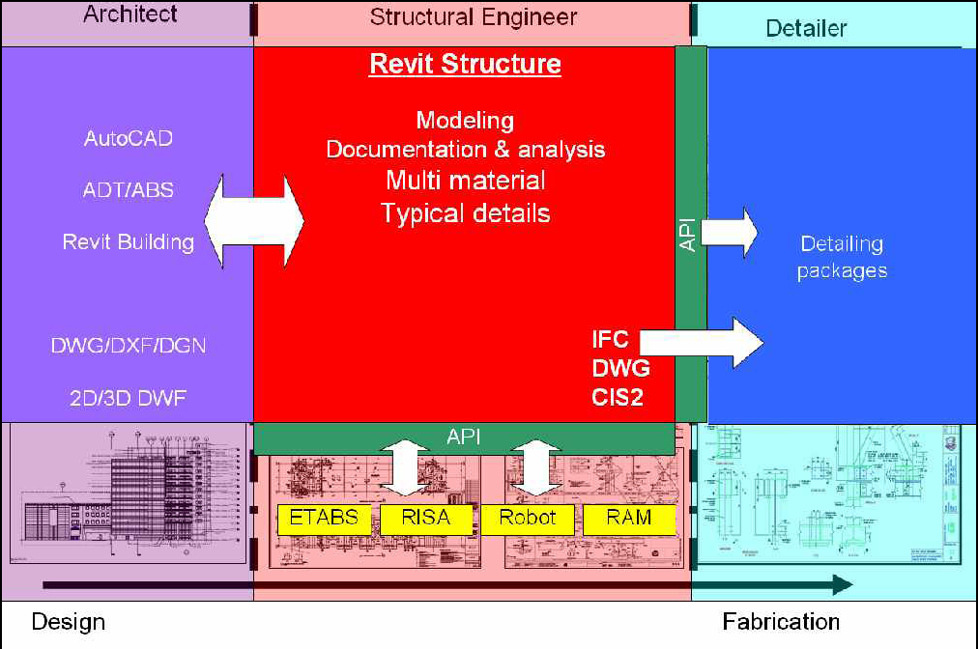
Introduction
Overview
Notes:
Revit Structure is used by a structural engineer to manage and combine data from several different sources:
Architectural data, the building design, which can come from Revit Architecture, but also from other Autodesk or non-Autodesk products.
Analysis data for stress analysis in external packages.
Details which are designed based on the analysis results.

Slide 11
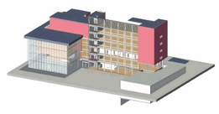
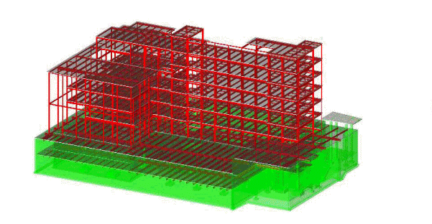
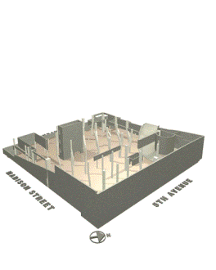
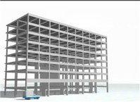
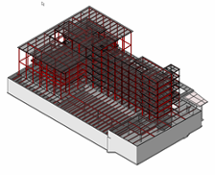
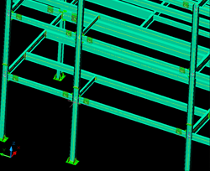
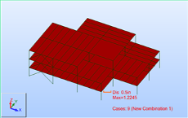
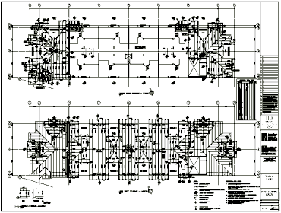
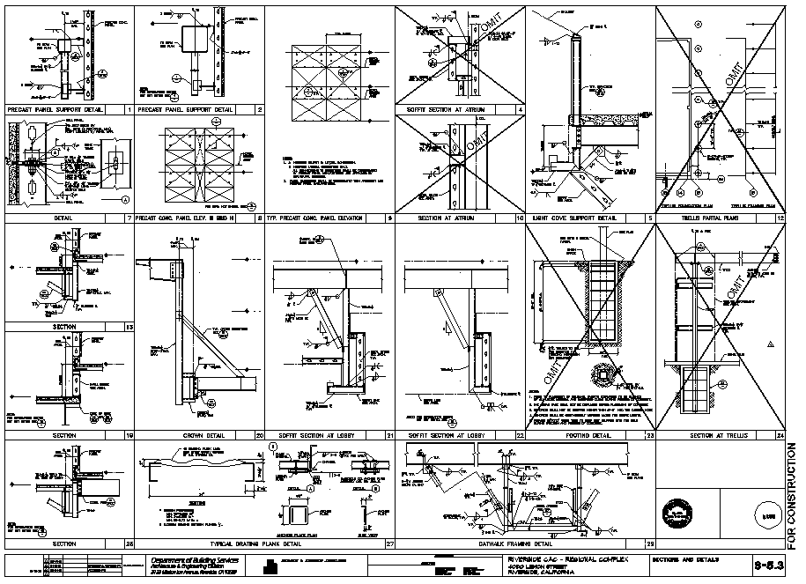
Structural BIM Workflow: The 4 Cs
Overview
Coordination
ARCHITECTS
BUILDERS
Construction
STRUCTURAL
ENGINEERS
FABRICATORS
Calculations
Construction Documents
Notes:
11
In the context of the structural BIM, we focus on four C’s which require significant coordination between architects, structural engineers, fabricators and builders:
Coordination
Calculations
Construction Documents
Construction
Developers and ADN partners can develop applications for each of the four Cs:
- Coordination with other disciplines
Using the rich information in RST and process it against other disciplines
Calculations or Analysis
Link analysis and design applications
Construction documentations
Focus on local standards
Automation
Construction
Use the information downstream for fabrication

Slide 12
Application Development Opportunities
Overview
Integration of analysis and design software
Automatic modeling
  Reinforcement
  Framing
  Connections (Steel, precast)
  Portal frames
  Bridge/tunnels
  Special structures (towers, retaining walls)
Data exchange (with other AutoCAD based applications)
Scheduling
Drawing automation
…
Notes:
As the API is becoming more and more robust, there are many areas of opportunity to port existing applications to RST or to develop new ones.
The API is a great way to automate repetitive manual tasks such as reinforcement, framing modeling. There is also an opportunity to create dedicated Revit families and to drive their generation with the API such as steel connections. You can also imagine building wizard type applications that generate civil structures including soil, geometry reinforcement etc. The API is also built so you can link the RST model to your existing application and complete what RST does not do such as local standard drawings or schedules. With the API you can drive an application to generate a dwg file and then import it automatically in RST.
12

Slide 13
Application Development Opportunities
Overview
Integration of analysis and design software
Automatic modeling
  Reinforcement
  Framing
  Connections (Steel, precast)
  Portal frames
  Bridge/tunnels
  Special structures (towers, retaining walls)
Data exchange (with other AutoCAD based applications)
Scheduling
Drawing automation
…
Notes:
Today we will focus on the three highlighted areas.
13

Slide 14
Comparison with Revit Architecture
Overview
  General User Interface
  Command organization
  Category filtering
  Functionality added
  Analytical model (generation and adjustment)
  Load modelling
  API specific model and load objects
  Rebar modelling
  Composite metal deck
  Graphical column schedule
  ...
Notes:
Revit Architecture and Structure have a lot of common features. The differences are visible in the user interface in the command organisation and the category filtering. Some structure-specific functionality has been added.

Slide 15
Comparison with Revit Architecture
Overview
  Functionality removed
  Reflected ceiling plans
  Room related functionalities
  Model text
  ...
Notes:
Some functionality has also been removed.

Slide 16
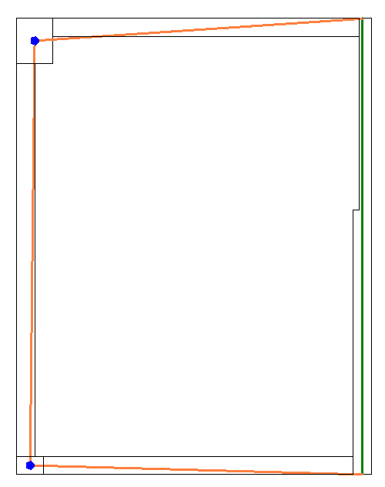
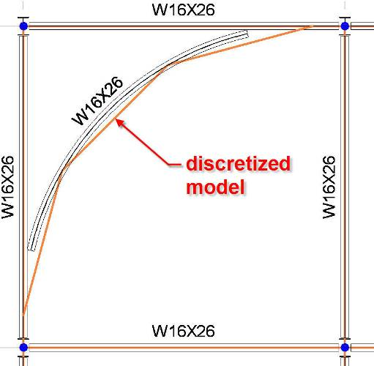
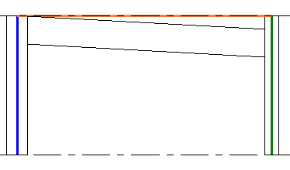
Analytical Model
Overview
Structural analysis model differs from drawing model
Revit Structure solves this problem
Physical model is used for drawings, coordination and construction
Analytical model is the simplified model used for analysis
Notes:
The most important problem of the structural industry is the fact that the information used for structural analysis is physically different than the one used for drawings. Revit Structure solves this problem. The physical model is the model that we use for drawings, coordination and construction, and the analytical model is the simplified model used for analysis.
Some examples show the discrepancies between the analytical and physical models.
For example, consider a plan view where the walls need to be aligned for the analysis and the beams need to join the centre of columns to end of walls.
Another example is an elevation where the analytical model is horizontally projected even if the physical model of the beam has a slope.
Finally, consider a situation where the physical model of the beam is curved and the analytical model is segmented.
Revit Structure maintains the coordination between the 2 models and will keep the analytical model of each element connected.
As a third party analysis developer, you just need to work with the analytical model.
16

Slide 17
What is in the analytical model?
Overview
Members that need to participate in the analysis
Geometry (location)
    Sections
    Materials
    Release conditions
    Reference to level (optional)
Loads
    Load cases
    Load combinations
    Point, line, area loads
Boundary conditions
    Support data
Notes:
In this presentation, we explain how to access all this information.
17

Slide 18
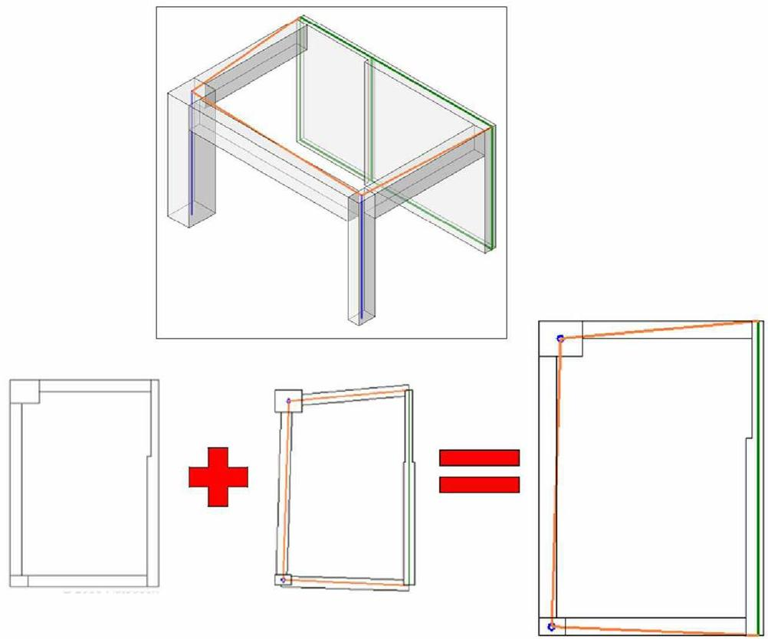
Analytical vs Physical Model
Overview
Notes:
Revit Structure combines the physical model which drives the modeling and documentation process with the analytical model which drives the analysis process and export to third party analysis software.
The Revit Structure analytical model can be adjusted for analysis purposes while the physical model stays accurate for documentation.

Slide 19
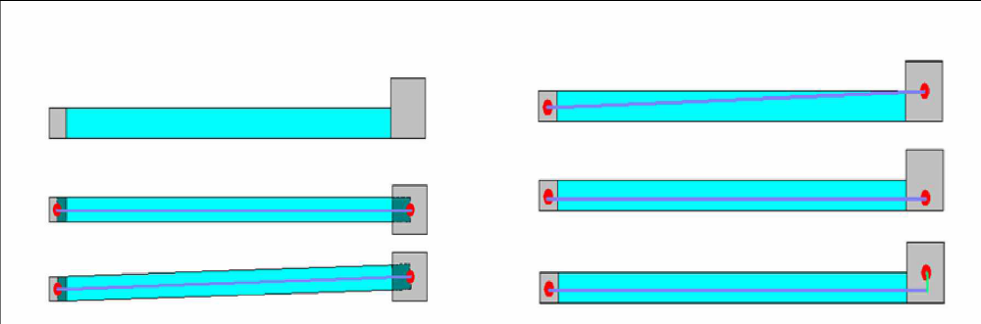
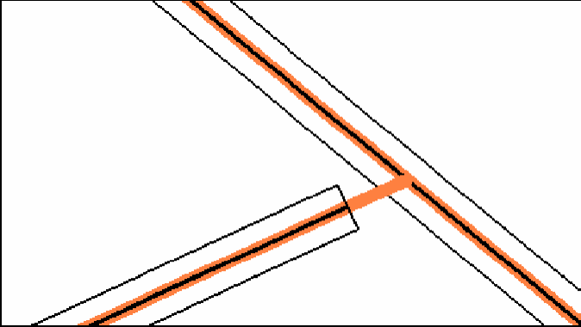
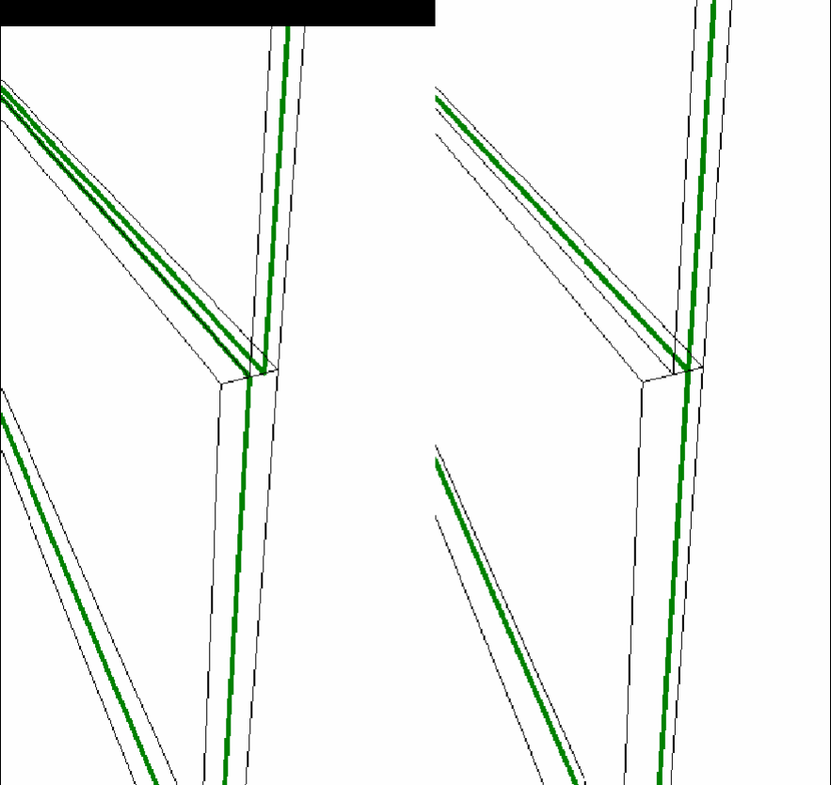
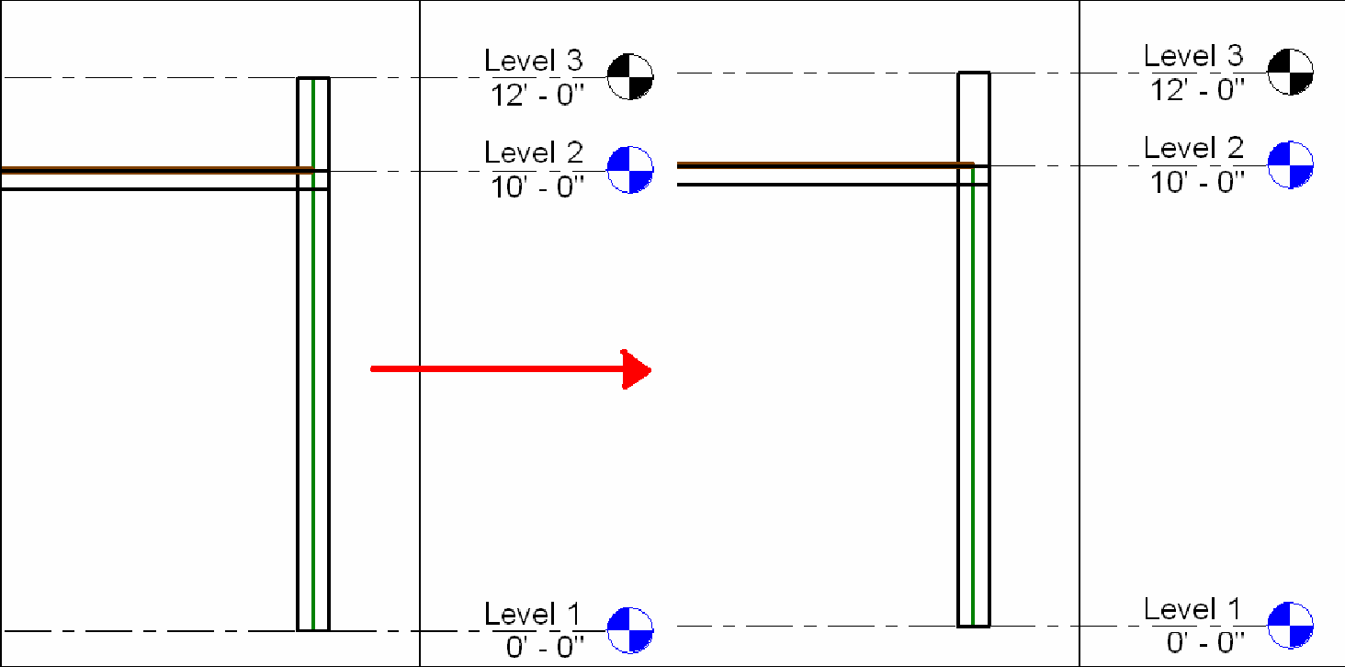
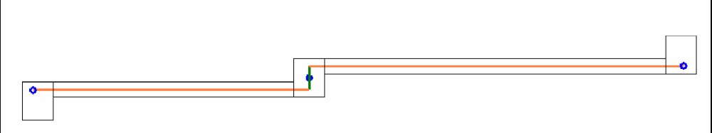
Analytical vs Physical Model
Overview
Notes:
Here are examples of different cases highlighting the difference between the physical and the analytical models and the need for flexibility in linking the two:
The end points of two beams may are not at the same location. We want to the end points of their analytical models to be located at the same point. An engineer decides to move the end of one beam.
Remodelling an old historic building, walls may not be straight. An engineer decides to approximate them by planes for analysis.
Two walls with different thicknesses but aligned analytical planes.
A wall with a parapet that does not need to be included in the analysis.
Adjusting the location of analytical columns horizontally.
The cases are taken from AE_CD_RST2008/Analysis_workflows/Analysis_Workflows.pdf.

Slide 20
Data Exchange Workflow
Overview
Geometry
Physical
Analytical
Loads
Connectivity
Material
Project parameters
Notes:
In general, we start off with a physical model. This can be used to automatically generate the analytical one. The analytical model is exported to an external analysis package, which adds its own data. As a result of the analysis, the analytical model may be modified, resulting in changes in the physical model as well. New changes may be added in the physical model as well. All of these processes may continue over many iterations.
The example presented displays the following steps:
RST defines the physical model, analytical model composed of geometry, loads, connectivity (release and boundary conditions), material properties, project parameters. This is information is accessible via the API
In the analysis software we get the analytical model
Analytical model initializes specific properties not present in RST (here they are symbolized with X and Y) and the user can change them. We can do an analysis, delete specific members, change sections and then the analysis software updates the RST model
Changes can be add, delete, create, and move members and also add new properties to RST members
If we select a column and duplicate it, it will have the Y parameter that was defined in 3)
So the next time we round trip the data to the 3rd party, we retrieve the Y parameter.

Slide 21
Analysis Requirements
Overview
  Extract the analytical model geometry
  Extract the load cases, load combinations, loads
  Extract release and boundary conditions
  Update the model with changes and new and deleted elements
  Add load cases and load combinations
  Add loads and reactions
  Add project information, shared parameters
  Add shared parameters on structural objects
Notes:
Now we understand the structural workflow and its needs, we can start looking at the API features provided to address these needs.
Here is an overview of the typical requirements for implementing a link to an external analysis package using the RST API.
In the following slides, we will look at the Revit samples and a series of labs demonstrating how to address these issues one by one.
Finally, the results of these labs will be integrated into the sample link application.

Slide 22
Adding local parameters to Revit
Overview
Shared parameters
  Can be defined in an external file
  Can be added with the API
  Can be defined per element
  Can be project specific, e.g. building codes
Templates
  Can contain specific information such as load combinations
Notes:
Here are some different strategies for a third party application to add new properties in the database.
22

Slide 23
Analytical model access
Overview
How to get the ...
  ... thickness of a wall with multiple layers?
    SDK sample TestWallThickness
  ... analytical model of an in-place family?
    SDK sample AnalyticalViewer
  ... analytical model defined in an external family?
    SDK sample AnalyticalViewer
  ... multiple analytical segments of a curved beam?
    Tessellate the underlying curve
Notes:
Here are some typical frequently asked questions and examples on how to solve them.
23

Slide 24
Useful Revit SDK Samples
Overview
Parameters
  BrowseBindings
  CreateShared
  FireRating
  InvisibleParam
Analytical Model
  AnalyticalSupportData_Info
  AnalyticalViewer
  BoundaryConditions
  InplaceFamilyAnalyticalModel3D
  Loads
  RotateFramingObjects
  SlabProperties
  SpanDirection
Notes:
Currently, information on how to combine Revit API calls to achieve certain complex tasks is contained mainly in the SDK samples. Here is a list of some of the Revit SDK samples which address areas related to structure.

Slide 25
Revit Structure Analysis Labs

Slide 26
Revit Structure Analysis Labs
Link Labs
Loads
  1-1 Load cases, natures, combinations, usages
  1-2 Point, line and area loads
  1-3 Load parameters and modification
  1-4 Load symbols
  1-5 Creating load objects
Structure
  2-1 Columns and framing
  2-2 Foundations
  2-3 Walls, floors, footings
Analytical Model
  3 Analytical model
Notes:
In the section, we demonstrate step by step how to implement the functionality required for an application linking Revit Structure with an external analysis package. The first group of labs addresses access and modification of load data, the second examines the building structure, and the third addresses the entire analytical model.

Slide 27
Load Grouping Objects
Link Labs
  Load Cases
  Load Natures
  Load Combinations
  Load Usages
  Lab 1-1
  To retrieve load case, nature, combination and usage objects, simply iterate over the document elements and check for the corresponding object class LoadCase, LoadNature, LoadCombination and LoadUsage
  To create new objects, use the Autodesk.Revit.Creation.Document methods NewLoadCase(), NewLoadCombination(), NewLoadNature(), NewLoadUsage() accessible through ActiveDocument.Create
Notes:
This first lab extracts and lists the load cases, natures, combinations and usages defined in the Revit model.

Slide 28
Loads Grouping Code
Link Labs
Retrieve objects
        Public Shared Function GetAllLoadNatures(
        ByVal revitApp As Revit.Application) As ElementSet
        Dim natures As ElementSet = revitApp.Create.NewElementSet
        Dim iter As IEnumerator = revitApp.ActiveDocument.Elements
        Do While (iter.MoveNext())
        Dim elem As Revit.Element = iter.Current
        If TypeOf elem Is LoadNature Then
        natures.Insert(elem)
        End If
        Loop
        Return natures
        End Function
Create objects
        ActiveDocument.Create.
        LoadCase NewLoadCase( string name, LoadNature nature, Category category );
        LoadNature NewLoadNature( string name )
        LoadUsage NewLoadUsage( string name )
        LoadCombination NewLoadCombination( string name, int typeInd, int stateInd,
        double[] factors, LoadCaseArray cases, LoadCombinationArray combinations,
        LoadUsageArray usages )

Slide 29
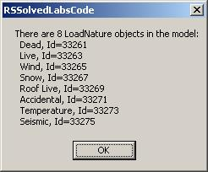
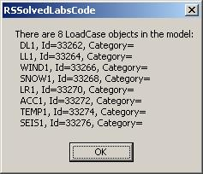
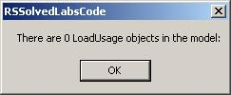
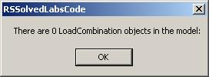
Loads Grouping Demo
Link Labs
Notes:
Todo: add image of model.
To run the demo, install and compile RSSolvedLabsCode, add Lab 1-1 to Revit.ini, start Revit, and select the external command.
[ExternalCommands]
ECCount=1
ECName1=RS Lab1-1 Load Natures, Cases and Combinations
ECDescription1=Lab1_1...
ECClassName1=RSSolvedLabsCode.Lab1_1
ECAssembly1=C:\a\j\adn\rst\rst_api\RSSolvedLabsCode\bin\RSSolvedLabsCode.dll

Slide 30
Access to Load Objects
Link Labs
  Point Loads
  Line Loads
  Area Loads
  Lab 1-2
  Shows how to access all load objects using the base or specific classes
  All three load classes are derived from LoadBase
  Creation through NewAreaLoad (3 overloads), NewLineLoad (2), NewPointLoad
Notes:
Lab 1-2 shows how to access all load objects using the base or specific classes. All three load classes are derived from LoadBase. They are creation through NewAreaLoad() (3 overloads), NewLineLoad() (2), and NewPointLoad().

Slide 31
Retrieve Load Objects
Link Labs
        Public Shared Sub GetAllSpecificLoads( _
        ByVal revitApp As Revit.Application, _
        ByRef pointLoads As ElementSet, _
        ByRef lineLoads As ElementSet, _
        ByRef areaLoads As ElementSet)
        Dim iter As IEnumerator = revitApp.ActiveDocument.Elements
        Do While (iter.MoveNext())
        Dim elem As Revit.Element = iter.Current
        If TypeOf elem Is PointLoad Then
        pointLoads.Insert(elem)
        ElseIf TypeOf elem Is LineLoad Then
        lineLoads.Insert(elem)
        ElseIf TypeOf elem Is AreaLoad Then
        areaLoads.Insert(elem)
        End If
        Loop
        End Sub
Notes:
Just like in the preceding lab, we iterate over all Revit elements and pick out the object types of interest. For each load type object, a number of properties are defined for extracting and modifying data.

Slide 32
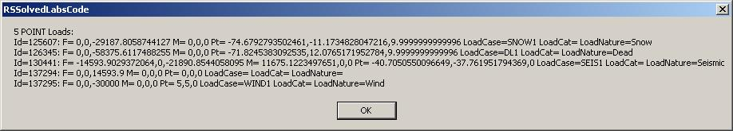
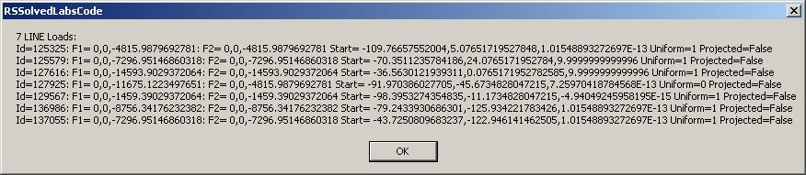
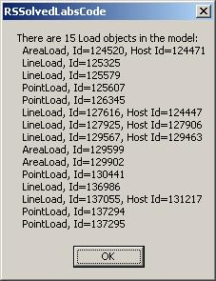
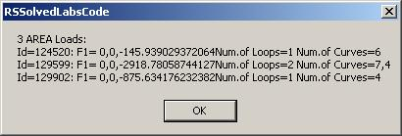
Load Objects Demo
Link Labs
Notes:
Todo: add image of model.
Open "C:\a\j\adn\rst\rst_api\RVT\RS Labs.rvt" to obtain a model with a few predefined loads.
Run the external command Lab 1-2 after adding RSSolvedLabsCode.dll to Revit.ini.

Slide 33
Load Object Parameters
Link Labs
  Lab 1-3
  Shows more details about loads, this time from selected objects
  How to access load parameters
  How to modify load objects
        Dim iter As ElementSetIterator = doc.Selection.Elements.ForwardIterator
        While iter.MoveNext
        Dim elem As Revit.Element = iter.Current
        If TypeOf elem Is PointLoad Then
        ListAndModifyPointLoad(CType(elem, PointLoad))
        ElseIf TypeOf elem Is LineLoad Then
        ListAndModifyLineLoad(CType(elem, LineLoad), app)
        ElseIf TypeOf elem Is AreaLoad Then
        ListAndModifyAreaLoad(CType(elem, AreaLoad), app)
        End If
        End While
Notes:
Lab 1-3 continues the exploration about loads.

Slide 34
Get Parameter by Display Name
Link Labs
Some parameters can be accessed via display name only
Using BuiltInParameter enum is language independent
        ' Helper to get specific parameter by name
        Shared Function GetElemParam( _
        ByVal elem As Revit.Element, _
        ByVal name As String ) As Parameter
        Dim parameters As Autodesk.Revit.ParameterSet = elem.Parameters
        Dim parameter As Autodesk.Revit.Parameter
        For Each parameter In parameters
        If (parameter.Definition.Name = name) Then
        Return parameter
        End If
        Next
        Return Nothing
        End Function
Notes:
Some element parameters can be accessed via display name only, so a utility function is provided for this. In general, we try to use the BuiltInParameter enum to access parameters whenever possible, since it is language independent.

Slide 35
Point Load Parameters
Link Labs
Equivalent
LOAD_IS_REACTION "Is Reaction"
LOAD_CASE_ID "Load Case"
Similar
LOAD_USE_LOCAL_COORDINATE_SYSTEM "Orient to"
Built-in only
LOAD_USE_LOCAL_COORDINATE_SYSTEM_HOSTED
LOAD_IS_CREATED_BY_API
Display name only
"Fz"
Notes:
Parameters vary from Revit version to version.

Slide 36
Other Load Parameters
Link Labs
See list of 59 load-relevant built-in parameters at end of Labs1.vb
LOAD_ALL_NON_0_LOADS
LOAD_AREA_AREA
LOAD_AREA_FORCE_FX1
LOAD_AREA_FORCE_FX2
LOAD_AREA_FORCE_FX3
LOAD_AREA_FORCE_FY1
LOAD_AREA_FORCE_FY2
LOAD_AREA_FORCE_FY3
LOAD_AREA_FORCE_FZ1
LOAD_AREA_FORCE_FZ2
LOAD_AREA_FORCE_FZ3
LOAD_ARROW_SEPARATION
LOAD_ATTR_AREA_FORCE_SCALE_FACTOR
LOAD_ATTR_FORCE_ARROW_TYPE
LOAD_ATTR_FORCE_SCALE_FACTOR
LOAD_ATTR_LINEAR_FORCE_SCALE_FACTOR
LOAD_ATTR_MOMENT_ARROW_ARC
LOAD_ATTR_MOMENT_ARROW_LINE
LOAD_ATTR_MOMENT_SCALE_FACTOR
LOAD_CASE_CATEGORY
LOAD_CASE_ID
LOAD_CASE_NAME
LOAD_CASE_NATURE
LOAD_CASE_NATURE_TEXT
LOAD_CASE_NUMBER
LOAD_COMBINATION_FACTOR
LOAD_COMBINATION_NAME
LOAD_COMBINATION_STATE
LOAD_COMBINATION_TYPE
LOAD_COMMENTS
LOAD_COMMENT_TEXT
LOAD_DESCRIPTION
LOAD_FORCE_FX
LOAD_FORCE_FY
LOAD_FORCE_FZ
LOAD_IS_CREATED_BY_API
LOAD_IS_PROJECTED
LOAD_IS_REACTION
LOAD_IS_UNIFORM
LOAD_LINEAR_FORCE_FX1
LOAD_LINEAR_FORCE_FX2
LOAD_LINEAR_FORCE_FY1
LOAD_LINEAR_FORCE_FY2
LOAD_LINEAR_FORCE_FZ1
LOAD_LINEAR_FORCE_FZ2
LOAD_LINEAR_LENGTH
LOAD_MOMENT_MX
LOAD_MOMENT_MX1
LOAD_MOMENT_MX2
LOAD_MOMENT_MY
LOAD_MOMENT_MY1
LOAD_MOMENT_MY2
LOAD_MOMENT_MZ
LOAD_MOMENT_MZ1
LOAD_MOMENT_MZ2
LOAD_NATURE_NAME
LOAD_USAGE_NAME
LOAD_USE_LOCAL_COORDINATE_SYSTEM
LOAD_USE_LOCAL_COORDINATE_SYSTEM_HOSTED
Notes:
Here is a full list of parameters relevant to loads given in the comment at the end of Labs1.vb.

Slide 37
Point Load Properties
Link Labs
LoadBase
  HostElement
  LoadCaseName
  LoadCategoryName
  LoadNatureName
PointLoad
  Force
  Moment
  Point
Explore
  Help file
  Reflection
  Debugger
  BuitInParamsChecker – DE105-1 The ABCs of Programming in Revit
  RvtMgdDbg – DE305-1 A Closer Look at the Database with the Revit API
Notes:
Some of the values accessible through parameters are also exposed directly as properties on the object class.
Whenever you are looking for a specific property, you will need to explore the Revit API and one or more suitable sample models to determine what exactly you are looking for and how to access it.

Slide 38
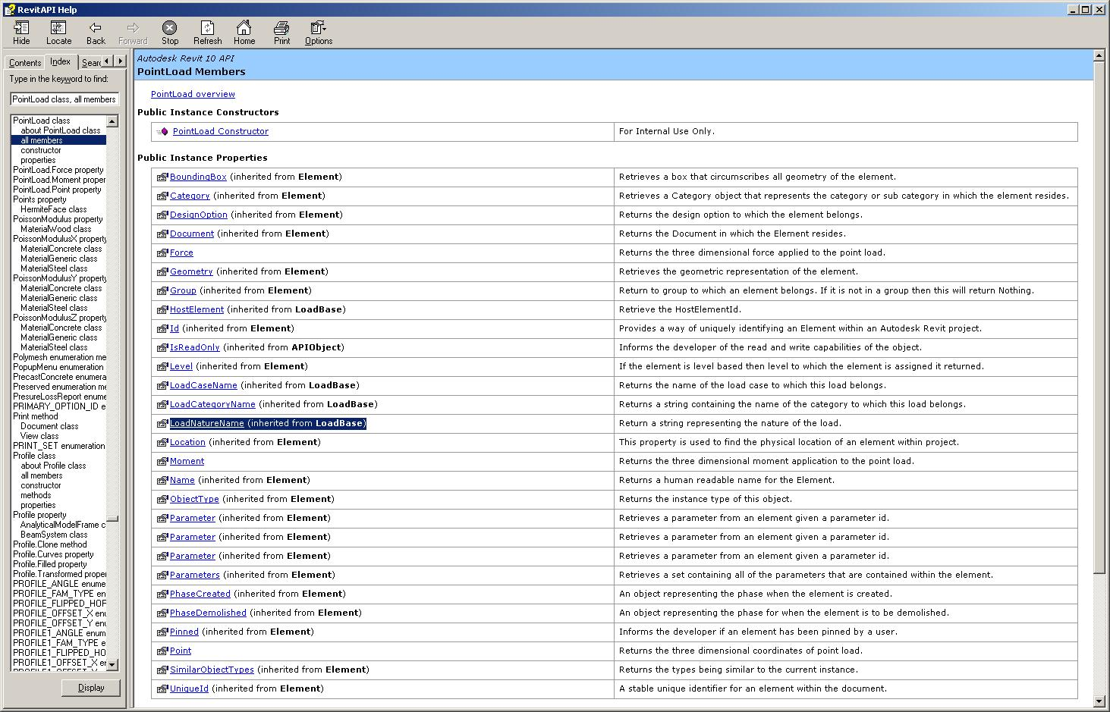
Point Load Properties
Link Labs
Notes:
Some of the values accessible through parameters are also exposed directly as properties on the object class.

Slide 39
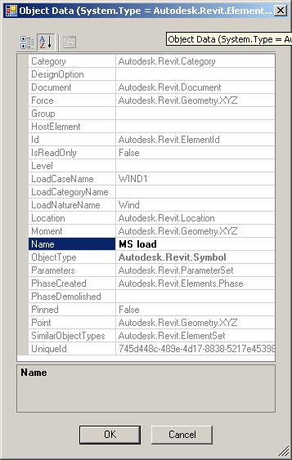
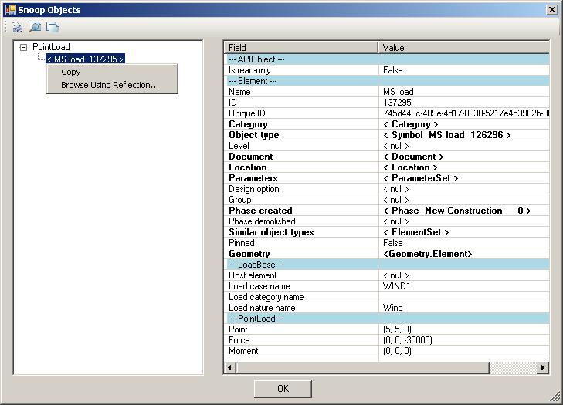
More Point Load Properties
Link Labs
RvtMgdDbg
  DE305-1 A Closer Look at the Database with the Revit API

Slide 40
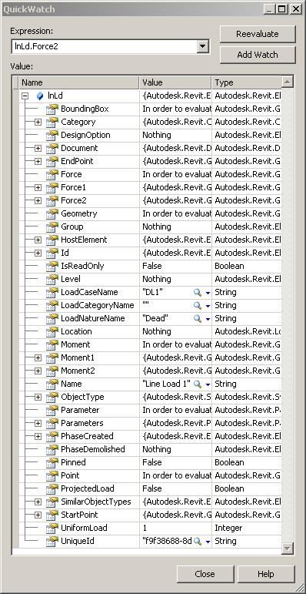
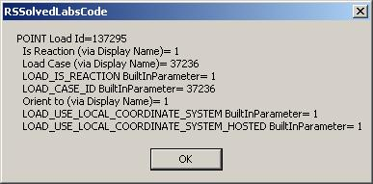
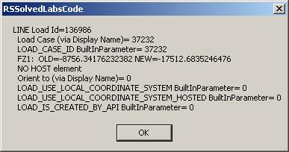
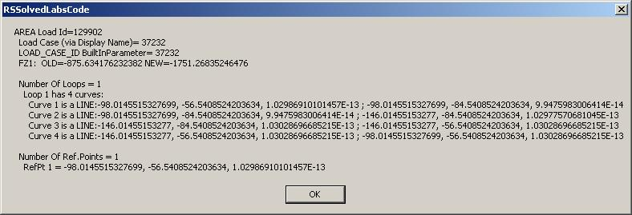
Modify Load Demo
Link Labs
        ' Scale Fz by factor 2
        Dim paramFz As Parameter
        paramFz = RBUtils.GetElemParam(ptLd, "Fz")
        Dim Fz_old As Double = paramFz.AsDouble
        paramFz.Set(2 * Fz_old)
Notes:
In "RS Labs.rvt", select a point, line and area load, then run the external command for Lab 1-3.
One new property in 2008 is the HostElement. Many other properties are also available. Here is an example of a line load element.

Slide 41
Load Symbols
Link Labs
  Lab 1-4
  Retrieve load symbols aka types available in the project
  Determine load symbol family
    One utility for all load symbols (point, line and area)
    Another one specifically for point loads
  Load symbols are system families, not standard ones

Slide 42
Retrieve Load Symbols
Link Labs
  Iterate over Elements
  Pick out Symbol instances
  Check for structural loads category
        Dim symbols As ElementSet = revitApp.Create.NewElementSet
        Dim catLoads As Category = doc.Settings.Categories.Item(BuiltInCategory.OST_Loads)
        Dim iter As IEnumerator = revitApp.ActiveDocument.Elements
        Do While (iter.MoveNext())
        Dim elem As Revit.Element = iter.Current
        If TypeOf elem Is Symbol Then
        Try
        Dim cat As Category = elem.Category
        'If cat.Name = "Structural Loads" Then
        If cat.Equals(catLoads) Then
        symbols.Insert(elem)
        End If
        Catch
        End Try
        End If
        Loop

Slide 43
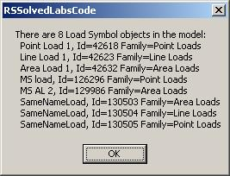
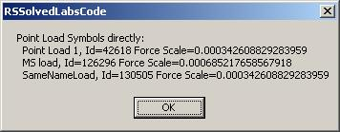
Determine Load Symbol Family
Link Labs
  No dedicated classes
  Examine family name parameter
  BuiltInParameter.SYMBOL_FAMILY_NAME_PARAM
  equals “Point Loads”, “Line Loads”, “Area Loads”

Slide 44
Creating Load Objects
Link Labs
  Lab 1-5
  Show how to create a new Load object, specifically PointLoad
    One as reaction, simulating analysis result
    One as standard external load
  Also show how to
    Set a selected symbol for this new load
    Assign the load to a selected load case
Notes:
Lab 1-5 shows how to create a new load object, specifically a point load. It creates two new point loads by calling NewPointLoad() with somewhat arbitrary parameters. One as reaction, simulating an analysis result, the other is a standard external load. It also shows how to set a selected symbol for this new load and assign the load to a selected load case. To assign a selected symbol to it, all point load symbols in the document are retrieved and the user is allowed to select one of them. Its id is then assigned to the newly created point load ELEM_TYPE_PARAM. Similarly, to assign a load case, all load cases are retrieved and displayed and the selected one's id is assigned to the LOAD_CASE_ID parameter.

Slide 45
Point Load Creation
Link Labs
Create
        Autodesk.Revit.Creation.Document.NewPointLoad(
        ByRef point As XYZ,
        ByRef force As XYZ,
        ByRef moment As XYZ,
        ByVal isReaction As Boolean) As PointLoad
Assign Symbol
  Iterate over all point load symbols
  Assign selected one’s id to parameter
        BuiltInParameter.ELEM_TYPE_PARAM
Assign Load Case
  Iterate over all load cases
  Assign selected one’s id to parameter
        BuiltInParameter.LOAD_CASE_ID

Slide 46
Columns and Framing
Link Labs
  Structural Elements
  Standard families
  Lab 2-1
  Retrieve all structural 'line segment' or 'stick' elements
    Columns belong to a separate standard family
    Others such as beam, brace, joist, etc. belong to the framing standard family
Notes:
The next section explores accessing and modifying structural elements and their data in RST.

Slide 47
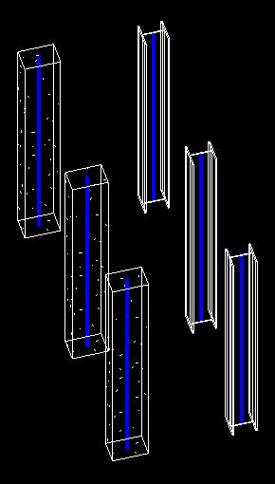
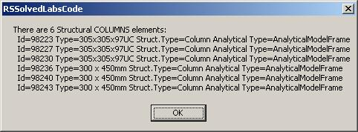
Select all columns
Link Labs
  Select all standard family instances for category OST_StructuralColumns
        Dim catStructuralColumns As Category = doc.Settings.Categories.Item(BuiltInCategory.OST_StructuralColumns)
        Dim columns As ElementSet = RBUtils.GetAllStandardFamilyInstancesForACategory(app, catStructuralColumns.Name)
        Dim sMsg As String = "There are " & columns.Size & " Structural COLUMNS elements:" & vbCrLf
        Dim col As FamilyInstance
        For Each col In columns
        sMsg += " Id=" & col.Id.Value.ToString & " Type=" & col.Symbol.Name & _
        " Struct.Type=" & col.StructuralType.ToString & _
        " Analytical Type=" & col.AnalyticalModel.GetType.Name & vbCrLf
        Next
        MsgBox(sMsg)
        . . .
        Dim elems As ElementSet = revitApp.Create.NewElementSet
        Dim iter As IEnumerator = revitApp.ActiveDocument.Elements
        Do While (iter.MoveNext())
        Dim elem As Revit.Element = iter.Current
        ' First check for the class, then for specific category name
        If TypeOf elem Is FamilyInstance Then
        Try
        If elem.Category.Name.Equals(catName) Then
        elems.Insert(elem)
        End If
        Catch
        End Try
        End If
        Loop
Notes:
To select all columns in the model, we once again iterate over the Revit document elements and select all standard family instances for category OST_StructuralColumns. We can display generic element and column properties such as element id, symbol name, structural type and analytical model type.

Slide 48


Select all framing elements
Link Labs
  Select all standard family instances for category OST_StructuralFraming
        Dim catStructuralFraming As Category = doc.Settings.Categories.Item(BuiltInCategory.OST_StructuralFraming)
        Dim frmEls As ElementSet = RBUtils.GetAllStandardFamilyInstancesForACategory(app, catStructuralFraming.Name)
        sMsg = "There are " & frmEls.Size & " Structural FRAMING elements:" & vbCrLf
        Dim frmEl As FamilyInstance
        For Each frmEl In frmEls
        sMsg += " Id=" & frmEl.Id.Value.ToString & " Type=" & frmEl.Symbol.Name & _
        " Struct.Usage=" & frmEl.StructuralUsage.ToString & _
        " Struct.Type=" & frmEl.StructuralType.ToString & _
        " Analytical Type=" & frmEl.AnalyticalModel.GetType.Name & vbCrLf
        Next
        MsgBox(sMsg)

Slide 49
Foundations
Link Labs
  Structural Elements
  Foundations standard family
  Lab 2-2
  Retrieve structural foundation elements
    May not be needed for analysis package
  Alternative approach retrieves all standard family instances having structural usage, i.e., having an analytical model
Notes:
Foundations are structural elements and also make use of a standard family. Lab 2-2 demonstrates how to retrieve all structural foundation elements. This may not be required for every analysis package. An alternative approach would be to retrieve all standard family instances having structural usage, i.e., having an analytical model.

Slide 50


Retrieve Foundations
Link Labs
  Get all standard structural foundation elements
  Category OST_StructuralFoundation
  Excludes 'Wall Foundation' System Type under
  'Structural Foundations' category in the Browser
    These belong to 'Continuous Footing' system family, Lab 2-3
  Excludes 'Foundation Slab' System Type under
  'Structural Foundations' category in the Browser
    These are internally implemented as Revit 'Floor' system family, Lab 2-3
Notes:
To retrieve all foundations in the model, we can use the same approach as above, getting all standard structural foundation elements, using the category OST_StructuralFoundation. This excludes the 'Wall Foundation' system type under 'Structural Foundations' category in the browser, because these belong to the 'Continuous Footing' system family, and also the 'Foundation Slab' system type under the 'Structural Foundations' category in the browser, which are internally implemented as Revit 'Floor' system family. These are examined in Lab 2-3.

Slide 51


Retrieve Structural Family Instances
Link Labs
  Alternative approach
  Select all FamilyInstance objects having an analytical model
        sMsg = "ALL Structural FAMILY INSTANCES (generic check):" & vbCrLf
        Dim iter As IEnumerator = doc.Elements
        Dim categoryName As String
        Dim i As Integer = 0
        Do While (iter.MoveNext())
        Dim elem As Revit.Element = iter.Current
        If TypeOf elem Is FamilyInstance Then
        Dim fi As FamilyInstance = elem
        Dim anaMod As AnalyticalModel = fi.AnalyticalModel
        If Not anaMod Is Nothing Then
        i += 1
        categoryName = "?"
        Try
        categoryName = fi.Category.Name
        Catch
        End Try
        sMsg += i & ": Category=" & categoryName & _
        " Struct.Type=" & fi.StructuralType.ToString & _
        " Id= " & fi.Id.Value.ToString & vbCrLf
        End If
        End If
        Loop
Notes:
As an alternative approach, we can also iterate over the document elements and select all FamilyInstance objects having an analytical model.

Slide 52
Walls, Floors, Footings
Link Labs
  Structural Elements
  System families
  Wall, Floor (Slab), Continuous Footing
  Lab 2-3
  Retrieve all structural elements from each of these system families
  Not all instances will have analytical model (user-definable!)
Notes:
The structural elements walls, floors, and footings also all make use of system families, specifically Wall, Floor (Slab), and Continuous Footing, respectively. Lab 2-3 shows how to retrieve all structural elements from each of these system families. Please note that some instances may not have an analytical model, since this property is user definable.

Slide 53
Analytical Model
Link Labs
  Abstract API base class
    AnalyticalModel
  Specific derived classes
    Wall AnalyticalModelWall
    Floor AnalyticalModelFloor
    Cont.Footing AnalyticalModel3D
    Column, Framing AnalyticalModelFrame
    Foundation AnalyticalModelLocation
Notes:
The analytical model makes use of a separate little class hierarchy derived from the abstract base class AnalyticalModel. It defines specialised derived classes for various structural elements.

Slide 54


Retrieve Analytical Walls
Link Labs
  Retrieve all Wall elements having an analytical model
        Dim elems As ElementSet = revitApp.Create.NewElementSet
        Dim iter As IEnumerator = revitApp.ActiveDocument.Elements
        Do While (iter.MoveNext())
        Dim elem As Revit.Element = iter.Current
        If TypeOf elem Is Wall Then
        Dim w As Wall = elem
        Dim anaMod As AnalyticalModel
        Try
        anaMod = w.AnalyticalModel
        If Not anaMod Is Nothing Then
        elems.Insert(elem)
        End If
        Catch
        End Try
        End If
        Loop
  Same for ContFooting elements
Notes:
To retrieve all Wall elements having an analytical model, we perform the normal Revit document elements iteration, pick out wall elements, and check for the presence of an analytical model using the Wall.AnalyticalModel property. The same approach can be used for ContFooting elements.

Slide 55

Retrieve Analytical Floors
Link Labs
  Retrieve all Floor elements having a non-empty analytical model
        Dim elems As ElementSet = revitApp.Create.NewElementSet
        Dim iter As IEnumerator = revitApp.ActiveDocument.Elements
        Do While (iter.MoveNext())
        Dim elem As Revit.Element = iter.Current
        If TypeOf elem Is Floor Then
        Dim f As Floor = elem
        Dim anaMod As AnalyticalModel
        Try
        anaMod = f.AnalyticalModel
        If Not anaMod Is Nothing Then
        ' For non-structural floors
        ' anaMod is NOT Nothing, but it IS empty!
        Dim floorAnaMod As AnalyticalModelFloor = anaMod
        If floorAnaMod.Curves.Size > 0 Then
        elems.Insert(elem)
        End If
        End If
        Catch
        End Try
        End If
        Loop
Notes:
A similar approach as for walls can also be used for floor elements. However, in the case of floors, the analytical model may well be non-null, but still be empty, so we need to add an additional check that the number of curves in it, given by AnalyticalModelFloor.Curves.Size, is actually greater than zero.

Slide 56
Analytical Model
Link Labs
  Investigate geometry contained in model
  Lab 3
  Retrieve detailed analytical model geometry for selected elements, depending on the family and/or category
Notes:
Lab 3 implements some code to investigate the geometry contained in the analytical model. It retrieves detailed analytical model geometry for selected elements, depending on their family and/or category.

Slide 57

Retrieve Analytical Model
Link Labs
Iterate over selected elements
  Wall
  Floor
  ContFooting
  FamilyInstance with category
    OST_StructuralColumns
    OST_StructuralFraming
    OST_StructuralFoundation
Get AnalyticalModel and list
  Curves
  Support data – cf. AnalyticalSupportData_Info SDK sample

Slide 58




Retrieve Analytical Model
Link Labs

Slide 59
Structural Analysis Link

Slide 60

Structural Analysis Link
RSLink
Introduction
Export
Import
Practical Examples
Notes:
Now we have assembled all the tools we might need, let us put them together into an actual Revit Structure Analysis link application. First we discuss some general questions regarding applications linking Revit with external programs, followed by some practical examples.

Slide 61
Analysis Link Introduction
RSLink
There are MANY ways in which the link can be designed
There are MANY implementation scenarios concerning
  Which structural elements are passed between the applications
  Which kind of model changes are automatically supported in either of them
It is up to the particular 3rd party package and its implementer to design, code and document the link
  Revit Structure API provides the tools to do this
  RST does not pre-determine the design of the link application
Notes:
There are many different implementation scenarios in which it might be useful to link a Revit building model with some external data, both RST-specific for analysis as we are discussing here, and also generic for other situations. Obviously, there are also many ways in which such a link can be designed.
For the RST analysis link, we need to decide which structural elements are passed between the applications and what kind of model changes are automatically supported in either of them.
It is obviously up to the individual third party package and its implementer to design, code and document the link. The Revit Structure API provides the required tools to do this, and does not pre-determine the design of the link application in any way.

Slide 62
Analysis Link Export
RSLink
Data export from Revit to 3rd party A&D application
Use a custom Revit external command to export relevant data
  App's native file/DB format — typically proprietary
  App's neutral file/DB format — typically public
  Public neutral file/DB format supported by the app
  Intermediate file/DB format purpose-designed for the link
  ...
The choice depends on the combination of technical, functional, commercial and political requirements...
Notes:
For data export from Revit to a third party A&D application, one will generally use a custom Revit external command to export relevant data. The format used for this communication is once again completely up to the implementer, and could be any one of the following.

Slide 63
Analysis Link Import
RSLink
Define another custom Revit external command
The choice of options and reasoning is basically the same as for the export
The chosen file format need not be the same as for the export, though typically it would be
Notes:
For importing the updated and modified data from the external application back into Revit, one would generally define another custom Revit external command. The choice of options and reasoning is basically the same as for the export. The chosen file format does not need to be the same as for the export, though typically it would be.

Slide 64
Practical Examples
RSLink
RSLink
  Simple demonstration application
MidasLink
  Simple but real
FireRating
  Minimal generic Revit
RDBLink
  Generic Revit BIM, not RST specific
Commercial Software

Slide 65
Practical Example
RSLink
AutoCAD 2009 simulates A&D 3rd party app
  AutoCAD.NET API utilities used on the 'other' side
  Xdata used to store Revit Structure specific info on standard AutoCAD entities
  AutoCAD Dynamic Properties COM API used for the link-specific UI within AutoCAD
Intermediate, purpose designed XML
  Used in both directions
  For simplicity, based on .NET SOAP serialization
  Custom .NET neutral classes utilized by both sides' export/import commands
Notes:
We have implemented a custom designed practical example of a Revit Structure analysis link application called RSLink to accompany this presentation. We use AutoCAD 2008 with an AutoCAD.NET plug-in to simulate the external third party analysis and design application and extended entity data, also known as xdata, to store Revit Structure specific information on standard AutoCAD entities. We use the AutoCAD Dynamic Properties COM API and the Object Property Manager OPM for the link-specific user interface within AutoCAD.
AutoCAD.NET API utilities used on the 'other' side
Xdata used to store Revit Structure specific info on standard AutoCAD entities
AutoCAD Dynamic Properties COM API used for the link-specific UI within AutoCAD
The data exchange in both directions between the Revit model and the A&D simulation in AutoCAD is implemented using an intermediate, custom designed XML format. For simplicity, the XML format is based on .NET SOAP serialization. Some neutral custom .NET classes are utilised by both sides' export and import commands.
Used in both directions
For simplicity, based on .NET SOAP serialization
Custom .NET neutral classes utilized by both sides' export/import commands
Before running the demo, the following applications need to be present:
RSLink - helper dll shared by both acad and revit client
RSLinkRevitClient - command implementations
RSLinkRevitApp - external application
RSLinkAcadClient - AutoCAD client
RSLinkAcadClientDynProps - dynamic Revit properties for AutoCAD objects
Here are possible steps to run the demo:
Set up Revit.ini to load either the client or the external application or both.
Open or create a sample model in Revit Structure.
Run the export command. You are prompted for a file location. A dialogue box pops up, reporting the number of exported elements.
Start up AutoCAD and load the client and the dynamic property application.
This can be achieved automatically by setting up AutoCAD to start in the RVT sample directory and placing an acad.lsp file there containing:
(defun s::startup()
(command "_netload" "RSLinkAcadClient.dll")
(princ "\nAutoCAD RSLink client loaded.")
(arxload "RSLinkAcadClientDynProps.arx")
(princ "\nAutoCAD RSLink dynamic properties loaded.")
(princ)
)
If it does not load automatically, you can load it manually by calling
(load "C:/a/j/adn/revit/rst_api/RVT/acad.lsp")
with the appropriate full path, and then call
(s::startup).
The commands defined by the AutoCAD client are RSImport, RSExport and RSMakeMember.
Use RSImport to load the xml file just exported from Revit.
Modify some cross sections in the model using the OPM, simulating modifications made by the A&D application, and optionally RSMakeMember to add some new elements.
Use RSExport to write the model back out again.
Back in Revit, use the import command to read the modifications and update the Revit model accordingly. Dialogue boxes are displayed to report the number of elements imported and modified. Note that the column types were swapped. Currently, the new elements defined by RsMakeMember are ignored.

Slide 66


RSLink Modules
RSLink
RSLink
  Helper dll shared by both acad and revit client
RSLinkRevitClient
  Revit command implementations
  RSLinkImport, RSLinkExport
RSLinkRevitApp
  Revit external application
RSLinkAcadClient
  AutoCAD.NET client
  RSImport, RSExport, RSMakeMember
RSLinkAcadClientDynProps
  Dynamic Revit properties for AutoCAD objects

Slide 67


RSLink Revit Export
RSLink

Slide 68

RSLink AutoCAD Import
RSLink
Invoke RSImport command

Slide 69

Modify Cross Section
RSLink
Edit dynamic properties
Change cross section

Slide 70

Add new Members and Data
RSLink
Invoke RSMakeMember command

Slide 71



Import Modified Data into RST
RSLink
RSExport from AutoCAD
Import into Revit
  Column type was swapped
  New elements are ignored

Slide 72
Another Practical Example
MidasLink
Source code available on ADN
Search for "MidasLink"
  http://adn.autodesk.com/adn/servlet/item?siteID=4814862&id=9628885&linkID=4901650
Includes
  Analysis package executable
  Documentation
  Source code
  Installer
Notes:
MidasLink is a Revit Structure add-in program that exports and imports the Revit model to and from the MIDAS/Gen structure analysis application. The source code is provided to help developers integrating analysis programs with Revit Structure. The compiled add-in is available to Revit Structure subscription customers.

Slide 73
Analysis Software
RSLink
ROBOT
  www.revit.robobat.com/n/revit
ADAPT
  www.adaptsoft.com/releases.php
RISA
  www.risatech.com/partner/revit_structure.asp
RAM
  www.bentley.com/structural
CSC
MIDAS (Midas Link subscription module)
Analysis Partners site:
http://usa.autodesk.com/adsk/servlet/item?id=8447050&siteID=123112
Notes:
Here is an overview of some other available analysis link packages. An up-to-date list is available on the analysis partners site.

Slide 74
Revit Structure Product and SDK
RSLink
SP2 version available for download from product site
      http://usa.autodesk.com/adsk/servlet/item?siteID=123112&id=9281007
Including updated SDK
  <Revit install folder>\Download\Utilities\Common
  \Software Development Kit\Revit 2008 SDK.zip
  Two new samples: RoomSchedule and RDBLink
Notes:
A small heads-up for developers who may have missed it: The Revit 2008 SP2 version is currently available for download. This version also includes a slightly updated SDK. Among other things, two new samples have been added, RoomSchedule and RDBLink. These are discussed in the Revit SDK Smörgåsbord presentation.

Slide 75
Revit Structure Analysis Linking
RSLink
Overview
  Workflow
  Compare Architecture and Structure
  Physical versus analytical model
Requirements, Samples and Labs
  Explore and implement base functionality
Link
  Sample application
  Linking Revit with external analysis package
  Simulated using AutoCAD

Slide 76
Learning More
Online Help and SDK Samples
DevTV Introduction to Revit Programming
  http://adn.autodesk.com/adn/servlet/item?siteID=4814862&id=10194238&linkID=4901650
Discussion Groups
  http://discussion.autodesk.com
  Revit API
API Training Classes
  www.autodesk.com/apitraining
  Leave your business card for free attendance, worth up to USD 1500
Autodesk Developer Network
  www.autodesk.com/joinadn
DevHelp Online for ADN members
  adn.autodesk.com/
Notes:
We are offering free API training to attendees of our DevTech AU seminars. If they leave their business cards during the seminar, then they can attend one of our scheduled 2008 API training classes free of charge. Normal costs for these classes are up to 1500 USD per person. The schedule is posted on www.autodesk.com/apitraining. Feel free to add a slide to your presentations to advertise this. You can give the business cards you collect to Stephen Preston or any of our San Rafael based DevTech team (who can hand them to him).

Slide 77
Thank you very much!
Thank you for your interest and attention!
Please complete the session survey
Course id is DE201-1

Slide 78

End of Presentation
A.You

