Slide 1
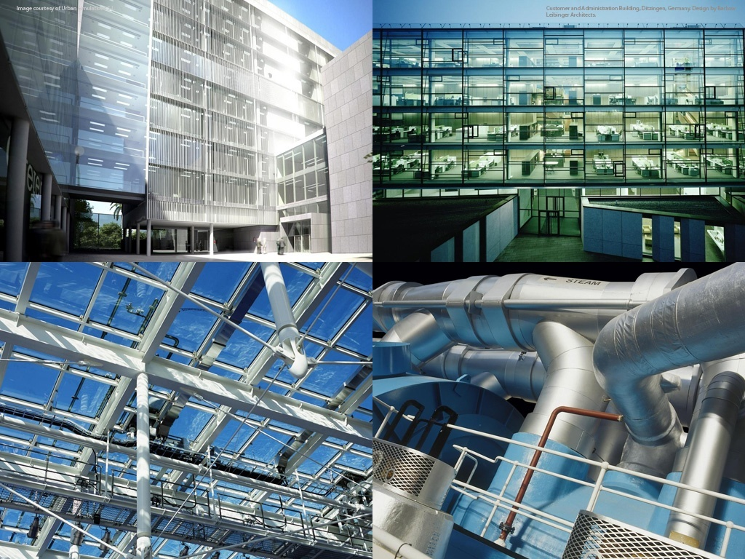
Autodesk Revit ® 2011
Family API Hands on Training
Trainer’s name
Developer Consultant
Developer Technical Services
Notes:
AEC Title

Slide 2
Family API Labs Exercises
Incremental exercises to create a column family:
Lab1 – create a column family with rectangular profile
Lab2 – create a column family with L-shaped profile
Lab3 – add formula and assign materials
Lab4 – add visibility control

Slide 3
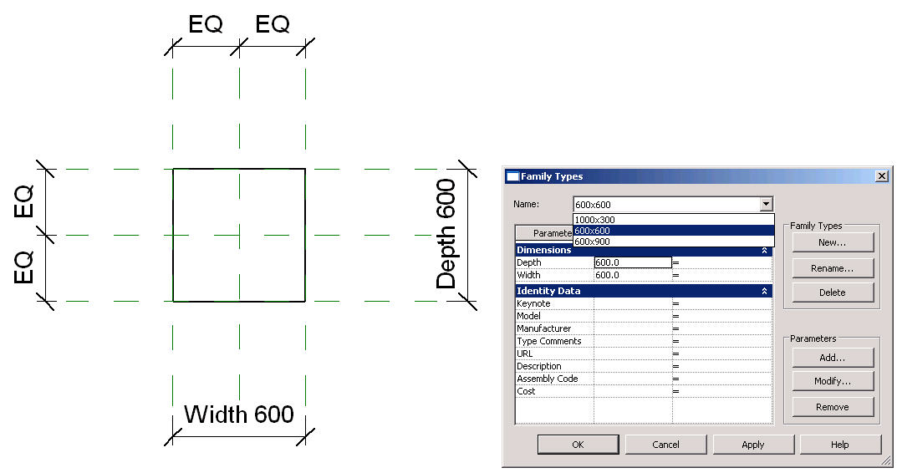
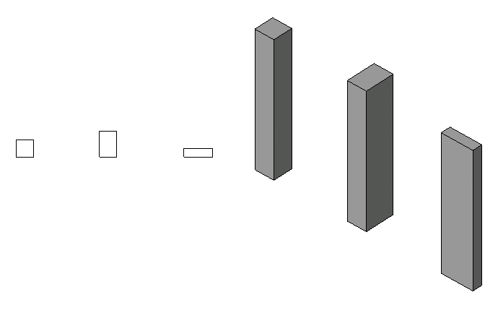
Lab1 – Create a Rectangular Column
Objective: learn THE basics of family API.
  check the family context
  create a simple solid using extrusion
  set alignments
  add types
Classes and methods:
  rvtDoc.IsFamilyDocument()
  rvtDoc.OwnerFamily.FamilyCategory.Name
  rvtDoc.FamilyCreate.NewExtrusion()
  rvtDoc.FamilyCreate.NewAlignment()
  familyMgr = rvtDoc.FamilyManager
  familyMgr.NewType()
  familyMgr.Parameter(); familyMgr.Set()

Slide 4
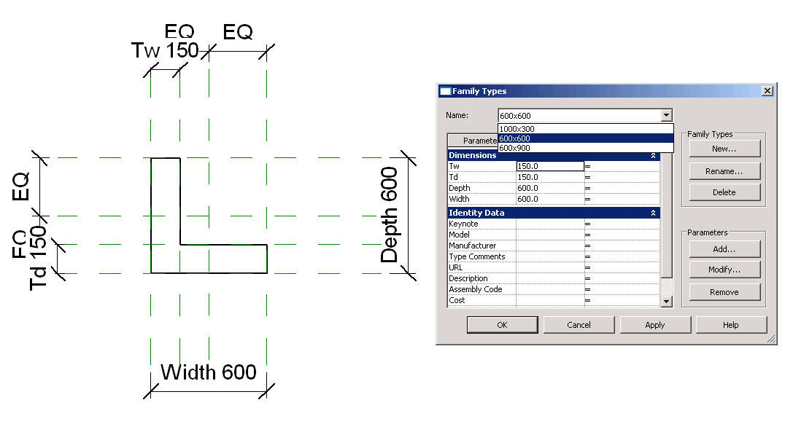
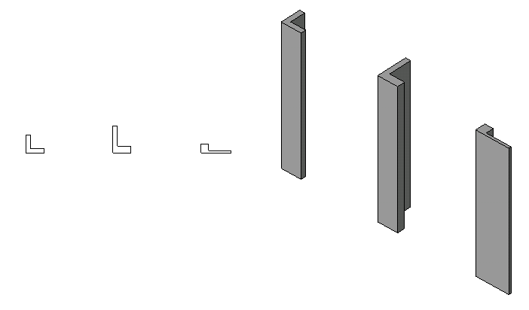
Lab2 – Create a L-Shape Column
Objective: learn the basics of family API.
  add reference planes
  add parameters
  add dimentiones
Classes and methods:
  rvtDoc.FamilyCreate.NewReferencePlane()
  familyMgr.AddParameter()
  rvtDoc.FamilyCreate.NewDimension()

Slide 5
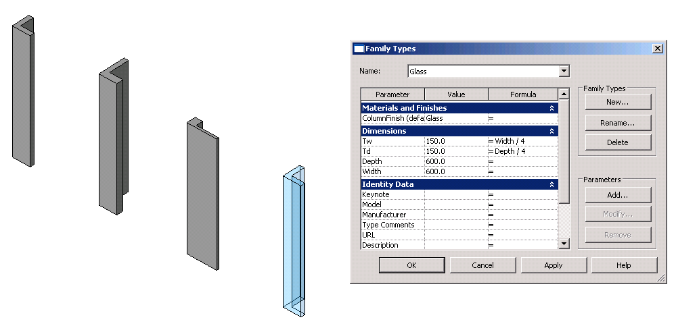
Lab3 – Add Formulas and Materials
Objective: learn the basics of family API.
  add formulas
  add materials
Classes and methods:
  familyMgr.SetFormula()
  pSolid.Parameter(“Material”)
  familyMgr.AddParameter(“MyColumnFinish”, BuiltInParameterGroup.PG_MATERIALS, ParameterType.Material, True)
  familyMgr.AssociateElementParameterToFamilyParameter()

Slide 6
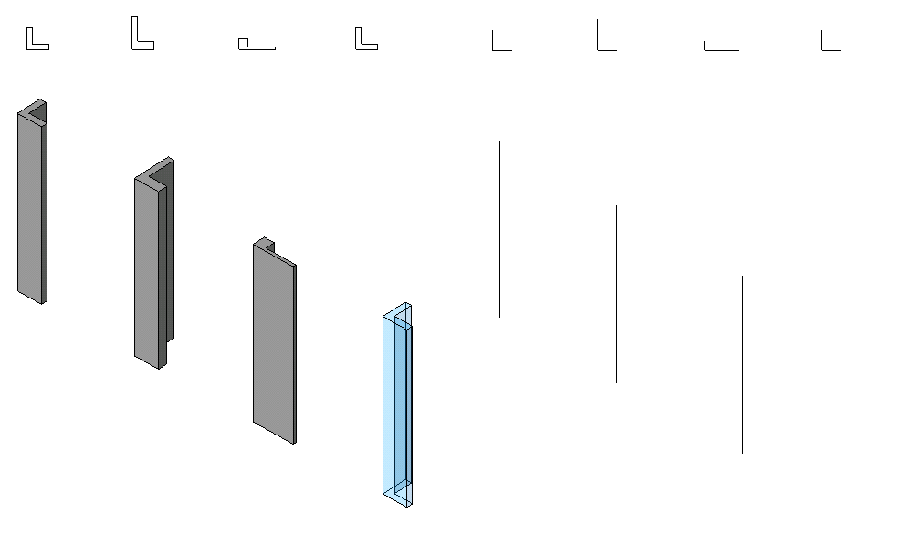
Lab4 – Add Visibility Control
Objective:
  add line representation
  add visibility control
Classes and methods:
  rvtDoc.FamilyCreate.NewSymbolicCurve()
  rvtDoc.FamilyCreate.NewModelCurve()
  FamilyElementVisibility(FamilyElementVisibilityType.ViewSpecific/Model)
  FamilyElementVisibility.IsShownInFine, etc.
  pLine.SetVisibility(pFamilyElementVisibility)

Slide 7
