Slide 1
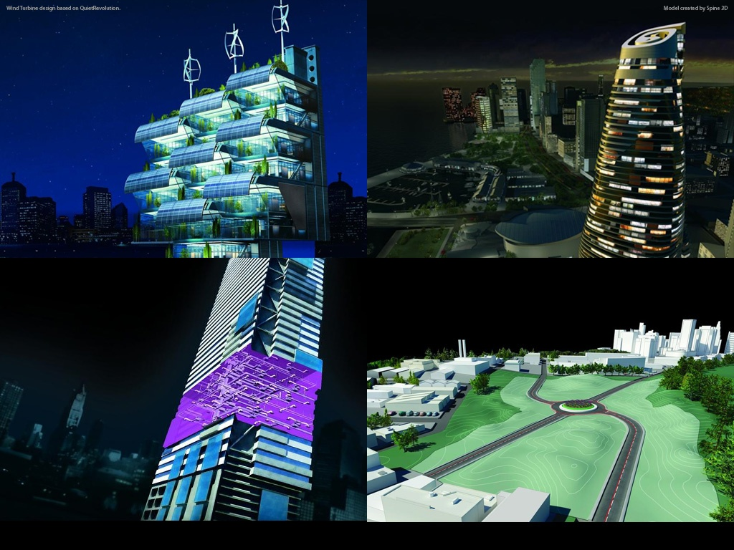
Introduction to Revit 2011 API
Hands-on Training Class – July 2010
Jeremy Tammik
Developer Consulting
Developer Technical Services
Notes:
AEC Title

Slide 2
Before we start …
Background and Experience?
  Name, Company?
  Background (IT/programming/structure engineering)?
  Revit Architecture/Structure/MEP?
  Revit API?
  VB.NET? C#?
  AutoCAD, AutoCAD Architecture, etc. API’s?
  ADN member?
  …

Slide 3
Agenda
Day 1: Overview and Revit database basics
    External command, external application, RevitLookup and RvtSamples setup, understanding the Revit element class, filtered element collector, object creation and modification
Day 2
  FindMaterialTypeElements2
    Developing something together following requests from the group
  Revit UI basics: ribbon, dialog, selection
  Event and dynamic modeling
  Family API
  Quick overview of other/advanced topics through samples
    Custom data in shared parameters: FireRating
    DocumentChanged event: ChangesMonitor
    Dynamic Model Update (DMU): DynamicModelUpdate and DistanceToSurfaces
    Analysis Visualisation Framework (AVF): DistanceToSurfaces and SpatialFieldGradient
  Q&A
Notes:
We are running in low resolution today, so that we can switch back and forth between the presentation and live demos.
So, what are the initial steps in creating a Revit application?
The first thing is to understand is what is installed, the API architecture, the information provided and where to obtain more information.
Then we explore how to set up the development environment and create a first "Hello world" type application.
After that, we will look into the Revit database structure and its data and elements.
The samples provide a valuable knowledgebase on how to solve Revit programming tasks.
For the people who attended the recent webcast on the Revit Structure API on May 3rd, the current presentation covers the first half of that, all the generic material.

Slide 4
Revit API Intro Labs
Revit API fundamentals
  Revit Add-ins: external command/application, attributes, add-in manifest and object model
  Representation of Revit elements
  Element iteration, filtering and queries
  Element modification
  Model creation
Exercises:
  Lab1 – “Hello World”
  Lab2 – DB element
  Lab3 – element filtering
  Lab4 – element modification
  Lab5 – model creation

Slide 5
Questions & Answers

Slide 6
