Slide 1
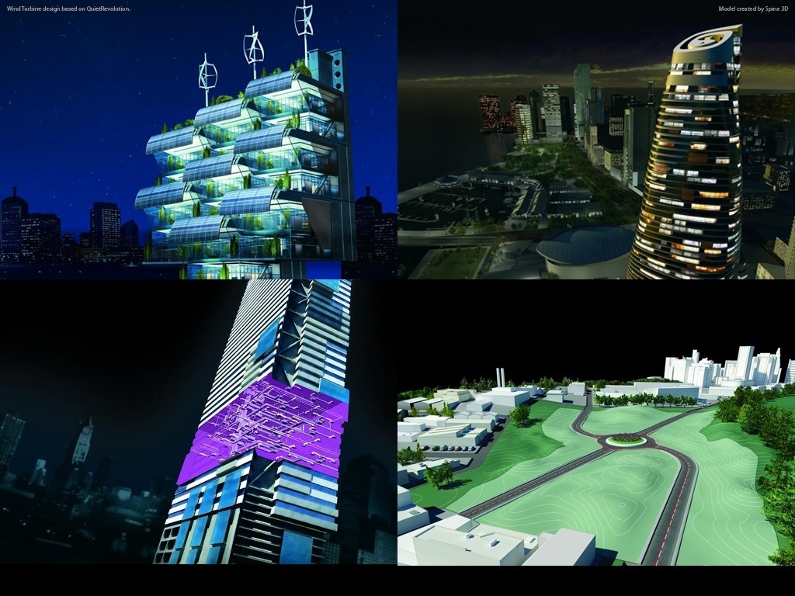
Introduction to Revit Programming
Hands-on Training Class
Jeremy Tammik
Developer Technical Services
Notes:
AEC Title

Slide 2
About this material
The material provided here is from our two day classroom training. You can also use it for self-learning.
It provides an introduction to the fundamentals of the Revit API and helps you get started. It is not meant to provide a complete coverage of the Revit API nor the .NET framework.
The material is provided in both C# and VB.NET. Lab exercises are provided for both languages. The PowerPoint presentation is mixed.
Disclaimer: We are aware that this material is not error free and are happy to correct it as we go along. We hope this will still be useful for you to get started with Revit API programming.
Good luck!
AEC workgroup
Developer Technical Services
Autodesk Developer Network
March 2013

Slide 3
Agenda
Day 1: Overview and Revit database basics
  External command, external application, RevitLookup and RvtSamples, understanding the Revit Element class, filtered element collector, object creation and modification
Day 2
  Revit UI basics: ribbon, dialog, selection, events
  Family API
  Advanced topics
    Extensible storage
    Custom data in shared parameters: FireRating
    DocumentChanged event: ChangesMonitor
    Dynamic Model Update (DMU): DynamicModelUpdate and DistanceToSurfaces
    Analysis Visualisation Framework (AVF): DistanceToSurfaces and SpatialFieldGradient
Notes:
We are running in low resolution today, so that we can switch back and forth between the presentation and live demos.
So, what are the initial steps in creating a Revit application?
The first thing is to understand is what is installed, the API architecture, the information provided and where to obtain more information.
Then we explore how to set up the development environment and create a first "Hello world" type application.
After that, we will look into the Revit database structure and its data and elements.
The samples provide a valuable knowledgebase on how to solve Revit programming tasks.

Slide 4
Revit API Intro Labs
Revit API fundamentals
  Revit add-ins: external command and application, attributes, add-in manifest and object model
  Representation of Revit elements
  Element filtering and queries
  Element modification
  Model creation
  Application own data
Exercises
  Lab1 – “Hello World”
  Lab2 – DB Element
  Lab3 – Element Filtering
  Lab4 – Element Modification
  Lab5 – Model Creation
  Lab6 – Extensible Storage
  Lab7 – Shared Parameter

Slide 5
Autodesk is a registered trademark of Autodesk, Inc., and/or its subsidiaries and/or affiliates in the USA and/or other countries. All other brand names, product names, or trademarks belong to their respective holders. Autodesk reserves the right to alter product and services offerings, and specifications and pricing at any time without notice, and is not responsible for typographical or graphical errors that may appear in this document.

