Slide 1

Introduction to Revit Programming
Database Fundamentals
Jeremy Tammik
Developer Technical Services

Slide 2
Agenda
Introduction
  Products, SDK, documentation and samples
Getting Started and Hello World
  Development environment, Revit add-ins, external command and application,
  add-in manifest, RvtSamples and RevitLookup, Visual Studio wizards
Database Fundamentals
  Understanding the representation of Revit elements
  Element iteration, filtering and queries
  Element modification
  Model creation

Slide 3
Overview
Revit Product, SDK and API assembly DLLs

Slide 4
Revit Products
Three flavours of Revit product and API plus Onebox
  Revit Architecture
  Revit MEP (mechanical, electrical, plumbing, aka. HVAC)
  Revit Structure
  Onebox
Product build and distribution
  DVD version posted to ADN member web site (members only)
    Software & Support > Revit > Downloads
    Posted once only at initial product release time
  Web version and Web Update version on Autodesk home page (public)
    Products > Revit > Buy or Store > USA & Canada ($ USD)> All Products > Revit Architecture/Structure/MEP
    Latest download version from the public product site
    Revit uses service pack technology, so no need for full installation on update

Slide 5
Revit API Assemblies
Revit API assembly DLLs are present in every Revit installation
  RevitAPI.dll
  RevitAPIUI.dll
Separate DB and UI modules for database and user interface
Revit Architecture, Structure and MEP flavours
    Same API DLLs
    Almost all functionality is identical
    Minor discipline-specific functionality is only active in Architecture, MEP or Structure
Notes:
The Revit SDK is basically purely for support and documentation purposes. All you actually need to develop a Revit add-in is the development environment and the RevitAPI.dll and RevitAPIUI.dll, nothing else. The SDK install is located under the 'Install Tools and Utilities' menu on the main page of the Revit installer. (Note: there is another menu called “Utilities” you see right after the product installation, which contains only the link to Content Batch utilities. Click on “Back to First Page” button to move back to the main page of the installer to install SDK.) Alternatively, you can also find the SDK in the extraction folder (to which you extracted the installer), under:
<extraction folder>\support\SDK\RevitSDK.exe
If you have accepted the default location, which typically looks like:
C:\Program Files\Autodesk\Revit 2014 support\SDK\RevitSDK.exe
The SDK was recently modified, so please download the latest update from the developer center. We are already updating the developer guide.

Slide 6
Revit Add-In Compilation and API References
  .NET API
  .NET Framework 4.0
  Microsoft Visual Studio 2010
  C# or VB.NET, managed C++, any .NET compliant language
  Class library
  References
    <revit install folder>\Program\RevitAPI.dll
    <revit install folder>\Program\RevitAPIUI.dll
    Remember to set 'Copy Local' to False
Notes:
For examples of flavour specific API functionality, room-related functionality is available in RAC only, the analytical model only in RST, systems only in RME.

Slide 7
Revit SDK
The SDK is provided with the product
  From installer under “Install Tools and Utilities”
  Web and download version
    <extraction folder>\Utilities\SDK\RevitSDK.exe
Latest SDK update is posted to Revit Developer Center
  http://www.autodesk.com/developrevit
Notes:
The Revit SDK is basically purely for support and documentation purposes. All you actually need to develop a Revit add-in is the development environment and the RevitAPI.dll, nothing else. The SDK install is located under the 'Install Tools and Utilities' menu on the main page of the Revit installer. (Note: there is another menu called “Utilities” you see right after the product installation, which contains only the link Content Batch utilities. Click on “Back to First Page” button to move back to the main page of the installer to install SDK.) Alternatively, you can also find the SDK in the extraction folder, under:
<extraction folder>\Utilities\SDK\RevitSDK.exe
If you have accepted the default location, which typically looks like:
C:\Program Files\Autodesk\Revit XXX 2014\Utilities\SDK\RevitSDK.exe
The SDK was recently modified, so please download the latest update from the developer center. We are already updating the developer guide.

Slide 8
SDK is only Documentation
Read once
    Read Me First.doc
    Getting Started with the Revit API.docx
    Revit Platform API Changes and Additions.docx
Familiarise yourself with and use regularly
    Revit API Developer’s Guide http://wikihelp.autodesk.com/Revit/enu/2014/Help/3665-Developers
    RevitAPI.chm
      What's New section is similar to Changes and Additions doc
Read and use if needed
    RevitAddInUtility.chm – installer
    Autodesk Icon Guidelines.pdf – user interface
    Macro Samples – Revit Macros
    Revit Server SDK – file access on server
    Revit Structure – section definitions and material properties
    REX SDK – Revit extensions framework
    Structural Analysis SDK – Analysis and code checking
Important utilities
    Add-In Manager
    RevitLookup
Samples
Notes:
Here are the top level contents of the SDK. The contents of the Getting Started document have changed from previous versions, because the RevitAPI.chm help file now includes a What's New section. This used to be in the Getting Started document. This information is duplicated in the Changes and Additions document. The Developer Guide is very comprehensive. The Class Diagram provides an object model, actually the class hierarchy. The Revit SDK samples provide a huge knowledgebase on how to address specific programming tasks using the Revit API. The API documentation in the help file lists all the classes and their methods and properties, and the developer guide and samples explain and demonstrate how they work together to solve specific tasks.

Slide 9
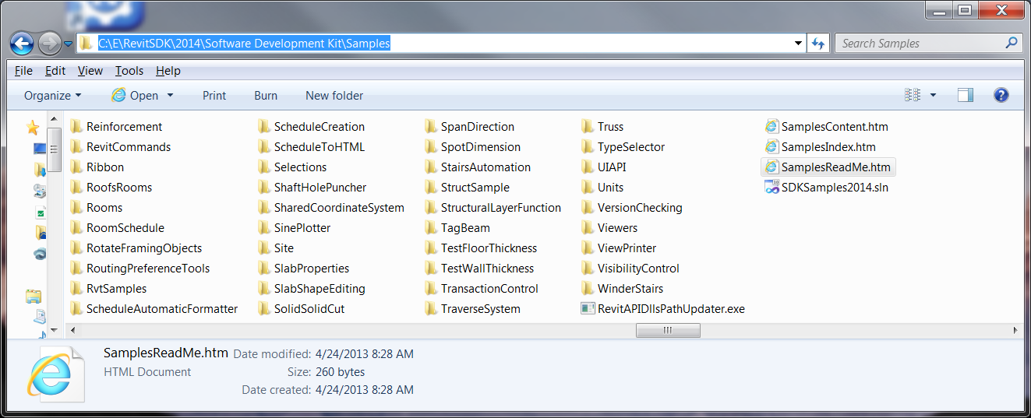
SDK Samples
Documentation
  SamplesReadMe.htm
Utility
  RevitAPIDllsPathUpdater.exe
Main samples solution
  SDKSamples2014.sln
And the samples themselves!
Notes:
The Revit SDK samples provide a huge knowledge base on how to address specific programming tasks using the Revit API. The API documentation in the help file lists all the classes and their methods and properties, and the developer guide and samples explain and demonstrate how they work together to solve specific tasks.

Slide 10
Tools
Revit Lookup, Add-In Manager, SDKSamples2014.sln, and RvtSamples
Notes:
That concludes the introduction. Now let us start looking at real development issues and take our first steps up to a simple “Hello World” example. The accompanying labs demonstrate the concepts discussed. They can also be used for self-learning, and as a reference to answer the most common Revit API beginner’s questions.

Slide 11
Tools
Must Know
RevitLookup – allows you to “snoop” into the Revit database structure. “Must have” for every Revit API programmer.
Add-In Manager – allows you to load unload your DLL while running Revit, and to run a command without an explicit .addin.
SDKSamples.sln – allows you to build all the sample projects at once. RevitAPIDllsPathUpdater.exe is provided to update the location of references in each MSVS project in case your installation of Revit is different from the default location or if you are using different verticals.
RvtSamples – application that creates a ribbon panel for all sample external commands for easy immediate testing
Visual Studio Revit add-in wizards – complete automatic generation of external application and command skeleton and add-in manifest for single click compile, install, run, debug

Slide 12
Extending Revit
1. External command
  Implement IExternalCommand; install an add-in manifest
  Commands are added to the External Tools pull-down in the ribbon Add-Ins tab
  Tools > External Tools
2. External application
  Implement IExternalApplication; install an add-in manifest
  Applications can create new panels in the ribbon Add-Ins tab
  External applications can invoke external commands
3. SharpDevelop macro ^{*)} not today’s focus
Notes:
We have two flavours of Revit add-in, the external command and the external application. An external application can define a user interface by creating its own panel in the ribbon add-ins tab. Within the panel, widgets are defined which are hooked up with external commands implementing the application functionality. An external command listed in add-in manifest is always added to the add-ins tab under the External Tools pull-down.
Today we focus on 1 & 2.

Slide 13
Getting Started
First Steps to Hello World: External command and add-ins manifest
Notes:
That concludes the introduction. Now let us start looking at real development issues and take our first steps up to a simple “Hello World” example. The accompanying labs demonstrate the concepts discussed. They can also be used for self-learning, and as a reference to answer the most common Revit API beginner’s questions.

Slide 14
Steps to Hello World External Command
  New .NET class library
  References (minimum):
    System.dll
    RevitAPI.dll
    RevitAPIUI.dll
  Most commonly used namespaces
    Autodesk.Revit.DB
    Autodesk.Revit.UI
    Autodesk.Revit.ApplicationServices
    Autodesk.Revit.Attributes
    If you use VB.NET, set namespaces in project properties
  Implement IExternalCommand and Execute() method
  Create and install the add-in manifest file

Slide 15
Implementing External Command
Minimum Code in VB.NET
<VB.NET>
'' Hello World #1 - A minimum Revit external command.
<Autodesk.Revit.Attributes.Transaction(Autodesk.Revit.Attributes.TransactionMode.Automatic)> _
Public Class HelloWorld
Implements IExternalCommand
Public Function Execute( _
ByVal commandData As Autodesk.Revit.UI.ExternalCommandData, _
ByRef message As String, _
ByVal elements As Autodesk.Revit.DB.ElementSet) _
As Autodesk.Revit.UI.Result _
Implements Autodesk.Revit.UI.IExternalCommand.Execute
Autodesk.Revit.UI.TaskDialog.Show("My Dialog Title", "Hello World!")
Return Result.Succeeded
End Function
End Class
</VB.NET>

Slide 16
Implementing External Command
Minimum Code in C#
<C#>
// Hello World #1 - A minimum Revit external command.
[Autodesk.Revit.Attributes.Transaction(Autodesk.Revit.Attributes.TransactionMode.Automatic)]
public class HelloWorld : IExternalCommand
{
public Autodesk.Revit.UI.Result Execute(
Autodesk.Revit.UI.ExternalCommandData commandData,
ref string message,
Autodesk.Revit.DB.ElementSet elements)
{
Autodesk.Revit.UI.TaskDialog.Show("My Dialog Title", "Hello World!");
return Result.Succeeded;
}
}
</C#>

Slide 17
Implementing External Command
IExternalCommand Class
<VB.NET>
'' Hello World #1 - A minimum Revit external command.
<Autodesk.Revit.Attributes.Transaction(Autodesk.Revit.Attributes.TransactionMode.Automatic)> _
Public Class HelloWorld
Implements IExternalCommand
Public Function Execute( _
ByVal commandData As Autodesk.Revit.UI.ExternalCommandData, _
ByRef message As String, _
ByVal elements As Autodesk.Revit.DB.ElementSet) _
As Autodesk.Revit.UI.Result _
Implements Autodesk.Revit.UI.IExternalCommand.Execute
Autodesk.Revit.UI.TaskDialog.Show("My Dialog Title", "Hello World!")
Return Result.Succeeded
End Function
End Class
</VB.NET>
1.Derive a class from IExternalCommand

Slide 18
Implementing External Command
Execute() Method
<VB.NET>
'' Hello World #1 - A minimum Revit external command.
<Autodesk.Revit.Attributes.Transaction(Autodesk.Revit.Attributes.TransactionMode.Automatic)> _
Public Class HelloWorld
Implements IExternalCommand
Public Function Execute( _
ByVal commandData As Autodesk.Revit.UI.ExternalCommandData, _
ByRef message As String, _
ByVal elements As Autodesk.Revit.DB.ElementSet) _
As Autodesk.Revit.UI.Result _
Implements Autodesk.Revit.UI.IExternalCommand.Execute
Autodesk.Revit.UI.TaskDialog.Show("My Dialog Title", "Hello World!")
Return Result.Succeeded
End Function
End Class
</VB.NET>
2.Implement Execute() method
Arguments:
1st Access to the Revit object model
2nd Message to the user when a command fails
3rd A set of elements to be highlighted when a command fails
Return value:
  Succeeded
  Failed
  Cancelled

Slide 19
Implementing External Command
Attributes
<VB.NET>
'' Hello World #1 - A minimum Revit external command.
<Autodesk.Revit.Attributes.Transaction(Autodesk.Revit.Attributes.TransactionMode.Automatic)> _
Public Class HelloWorld
Implements IExternalCommand
Public Function Execute( _
ByVal commandData As Autodesk.Revit.UI.ExternalCommandData, _
ByRef message As String, _
ByVal elements As Autodesk.Revit.DB.ElementSet) _
As Autodesk.Revit.UI.Result _
Implements Autodesk.Revit.UI.IExternalCommand.Execute
Autodesk.Revit.UI.TaskDialog.Show("My Dialog Title", "Hello World!")
Return Result.Succeeded
End Function
End Class
</VB.NET>
3. Set attributes
A Transaction mode: controls the transaction behavior
  Automatic
  Manual
  ReadOnly

Slide 20
Implementing External Command
Show Hello World
<VB.NET>
'' Hello World #1 - A minimum Revit external command.
<Autodesk.Revit.Attributes.Transaction(Autodesk.Revit.Attributes.TransactionMode.Automatic)> _
Public Class HelloWorld
Implements IExternalCommand
Public Function Execute( _
ByVal commandData As Autodesk.Revit.UI.ExternalCommandData, _
ByRef message As String, _
ByVal elements As Autodesk.Revit.DB.ElementSet) _
As Autodesk.Revit.UI.Result _
Implements Autodesk.Revit.UI.IExternalCommand.Execute
Autodesk.Revit.UI.TaskDialog.Show("My Dialog Title", "Hello World!")
Return Result.Succeeded
End Function
End Class
</VB.NET>
4. Show a dialog with a message
Task Dialog:
Revit-style message box
to say “Hello World”

Slide 21
Add-in Manifest
Registration Mechanism
Automatically read by Revit at startup
Two locations: All Users, and <user> specific location
Vista/Windows 7
C:\ProgramData\Autodesk\Revit\Addins\2020
C:\Users\<user>\AppData\Roaming\Autodesk\Revit\Addins\2020
/ProgramData/Autodesk/Revit/Addins/2020
/Users/All Users/Autodesk/Revit/Addins/2020
/Users/tammikj/AppData/Roaming/Autodesk/Revit/Addins/2020

Slide 22
Add-in Manifest
.addin File
<?xml version="1.0" encoding="utf-8" standalone="no"?>
<RevitAddIns>
<AddIn Type="Command">
<Assembly>C:\...\HelloWorld.dll</Assembly>
<FullClassName>IntroVb.HelloWorld</FullClassName>
<Text>Hello World</Text>
<AddInId>0B997216-52F3-412a-8A97-58558DC62D1E</AddInId>
<VendorId>ADNP</VendorId>
<VendorDescription>Autodesk, Inc. www.autodesk.com</VendorDescription>
</AddIn>
</RevitAddIns>
Information about:
  Type of the add-in: command or application
  Text that appears in Revit under
  [Add-Ins] tab >> [External Tools] panel
  Full class name including namespace
  Class name is Case Sensitive
  Full path to the dll
  GUID or a unique identifier of the command
More options
See Developer Guide section 3.4.1 (pp40)

Slide 23
Registered Developer Symbol for Vendor Id
The Vendor Id should be unique
A safe way to obtain a unique symbol:
  Use an Autodesk registered developer symbol (RDS)
  Google for "autodesk register developer symbol"
Symbols Registration on the Autodesk Developer Center
  Exactly four alphanumeric characters
  Cannot contain: %, ., @, *, [, ], {, }, ^, $, /, \ or other special characters such as umlaut and accent
All ADN plug-ins use "ADNP" for "ADN Plugin"

Slide 24
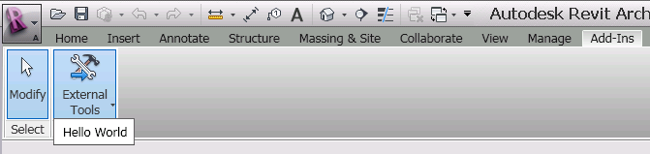
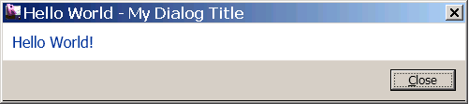
External Tools Panel
Run Your Add-in
Once the .addin add-in manifest is in place, the [Add-Ins] tab and [External Tools] panel are displayed (not visible with no add-ins)
Run your command from the pull down menu

Slide 25
Carrying On …
External application and external command data
Notes:
That concludes the introduction. Now let us start looking at real development issues and take our first steps up to a simple “Hello World” example. The accompanying labs demonstrate the concepts discussed. They can also be used for self-learning, and as a reference to answer the most common Revit API beginner’s questions.

Slide 26
External Application
Minimum Code in VB.NET
<VB.NET>
'' Hello World App - minimum external application
Public Class HelloWorldApp
Implements IExternalApplication
'' OnShutdown() - called when Revit ends.
Public Function OnShutdown(ByVal application As UIControlledApplication) _
As Result _
Implements IExternalApplication.OnShutdown
Return Result.Succeeded
End Function
'' OnStartup() - called when Revit starts.
Public Function OnStartup(ByVal application As UIControlledApplication) _
As Result _
Implements IExternalApplication.OnStartup
TaskDialog.Show("My Dialog Title", "Hello World from App!")
Return Result.Succeeded
End Function
End Class
</VB.NET>
Implement IExternalApplication
OnShutdown is called when Revit ends
OnStartup is called when Revit starts

Slide 27
External Application
Minimum Code in VB.NET
<C#>
// Hello World #3 - minimum external application
public class HelloWorldApp : IExternalApplication
{
// OnStartup() - called when Revit starts.
public Result OnStartup(UIControlledApplication application)
{
TaskDialog.Show("My Dialog Title", "Hello World from App!");
return Result.Succeeded;
}
// OnShutdown() - called when Revit ends.
public Result OnShutdown(UIControlledApplication application)
{
return Result.Succeeded;
}
}
</C#>

Slide 28
External Application
.addin Manifest
Type = “Application” instead of “Command”
<Name> instead of <Text>
<AddIn Type="Application">
<Name>Hello World App</Name>
<FullClassName>IntroVb.HelloWorldApp</FullClassName>
<Assembly>C:\...\IntroVb.dll</Assembly>
<AddInId>08E8EFB1-FCC1-4b99-AD14-93523EE229AA</AddInId>
<VendorId>ADNP</VendorId>
<VendorDescription>Autodesk, Inc. www.autodesk.com</VendorDescription>
</AddIn>

Slide 29
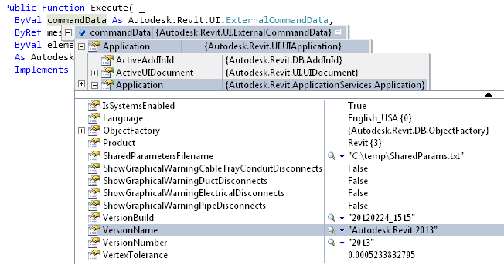
Command Data
Access to the Revit Object Model
ExternalCommandData = 1st argument of Execute() method
Top most object that allows us to access a Revit model

Slide 30
Command Data
Access to the Revit Object Model
Examples:
'' access to the version of Revit and the title of the document currently in use
Dim versionName As String = _
commandData.Application.Application.VersionName
Dim documentTitle As String = _
commandData.Application.ActiveUIDocument.Document.Title
'' print out wall types available in the current rvt project
Dim collector As New FilteredElementCollector(rvtDoc)
Collector.OfClass(GetType(WallType))
Dim s As String = ""
For Each wType As WallType In wallTypes
s = s + wType.Name + vbCr
Next

Slide 31
CommandData
Access to the Revit Object Model
Access to Application and Document in DB and UI portions
<VB.NET>
Public Class DBElement
Implements IExternalCommand
'' member variables
Dim m_rvtApp As Application
Dim m_rvtDoc As Document
Public Function Execute(ByVal commandData As ExternalCommandData, _
...
'' Get the access to the top most objects.
Dim rvtUIApp As UIApplication = commandData.Application
Dim rvtUIDoc As UIDocument = rvtUIApp.ActiveUIDocument
m_rvtApp = rvtUIApp.Application
m_rvtDoc = rvtUIDoc.Document
'' ...
</VB.NET>

Slide 32
DB Element
Understanding the Representation of Revit Element
Notes:
That concludes the introduction. Now let us start looking at real development issues and take our first steps up to a simple “Hello World” example. The accompanying labs demonstrate the concepts discussed. They can also be used for self-learning, and as a reference to answer the most common Revit API beginner’s questions.

Slide 33
DB Element
Element Basics
In typical programming, we identify the given object by checking its class name. Does the same apply to Revit API?
Answer is “no”
Let’s take a look to understand why …

Slide 34
DB Element
Class Derivations
API Object
Element
Family Base
ElementType
Group
Instance
HostObject
Family
Group Type
HostObject Attributes
Insertable Object
Insertable Instance
Wall
Floor
Family Symbol
Family Instance
Clg. & Flr
Wall Type
Floor Type
Cont. Footing Type
Cont. Footing
RoofBase
Families and types, aka symbols
Host and component objects, standard and system
Notes:
Here is a smaller subset of the most important database classes, i.e. non-geometrical classes, that appear in a typical Revit model programming task. The red classes are the most commonly used. The RoofBase class and its derived types FootPrintRoof and ExtrusionRoof were added in Revit 2009. In the model, we see the host and component objects, such as windows and doors. These are actually instances of types. The family base and family are used to manage collections of related types. Symbol is a base class for all types, also known as symbols. Family symbol is the generic class for these, whereas wall and floor type are more specialised classes. Family instance represents an occurrence or usage instance of a generic family symbol, whereas wall and floor represent the same for a wall or floor type.

Slide 35
DB Element
Element versus Symbol
Element |  |  |  | Symbol
Kind of Element in UI | Derived from Element/TypeOf | Category |  | Derived from Symbol/TypeOf | Category
Wall | HostObject/Wall | Walls |  | HostObjAttributes/WallType | Walls
Door | Instance/InsertableInstance/FamilyInstance | Doors |  | InsertableObject /FamilySymbol | Doors
Door Tag | IndependentTag | Door Tags |  | InsertableObject /FamilySymbol | Door Tags
Window | Instance/InsertableInstance/FamilyInstance | Windows |  | InsertableObject /FamilySymbol | Windows
WindowTag | IndependentTag | Window Tags |  | InsertableObject /FamilySymbol | Window Tags
Opening | Opening | Rectangular Straight Wall Opening |  | < null > | ---
Floor | HostObject/Floor | Floors |  | HostObjAttributes/FloorType | Floors
Ceiling | < Element > | Ceilings |  | HostObjAttributes | Ceilings
Roof | HostObject/RoofBase/FootPrintRoof,ExtrusionRoof | Roofs |  | HostObjAttributes/RoofType | Roofs
Column | Instance/InsertableInstance/FamilyInstance | Columns |  | InsertableObject /FamilySymbol | Columns
Component (Desk) | Instance/InsertableInstance/FamilyInstance | Furniture |  | InsertableObject /FamilySymbol | Furniture
Component (Tree) | Instance/InsertableInstance/FamilyInstance | Planting |  | InsertableObject /FamilySymbol | Planting
Stairs | < Element > | Stairs |  | < Symbol > | Staies
Railing | < Element > | Railings |  | < Symbol > | Railings
Room | Room | Rooms |  | < null > | ---
Room Tag | RoomTag | Room Tags |  | < Symbol > | Room Tags
Grid | Grid | Grids |  | LineAndTextAttrSymbol/GridType | < null >
Lines | ModelCurve/ModelLine | Lines |  | < null > | ---
Ref Plane | ReferencePlane | Reference Planes |  | < null > | ---
Dimension | Dimension | Dimensions |  | DimensionType | < null >
Section | < Element > | Views |  | < Symbol > | < null >
Text | TextElement/TextNote | Text Notes |  | LineAndTextAttrSymbol/TextElementType/TextNoteType | < null >
Level | Level | Levels |  | LevelType | Levels
Model Group | Group | Model Group |  | GroupType | Model Groups
Create…/Walls | Instance/InsertableInstance/FamilyInstance | Walls |  | InsertableObject /FamilySymbol | Walls
Notes:
The second table shows a similar list with the symbol type and its corresponding category added. The two columns on the right show the type and category of the symbol or family type used for each model elemeent, represented by a family or dedicated type instance. It shows the correspondence between the instance and symbol elements. The symbol used for a wall is WallType, floor uses FloorType, roof uses RoofType. For component families such as door, window, column, desk and tree, the symbol type is FamilySymbol. Again, in these cases you need to rely on the category to tell the different family symbols apart, while there are designed types for system families.

Slide 36
DB Element
Identifying Element
A system family is a built-in object in Revit. There is a designated class for it. You can use it to identify the element.
A component family has a generic form as FamilyInstance/FamilySymbol. Category is the way to further identify the kind of object it is representing in Revit.
Depending on an element you are interested in, you will need to check the following:
    Class name
    Category property
    If an element is Element
    Type (Symbol) or not
 | System Family | Component Family
Family Type | WallType FloorType | FamilySymbol & Category - Doors, Windows
Instance | Wall Floor | FamilyInstance & Category - Doors, Windows

Slide 37
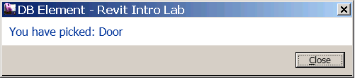
DB Element
Identifying an Element
<VB.NET>
'' identify the type of the element known to the UI.
Public Sub IdentifyElement(ByVal elem As Element)
Dim s As String = ""
If TypeOf elem Is Wall Then
s = "Wall"
ElseIf TypeOf elem Is Floor Then
s = "Floor"
ElseIf TypeOf elem Is RoofBase Then
s = "Roof"
ElseIf TypeOf elem Is FamilyInstance Then
'' An instance of a component family is all FamilyInstance.
'' We'll need to further check its category.
If elem.Category.Id.IntegerValue = _
BuiltInCategory.OST_Doors Then
s = "Door"
ElseIf elem.Category.Id.IntegerValue = _
BuiltInCategory.OST_Windows Then
s = "Window"
ElseIf elem.Category.Id.IntegerValue = _
BuiltInCategory.OST_Furniture Then
s = "Furniture"
Else
s = "Component family instance" '' e.g. Plant
End If
...
</VB.NET>
DB Element
Identifying Element
ABC

Slide 38
DB Element
Element.Parameters
Parameters property of an Element class largely corresponds to an element or family “properties” in the UI.
In API, there are two ways to access those properties or parameters:
    Element.Parameters – returns a set of parameters applicable to the given element.
    Element.Parameter – takes an argument that can identify the kind of parameter and returns the value of single parameter.

Slide 39
DB Element
Element.Parameters
<VB.NET>
'' show all the parameter values of the element
Public Sub ShowParameters(ByVal elem As Element, _
Optional ByVal header As String = "")
Dim s As String = header + vbCr + vbCr
Dim params As ParameterSet = elem.Parameters
For Each param As Parameter In params
Dim name As String = param.Definition.Name
'' see the helper function below
Dim val As String = ParameterToString(param)
s = s + name + " = " + val + vbCr
Next
TaskDialog.Show("Revit Intro Lab", s)
End Sub
</VB.NET>

Slide 40
DB Element
Parameters
<VB.NET>
'' Helper function: return a string from of a given parameter.
Public Shared Function ParameterToString(ByVal param As Parameter) As String
Dim val As String = "none"
If param Is Nothing Then
Return val
End If
'' to get to the parameter value, we need to pause it depending on
'' its strage type
Select Case param.StorageType
Case StorageType.Double
Dim dVal As Double = param.AsDouble
val = dVal.ToString
Case StorageType.Integer
Dim iVal As Integer = param.AsInteger
val = iVal.ToString()
Case StorageType.String
Dim sVal As String = param.AsString
val = sVal
Case StorageType.ElementId
Dim idVal As ElementId = param.AsElementId
val = idVal.IntegerValue.ToString
Case StorageType.None
Case Else
End Select
Return val
End Function
</VB.NET>
ABC

Slide 41
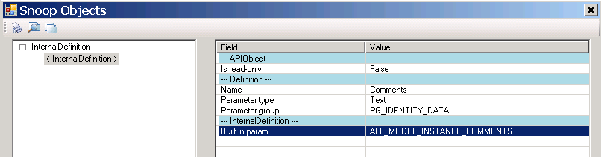
DB Element
Element.Parameter and Built-In Parameters
There are four ways to access individual parameters:
  Parameter(BuiltInParameter) – retrieve a parameter using the parameter Id.
  Parameter(String) – retrieve using the name.
  Parameter(Definition) – retrieve from its definition.
  Parameter(GUID) – retrieve shared parameter using GUID.
RevitLookup tool comes handy to explore and find out which BuiltInParameter corresponds to which parameter name
Notes:
Here we’ll look at the first and second.

Slide 42
DB Element
Element.Parameter and Built-In Parameters
<VB.NET>
'' examples of retrieving a specific parameter individlly.
Public Sub RetrieveParameter(ByVal elem As Element, _
Optional ByVal header As String = "")
Dim s As String = header + vbCr + vbCr
'' comments - most of instance has this parameter
'' (1) by name. (Mark - most of instance has this parameter.)
param = elem.Parameter("Mark")
...
'' (2) by BuiltInParameter.
Dim param As Parameter = _
elem.Parameter(BuiltInParameter.ALL_MODEL_INSTANCE_COMMENTS)
...
'' using the BuiltInParameter, you can sometimes access one
'' that is not in the parameters set.
param = elem.Parameter(BuiltInParameter.SYMBOL_FAMILY_AND_TYPE_NAMES_PARAM)
...
param = elem.Parameter(BuiltInParameter.SYMBOL_FAMILY_NAME_PARAM)
...
</VB.NET>

Slide 43
DB Element
Location
Location property
Location is further derived in two forms:
    LocationPoint - point-based location (e.g., furniture)
    LocationCurve – line-based location (e.g., wall)
You will need to cast to LocationPoint or LocationCurve in order to access more properties.

Slide 44
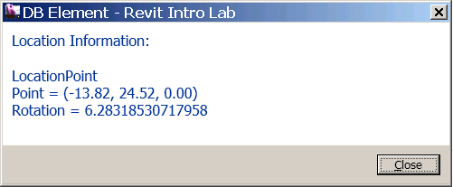
DB Element
Location
<VB.NET>
'' show the location information of the given element.
Public Sub ShowLocation(ByVal elem As Element)
Dim s As String = "Location Information: " + vbCr + vbCr
Dim loc As Location = elem.Location
If TypeOf loc Is LocationPoint Then
'' (1) we have a location point
Dim locPoint As LocationPoint = loc
Dim pt As XYZ = locPoint.Point
Dim r As Double = locPoint.Rotation
...
ElseIf TypeOf loc Is LocationCurve Then
'' (2) we have a location curve
Dim locCurve As LocationCurve = loc
Dim crv As Curve = locCurve.Curve
...
s = s + "EndPoint(0)/Start Point = " + PointToString(crv.EndPoint(0))
s = s + "EndPoint(1)/End point = " + PointToString(crv.EndPoint(1))
s = s + "Length = " + crv.Length.ToString + vbCr
End If
…
End Sub
</VB.NET>

Slide 45
DB Element
Geometry
Geometry Options – specify the detail level
Kinds of geometry objects
    Solid
    Geometry Instance (a instance of a symbol element, e.g. door or window)
    Curve
    Mesh
Further drill down into Solids/Faces/Edges - use RevitLookup
RevitCommands SDK sample has a simple example
SDK samples show geometry access with a viewer
    ElementViewer
    RoomViewer
    AnalyticalViewer
Further viewing options
    SVG Simple Vector Graphics, VRML Virtual Reality Markup Language, OpenGL, DirectX, many public domain viewers

Slide 46
Element Filtering
Element Iterations, Filtering and Queries

Slide 47
Element Filtering
Retrieving an Element
Elements in Revit are bundled in one single sack
To retrieve an element of interest, you filter for it
Typically, we would like to:
    Retrieve a list of family types (e.g., wall types, door types)
    Retrieve instances of a specific object class
    (e.g., all the walls, all the doors)
    Find a specific family type with a given name
    (e.g., “Basic Wall: Generic – 200mm”, “M_Single-Flush: 0915 x 2134mm”)
    Find specific instances (e.g., “Level 1” “View Plan 1”)
Similar to identifying element, you will need to consider a different approach depending on whether an element is a component-based or system-based.

Slide 48
FilteredElementCollector - documentation
Used to search, filter and iterate through a set of elements
Assign a variety of conditions to filter the elements which are returned.
Requires that at least one condition be set before making the attempt to access the elements, otherwise exception thrown.
Supports the IEnumerable interface
  Tip: because the ElementFilters and the shortcut methods offered by this class process elements in native code before their managed wrappers are generated, better performance will be obtained by using as many native filters as possible on the collector before attempting to process the results using LINQ queries

Slide 49
Filter types
Logical Filters – help to combine filter logic
  And
  Or
Quick filters - use an internal element record to determine passing state. This allows Revit to find elements which have not been expanded into internal memory yet.
  Examples:
    ElementClassFilter
    ElementCategoryFilter
Slow filters – not all information can be obtained by the element record, so these filters must expand to determine passing state.
  Examples:
    FamilyInstanceFilter
    AreaFilter

Slide 50
Efficiency guidelines
Filter quick aspects first
Filter slow second
After using built-in filtering techniques, consider LINQ to narrow down further.
Tip: Use the shortcut methods on FilteredElementCollector
  Because there are currently no shortcuts for Slow Filters, you can be sure when using a shortcut you are getting a Quick Filter.
  Examples:
    OfClass
    OfCategoryId

Slide 51
Logical Filters
Filter Name | Passing Criteria | Shortcut Methods
LogicalAndFilter | Where elements must pass 2 or more filters | WherePasses()- adds one additional filter IntersectWith() - joins two sets of independent filters
LogicalOrFilter | Where elements must pass at least one of 2 or more filters | UnionWith() - joins two sets of independent filters

Slide 52
Quick Filters
Name | Passing Criteria | Shortcut Methods
ElementCategoryFilter | Elements matching the input category id | OfCategoryId
ElementClassFilter | Elements matching the input runtime class | OfClass
ElementIsElementTypeFilter | Elements which are "Element types" (symbols) | WhereElementIsElementType WhereElementIsNotElementType
ElementOwnerViewFilter | Elements which are view-specific | OwnedByView WhereElementIsViewIndependent
ElementDesignOptionFilter | Elements in a particular design option | ContainedInDesignOption
ElementIsCurveDrivenFilter | Elements which are curve driven | WhereElementIsCurveDriven
ElementStructuralTypeFilter | Elements matching the given structural type | none
FamilySymbolFilter | Symbols of a particular family | none
ExclusionFilter | All elements except the element ids input to the filter | Excluding
BoundingBoxIntersectsFilter | Elements which have a bounding box which intersects a given outline. | none
BoundingBoxIsInsideFilter | Elements which have a bounding box inside a given outline | none
BoundingBoxContainsPointFilter | Elements which have a bounding box that contain a given point | none

Slide 53
Slow Filters
Name | Passing Criteria | Shortcut Methods
FamilyInstanceFilter | Instances of a particular family symbol | none
ElementLevelFilter | Elements associated to a given level id | none
ElementParameterFilter | Parameter existence, value matching, range matching, and/or string matching | none
PrimaryDesignOptionMemberFilter | Elements owned by any primary design option. | none
StructuralInstanceUsageFilter | Structural usage parameter for FamilyInstances | none
StructuralWallUsageFilter | Structural usage parameter for Walls | none
StructuralMaterialTypeFilter | Material type applied to FamilyInstances | none
RoomFilter | Finds rooms | none
SpaceFilter | Finds spaces | none
AreaFilter | Finds areas | none
RoomTagFilter | Finds room tags | none
SpaceTagFilter | Finds space tags | none
AreaTagFilter | Finds area tags | none
CurveElementFilter | Finds specific types of curve elements (model curves, symbolic curves, detail curves, etc) | none

Slide 54
Fourth Level – Last Resort
Post-processing
Native .NET code
LINQ

Slide 55
Element Filtering
1.1 A List of Family Types - System Family
Collect all the wall types (2nd and 3rd using shortcuts)
<VB.NET>
Dim wallTypeCollector1 = New FilteredElementCollector(m_rvtDoc)
wallTypeCollector1.WherePasses(New ElementClassFilter(GetType(WallType)))
Dim wallTypes1 As IList(Of Element) = wallTypeCollector1.ToElements
</VB.NET>
<VB.NET>
Dim wallTypeCollector2 = New FilteredElementCollector(m_rvtDoc)
wallTypeCollector2.OfClass(GetType(WallType))
</VB.NET>
<VB.NET>
Dim wallTypeCollector3 = _
New FilteredElementCollector(m_rvtDoc).OfClass(GetType(WallType))
</VB.NET>

Slide 56
Element Filtering
1.2 A List of Family Types - Component Family
Collect all the door types
<VB.NET>
Dim doorTypeCollector = New FilteredElementCollector(m_rvtDoc)
doorTypeCollector.OfClass(GetType(FamilySymbol))
doorTypeCollector.OfCategory(BuiltInCategory.OST_Doors)
Dim doorTypes As IList(Of Element) = doorTypeCollector.ToElements
</VB.NET>
<VB.NET>
Dim doorTypes As IList(Of Element) _
= New FilteredElementCollector(m_rvtDoc) _
.OfClass(GetType(FamilySymbol)) _
.OfCategory(BuiltInCategory.OST_Doors) _
.ToElements
</VB.NET>

Slide 57
Element Filtering
2.1 List of Instances of a Specific Object Class - System Family
Collect all the instances of wall
<VB.NET>
Dim wallCollector = New FilteredElementCollector(m_rvtDoc).OfClass(GetType(Wall))
Dim wallList As IList(Of Element) = wallCollector.ToElements
</VB.NET>

Slide 58
Element Filtering
2.2 List of Instances of a Specific Object Class - Component Family
Collect all the instances of door
<VB.NET>
Dim doorCollector = New FilteredElementCollector(m_rvtDoc). _
OfClass(GetType(FamilyInstance))
doorCollector.OfCategory(BuiltInCategory.OST_Doors)
Dim doorList As IList(Of Element) = doorCollector.ToElements
</VB.NET>

Slide 59
Element Filtering
3.1 Find a Specific Family Type – System Family Type
Find a wall type e.g., “Basic Wall: Generic – 200mm”
<VB.NET>
Function FindFamilyType_Wall_v1(ByVal wallFamilyName As String, _
ByVal wallTypeName As String) As Element
'' narrow down a collector with class.
Dim wallTypeCollector1 = New FilteredElementCollector(m_rvtDoc)
wallTypeCollector1.OfClass(GetType(WallType))
'' LINQ query
Dim wallTypeElems1 = _
From element In wallTypeCollector1 _
Where element.Name.Equals(wallTypeName) _
Select element
'' get the result.
Dim wallType1 As Element = Nothing '' result will go here.
If wallTypeElems1.Count > 0 Then
wallType1 = wallTypeElems1.First
End If
Return wallType1
End Function
</VB.NET>

Slide 60
Element Filtering
3.2 Find a Specific Family Type – Component Family
Find a door type, e.g., “M_Single-Flush: 0915 x 2134”
Function FindFamilyType_Door_v1(ByVal doorFamilyName As String, ByVal doorTypeName As String) As Element
'' narrow down the collection with class and category.
Dim doorFamilyCollector1 = New FilteredElementCollector(m_rvtDoc)
doorFamilyCollector1.OfClass(GetType(FamilySymbol))
doorFamilyCollector1.OfCategory(BuiltInCategory.OST_Doors)
'' parse the collection for the given name using LINQ query here.
Dim doorTypeElems = _
From element In doorFamilyCollector1 _
Where element.Name.Equals(doorTypeName) And _
element.Parameter(BuiltInParameter.SYMBOL_FAMILY_NAME_PARAM). _
AsString.Equals(doorFamilyName) _
Select element
'' get the result.
Dim doorType1 As Element = Nothing
Dim doorTypeList As IList(Of Element) = doorTypeElems.ToList()
If doorTypeList.Count > 0 Then '' we should have only one.
doorType1 = doorTypeList(0) ' found it.
End If
Return doorType1
End Function

Slide 61
Element Filtering
4.1 Find Instances of a Given Family Type
Find doors with a given type e.g.,“M_Single-Flush: 0915 x 2134”
<VB.NET>
'' Find a list of element with the given Class, family type and Category (optional).
Function FindInstancesOfType(ByVal targetType As Type, _
ByVal idFamilyType As ElementId, _
Optional ByVal targetCategory As BuiltInCategory = Nothing) As IList(Of Element)
'' narrow down to the elements of the given type and category
Dim collector = New FilteredElementCollector(m_rvtDoc).OfClass(targetType)
If Not (targetCategory = Nothing) Then
collector.OfCategory(targetCategory)
End If
'' parse the collection for the given family type id. using LINQ query here.
Dim elems = _
From element In collector _
Where element.Parameter(BuiltInParameter.SYMBOL_ID_PARAM). _
AsElementId.Equals(idType) _
Select element
'' put the result as a list of element for accessibility.
Return elems.ToList()
End Function
</VB.NET>

Slide 62
Element Filtering
4.2 Find Elements with a Given Class and Name
Find levels with a given name
<VB.NET>
'' Find a list of elements with given class, name, category (optional).
Public Shared Function FindElements(ByVal rvtDoc As Document, _
ByVal targetType As Type, ByVal targetName As String, _
Optional ByVal targetCategory As BuiltInCategory = Nothing) As IList(Of Element)
'' narrow down to the elements of the given type and category
Dim collector = _
New FilteredElementCollector(rvtDoc).OfClass(targetType)
If Not (targetCategory = Nothing) Then
collector.OfCategory(targetCategory)
End If
'' parse the collection for the given names. using LINQ query here.
Dim elems = _
From element In collector _
Where element.Name.Equals(targetName) _
Select element
'' put the result as a list of element for accessibility.
Return elems.ToList()
End Function
</VB.NET>

Slide 63
Element Filtering
More Options
We have learnt how to use the following classes:
    FilteredElementCollector
    ElementClassFilter
    ElemetCategoryFilter
There are more different kinds of filters, such as:
    BoundingBoxContainsPointFilter
    ElementDesignOptionFilter
    ElementIsCurveDrivenFilter
    ElementIsElementTypeFilter
    ElementParameterFilter
    …
cf. Online Developer Guide.

Slide 64
Element Modification
How to modify an element
Notes:
That concludes the introduction. Now let us start looking at real development issues and take our first steps up to a simple “Hello World” example. The accompanying labs demonstrate the concepts discussed. They can also be used for self-learning, and as a reference to answer the most common Revit API beginner’s questions.

Slide 65
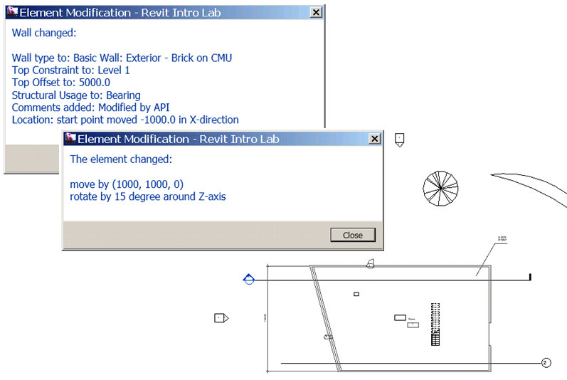
Element Modification
Element Level vs. Document Level Modification
Two approaches to modify an element:
    by changing its properties, parameters and location at each element level
    using ElementTransformUtils class methods, such as Move and Rotate
At each element level,
you can change:
    Family type
    Parameters
    Location
By Document methods:
    Move, Rotate, Mirror, Array, Array without
    associate (this will not create a group)

Slide 66
Element Modification
Element Level – Family Type
Change the family type of an instance (e.g., a wall and a door)
<VB.NET>
'' e.g., an element we are given is a wall.
Dim aWall As Wall = elem
'' find a wall family type with the given name.
Dim newWallType As Element = ElementFiltering.FindFamilyType( m_rvtDoc, _
GetType(WallType), "Basic Wall", "Exterior - Brick on CMU")
'' assign a new family type.
aWall.WallType = newWallType
</VB.NET>
<VB.NET>
'' e.g., an element we are given is a door.
Dim aDoor As FamilyInstance = elem
'' find a door family type with the given name.
Dim newDoorType As Element = ElementFiltering.FindFamilyType( _
GetType(FamilySymbol), "M_Single-Flush", "0762 x 2032mm", _
BuiltInCategory.OST_Doors)
'' assign a new family type.
aDoor.Symbol = newDoorType
</VB.NET>

Slide 67
Element Modification
Element Level – Parameter
Change a parameter of an element (e.g., a wall and a door)
<VB.NET>
aWall.Parameter(BuiltInParameter.WALL_TOP_OFFSET).Set(14.0)
aWall.Parameter(BuiltInParameter.ALL_MODEL_INSTANCE_COMMENTS).Set( _
"Modified by API")
</VB.NET>

Slide 68
Element Modification
Element Level – Location Curve
Change a value of location information (e.g., a wall)
<VB.NET>
Dim wallLocation As LocationCurve = aWall.Location
'' create a new line bound.
Dim newPt1 = New XYZ(0.0, 0.0, 0.0)
Dim newPt2 = New XYZ(20.0, 0.0, 0.0)
Dim newWallLine As Line = m_rvtApp.Create.NewLineBound(newPt1, newPt2)
'' change the curve.
wallLocation.Curve = newWallLine
</VB.NET>

Slide 69
Element Modification
Document Level – Move and Rotate
Move and rotate an element (e.g., a wall)
<VB.NET>
'' move by displacement
Dim v As XYZ = New XYZ(10.0, 10.0, 0.0)
m_rvtDoc.Move(elem, v)
</VB.NET>
<VB.NET>
'' rotate by 15 degree around z-axis.
Dim pt1 = XYZ.Zero
Dim pt2 = XYZ.BasisZ
Dim axis As Line = m_rvtApp.Create.NewLineBound(pt1, pt2)
m_rvtDoc.Rotate(elem, axis, Math.PI / 12.0)
</VB.NET>

Slide 70
Element Modification
Regeneration of Graphics
When you modify an element that results in changes in a model geometry and you need to access to the updated geometry, the graphics need to be regenerated.
You can control this by calling Document.Regenerate()
RegenerationOption.Manual is the only regeneration option ...
m_rvtDoc.Regenerate()

Slide 71
Model Creation
How to create instances of Revit elements
Notes:
That concludes the introduction. Now let us start looking at real development issues and take our first steps up to a simple “Hello World” example. The accompanying labs demonstrate the concepts discussed. They can also be used for self-learning, and as a reference to answer the most common Revit API beginner’s questions.

Slide 72
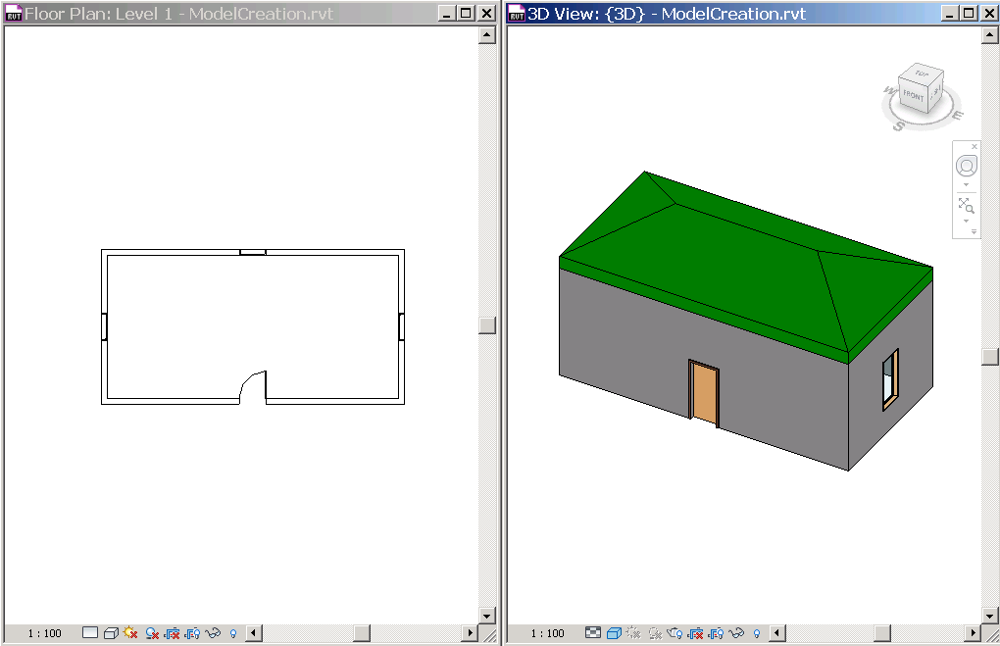
Model Creation
Create Instances of Revit Elements
Create a new geometry element:
    Application.Create.NewXxx() e.g., NewLineBound()
Create a new model element:
    Document.Create.NewXxx() e.g., NewFamilyInstance()
    Use static Create methods e.g., Wall.Create(doc, …)
Multiple overloaded methods,
each for a specific condition
and/or apply only certain
types of elements.
e.g., 5 Wall.Create(),
9 NewFamilyInstance()
  cf. Dev Guide

Slide 73
Model Creation
Create a Wall
Model Creation
New Walls
<VB.NET>
'' create walls
Sub CreateWalls()
'' get the levels we want to work on.
Dim level1 As Level = ElementFiltering.FindElement(m_rvtDoc, GetType(Level), "Level 1")
Dim level2 As Level = ElementFiltering.FindElement(m_rvtDoc, GetType(Level), "Level 2")
'' set four corner of walls.
Dim pts As New List(Of XYZ)(5)
...
Dim isStructural As Boolean = False '' flag for structural wall or not.
'' loop through list of points and define four walls.
For i As Integer = 0 To 3
'' define a base curve from two points.
Dim baseCurve As Line = Line.CreateBound(pts(i), pts(i + 1))
'' create a wall using the one of overloaded methods.
Dim aWall As Wall = Wall.Create(m_rvtDoc, baseCurve, level1, isStructural)
'' set the Top Constraint to Level 2
aWall.Parameter(BuiltInParameter.WALL_HEIGHT_TYPE).Set(level2.Id)
Next
'' This is important. we need these lines to have shrinkwrap working.
m_rvtDoc.Regenerate()
m_rvtDoc.AutoJoinElements()
End Sub
</VB.NET>

Slide 74
Model Creation
Create a Wall
Model Creation
A New Door
<VB.NET>
'' add a door to the center of the given wall.
Sub AddDoor(ByVal hostWall As Wall)
'' get the door type to use.
Dim doorType As FamilySymbol = _
ElementFiltering.FindFamilyType(m_rvtDoc, GetType(FamilySymbol), _
"M_Single-Flush", "0915 x 2134mm", BuiltInCategory.OST_Doors)
'' get the start and end points of the wall.
Dim locCurve As LocationCurve = hostWall.Location
Dim pt1 As XYZ = locCurve.Curve.EndPoint(0)
Dim pt2 As XYZ = locCurve.Curve.EndPoint(1)
'' calculate the mid point.
Dim pt As XYZ = (pt1 + pt2) / 2.0
'' we want to set the reference as a bottom of the wall or level1.
Dim idLevel1 As ElementId = _
hostWall.Parameter(BuiltInParameter.WALL_BASE_CONSTRAINT).AsElementId
Dim level1 As Level = m_rvtDoc.Element(idLevel1)
'' finally, create a door.
Dim aDoor As FamilyInstance = m_rvtDoc.Create.NewFamilyInstance( _
pt, doorType, hostWall, level1, StructuralType.NonStructural)
End Sub
</VB.NET>

Slide 75
Revit API Intro Labs
Revit API fundamentals
  Revit Add-ins: external command/application, attributes, add-in manifest and object model
  Representation of Revit elements
  Element iteration, filtering and queries
  Element modification
  Model creation
Exercises
  Lab1 – “Hello World”
  Lab2 – DB element
  Lab3 – element filtering
  Lab4 – element modification
  Lab5 – model creation

Slide 76
Addendum: Additional Lab Exercises
If interested, work on additional labs:
  Extensible Storage Lab – Learn to add custom data to Revit element
  Shared Parameter Lab – Learn to create shared parameters

Slide 77
Thank you!

Slide 78
Autodesk is a registered trademark of Autodesk, Inc., and/or its subsidiaries and/or affiliates in the USA and/or other countries. All other brand names, product names, or trademarks belong to their respective holders. Autodesk reserves the right to alter product and services offerings, and specifications and pricing at any time without notice, and is not responsible for typographical or graphical errors that may appear in this document.

