Slide 1

The Revit SDK Samples
Jeremy Tammik
Consulting Analyst

Slide 2

About the Presenter
Jeremy Tammik
Developer Technical Services
EMEA, Autodesk SARL
Jeremy is a member of the AEC workgroup of the Autodesk Developer Network ADN team, providing developer support, training, conference presentations, and blogging on the Revit API.
He joined Autodesk in 1988 as the technology evangelist responsible for European developer support to lecture, consult, and support AutoCAD application developers in Europe, the U.S., Australia, and Africa. He was a co-founder of ADGE, the AutoCAD Developer Group Europe, and a prolific author on AutoCAD application development. He left Autodesk in 1994 to work as an HVAC application developer, and then rejoined the company in 2005.
Jeremy graduated in mathematics and physics in Germany, worked as a teacher and translator, then as a C++ programmer on early GUI and multitasking projects. He is fluent in six European languages, vegetarian, has four kids, plays the flute, likes reading, travelling, theatre improvisation, and carpentry, loves mountains, oceans, sports, and especially climbing.
Notes:
It is my pleasure to work in the AEC workgroup of the DevTech team supporting the Autodesk Developer Network ADN.

Slide 3
Acronyms
  ADN Autodesk Developer Network
  AEC Architecture, Engineering, Construction
  API Application Programming Interface
  BIM Building Information Model
  GUI Graphical User Interface
  MEP Mechanical, Electrical, Plumbing
  RAC Revit Architecture
  RME Revit MEP
  RST Revit Structure
  SDK Software Development Kit
  UI User Interface

Slide 4
Revit API History
  5, 6, 7 had no API and no verticals
  8 first public API for Building and Structure
  9 many new objects and creation methods
  9.1 journal, units, new creation methods
  2008 strong consolidation and major new features
  2009 filtering facilities, data access, samples, VSTA
  2010 family API, form creation, ribbon, events, MEP
  2011
    RAC: improved form generation, flexible components
    RME: conduits, cable trays, panel schedules
    RST: concrete joins, improved analytical model
    Platform: user interface, performance, reporting parameters
    API: dynamic update, analysis visualization, transactions, iteration, selection
  Long term target is API and kernel-based application
  API continues evolving fast ...
Notes:
A little bit on the history of the Revit API. The API has been and still is evolving very strongly, since Revit 8.0, and has reached maturity now. We are in the long-term process of restructuring Revit to make it more API driven, i.e. create a kernel providing the API on top of which the various Revit flavours can be implemented, instead of implementing the API as the outermost layer on top of the completed product.

Slide 5
SDK Documentation
Read once
  Read Me First.doc
  Getting Started with the Revit API.doc
  Revit Platform API Changes and Additions.doc
Keep at hand always
  Revit API Developer Guide.pdf
  RevitAPI.chm
    What's New section is similar to Changes and Additions doc
Read if needed
  RevitAddInUtility.chm – installer
  Autodesk Icon Guidelines.pdf – user interface
  Revit Structure – section definitions and material properties
Very important utilities
  Add-In Manager
  RevitLookup
VSTA Samples
Samples
  RevitAPIDllsPathUpdater.exe
  SamplesReadMe.htm
  SDKSamples2012.sln
Notes:
Here are the top level contents of the SDK. The Developer Guide is very comprehensive. The Revit SDK samples provide a huge knowledge base on how to address specific programming tasks using the Revit API. The API documentation in the help file lists all the classes and their methods and properties, and the developer guide and samples explain and demonstrate how they work together to solve specific tasks.

Slide 6
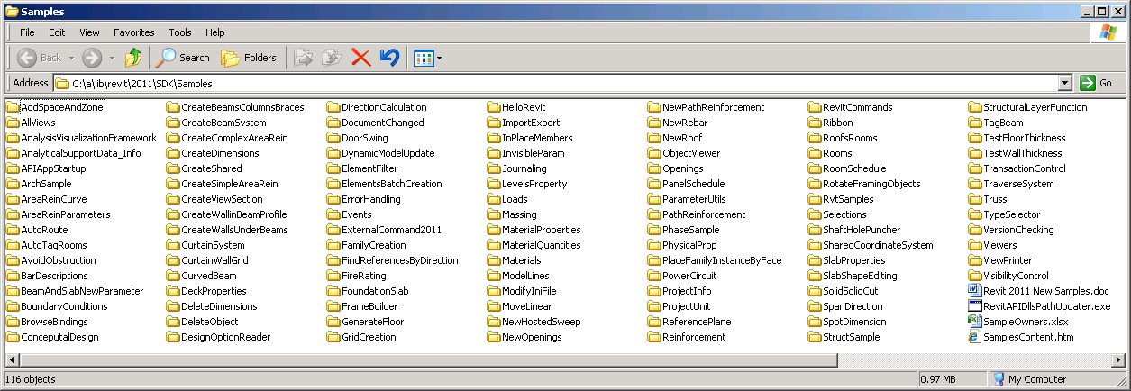
SDK Samples
Documentation
  SamplesReadMe.htm
  Revit 2011 New Samples.doc
Utility
  RevitAPIDllsPathUpdater.exe
Main samples solution
  SDKSamples2011.sln
And the samples themselves!
Notes:
The Revit SDK samples provide a huge knowledge base on how to address specific programming tasks using the Revit API. The API documentation in the help file lists all the classes and their methods and properties, and the developer guide and samples explain and demonstrate how they work together to solve specific tasks.

Slide 7
Copy Revit API Assemblies for SDKSamples2011.sln
C:\Program Files\Autodesk\ > md "Revit MEP 2011"
C:\Program Files\Autodesk\ > md "Revit MEP 2011\Program"
C:\Program Files\Autodesk\ > copy
"Revit Architecture 2011\Program\RevitAPI.dll"
"Revit MEP 2011\Program"
C:\Program Files\Autodesk\ > copy
"Revit Architecture 2011\Program\RevitAPIUI.dll"
"Revit MEP 2011\Program"
Repeat for Structure as well...

Slide 8

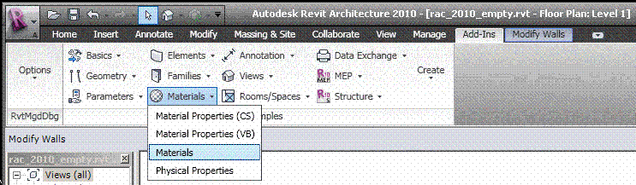
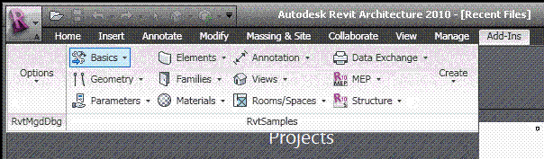
RvtSamples
So every external command needs an own manifest file?
Not using the SDK sample application RvtSamples!
Includes RvtSamples.txt listing all SDK samples
Adds them all to an own ribbon panel
Add one single add-in manifest file and never touch it again
You can add your own entries to RvtSamples.txt
Also define own pulldown buttons for additional sections
  Example AdnSamples.txt
Notes:
The RvtSamples application and RvtSamples.txt is included in the Revit SDK ... show contents on screen in explorer ... so, SDKSamples2010.sln provides accesss to search and debug all sample source code, and RvtSamples enables running every single sample

Slide 9
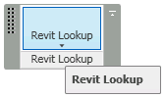
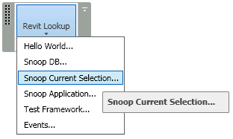
RevitLookup
Included in Revit SDK
Interactively access and explore entire database structure
Elements, parameters, relationships
Comprehensive Revit API test
Sample code and utility classes
Scaffolding for quick tests
Explore
  Application
  Document
  Current selection
  Reflection
  Events
  Tests
Notes:
RevitLookup, formerly RvtMgdDbg, is a utility similar to the well-known ArxDbg and MgdDbg utilities provided for AutoCAD, written by the same author and his team. It is a Revit extension application which defines its own ribbon panel.

Slide 10
Non-SDK Samples

Slide 11
Non-SDK Samples
RME Labs
  Using the generic Revit API for RME: HVAC sample to calculate and resize ducts
  Using the RME-specific API: electrical sample to generate a specialised tree view
RST Labs and Link
  Revit Structure Labs and Link Sample, rst_lab.zip and rst_link.zip
MidasLink
  Complete professional application
  Handling elements, export and import forms
  Localisation, Units
  Installer
Available from ADN
Notes:
Before moving on to an overview and detailed discussion of the standard Revit SDK samples, let me point out a few interesting ones not included in the SDK. First and foremost, RvtMgdDbg is an absolute must-have for every serious Revit programmer. It is discussed in a separate session. We have implemented some specialised labs and samples for RME and RST which are discussed in separate sessions as well. Another more full-fledged RST linking sample is MidasLink, which is available on the ADN site.
Revit MEP 2009 provided the first MEP-specific API on the Revit platform. Before that, there were no RME-specific SDK samples. However, the generic Revit API can be used to access and modify an MEP model as well. For instance, the generic API can be used to implement an HVAC sample for calculating and resizing air terminals. The RME-specific API added in Revit 2009 makes it possible to implement more powerful applications making use of MEP-specific data. This is demonstrated by the Revit 2009 SDK samples AddSpaceAndZone, PowerCircuit, and RoofsRooms. We also implemented a non-SDK sample to analyse and display the connection hierarchy of an electrical system.
The important features of the structural API are the exposure of structural elements and their usage. Revit Structure manages a simplified analytical model for analysing the structural behaviour of the building under stress in parallel with the physical model which is of interest to architects and most other parties. In programming for Revit Structure, a developer often faces special requirements. The main areas of interest are linking the parallel analytical and physical models maintained by Revit Structure with an external analysis application, and optimising the generation of detailing drawings. A number of SDK samples are dedicated to the Revit Structure specific API and topics especially interesting in the structural domain.
Finally, an additional sample available for demonstrating the linking of an external analysis application with Revit Structure is provided by MidasLink. This sample is of special interest even to non-structural developers, because it constitutes a complete professional application and is in productive use. It demonstrates the element handling, export and import forms, localisation, unit handling, and also includes the complete source code for an installer.

Slide 12
Managing Samples
Resources, Utilities and Tools
Notes:
In this section, we look at overview documentation, utilities and tools for managing the wealth of existing Revit SDK samples effectively.

Slide 13
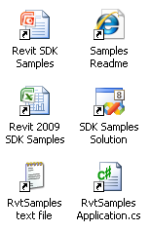
Managing Samples
Complete samples overview and readme
  SamplesReadme.htm
Main samples solution
  SDKSamples2012.sln
  Knowledge base
  Global search
Revit SDK samples spreadsheet
  Revit_SDK_Samples.xlsx
External sample manager application
  RvtSamples, a generic menu generator

Slide 14
SDK Samples Usage
Main tasks
  Compile all projects
  Load all projects into Revit
  Search for solution to specific task
Main tools
  Top-level search is supported by SamplesReadMe.htm
  Compile and detailed search can be done in SDKSamples2009.sln
  Load is handled by RvtSamples external application

Slide 15
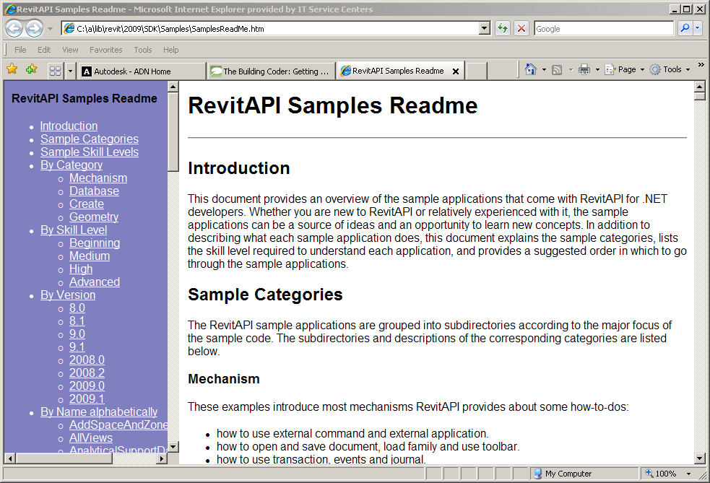
Complete overview and readme
Every sample in the Revit SDK includes a readme file
Mostly *.rtf, sometimes *.txt
This documentation is dispersed
Rtf files are hard to search globally
Enter SamplesReadme.htm
Modelled on ObjectARX samples readme
All descriptions in one file
Additional categorisations

Slide 16
Main Samples Solution
All Revit SDK samples are united in SDKSamples2012.sln
  Both C# and VB
Compiling all samples requires correct reference path to Revit API assemblies
  Installing Revit to default location matches default, otherwise adjust
  Ensure 'Copy Local' flag is set to False
Use global searching to explore a specific programming task
  Search for CreateWall
  Whole word and match case
  In Journaling, discover what we really want: NewWall()
Bare-bones external command requires add-in manifest
  It is a large effort to test all samples one by one
  Solution: RvtSamples external application
Notes:
Open SDK Samples solution; note that it contains both C# and VB projects. Search for CreateWall, note it appears many times, select whole word and match case, less hits, discover that the journaling sample actually calls the Revit API method NewWall, search for that, et voilà all samples that create walls. One remaining problem is that testing all the samples requires a lot effort in adjusting Revit.ini. In addition, it is impossible to add all the samples as individual external commands to Revit.ini at the same time, since that exceeds the maximum number of permitted menu entries.

Slide 17
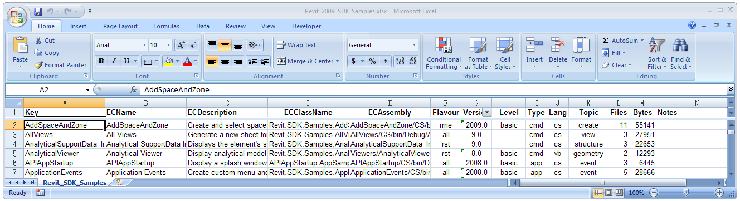
Revit Samples Spreadsheet
Excel spreadsheet listing all samples
    Revit_SDK_Samples.xlsx
  Includes the required add-in manifest data
  Includes classification by various categories
    Flavour: generic, rac, rst, rme
    Version: 8.0, 8.1, 9.0, 9.1, 2008.0, 2008.2, 2009.0, 2009.1, 2010, 2011, 2012
    Level: basic, intermediate, advanced
    Type: cmd, app, exe
    Language: cs or vb
    Topic: creation, element, parameter, etc.
    Files: number of source files
    Bytes: total source file size
Notes:
Revit_SDK_Samples.xlsx is an Excel spreadsheet database of all the Revit SDK samples including all the EC or external command data required for creating the Revit.ini entries for invoking the samples as external Revit commands. It also manages additional information such as classification into different categories. This data is useful in itself to provide an overview of the samples. It can also be used to automatically generate Revit.ini entries to invoke the commands for test purposes. Last but not least, it is used to generate a text file RvtSamples.txt which is used as an input file by the RvtSamples external application to automatically generate a menu hierarchy including all SDK samples.
Open the spreadsheet, look at the classifications.

Slide 18
RvtSamples
External application
Defines entire menu hierarchy
Generic menu generator
  Used for additional ADN and BC material as well
Lists all Revit samples
Multiple categorisations
Database driven
Avoid hitting max. number of menu entries
Minimal edits in Revit.ini
Enhanced version supporting #include
  http://thebuildingcoder.typepad.com/blog/2008/11/loading-the-building-coder-samples.html
Notes:
RvtSamples is a generic Revit menu generator which reads a text file RvtSamples.txt listing all the Revit SDK samples categorised in various ways and creates a new top level hierarchical menu providing simultaneous access to all of them.
It is not limited to the SDK samples, you can add any other menu entry definitions you like, as well as or instead of the predefined ones for the SDK samples. For instance, in my system, I have added entries to define a second complete menu hierarchy for all the ADN, AU and The Building Coder samples.
RvtSamples is implemented as an external application and thus requires only a minimal edit of Revit.ini, an addition of two or maximally four lines, as opposed to the hundreds of lines required if you want to add the SDK samples individually. It defines its own menu hierarchy, which can be completely freely defined by the driving text file. Using the default database driven input file, it generates entries for all SDK samples, categorised in several different ways, e.g. by Revit flavour and original release version. It circumvents the maximum limit of about 50 entries that can be made to the Tools > External Tools submenu. Open the project, look at how to create menu entries, debug through steps in reading RvtSamples.txt and generating the menu hierarchy.
Open RvtSamples, look at how to create menu, debug through steps in reading RvtSamples.txt and generating menu and menu entries.
I have implemented an enhanced version of RvtSamples which supports an #include statement, similar to the functionality provided by the C and C++ language preprocessor. I use it to include my own regularly updated collection of samples. I have two collections of samples that I regularly work on and add to: the ADN and the Building Coder collections. To load them, I simply add the following two lines at the end of RvtSamples.txt:
#include C:/a/j/adn/train/revit/2009/src/AdnSamples.txt
#include C:/a/j/adn/train/revit/2009/src/bc/BcSamples.txt

Slide 19
SDK Samples Overview

Slide 20
Revit SDK Samples
Huge knowledge base … most of the Revit SDK information is contained in the samples ... impossible to discuss each and every one ...
APIAppStartup
AddSpaceAndZone
AllViews
AnalyticalSupportData_Info
ApplicationEvents
ArchSample
AreaReinCurve
AreaReinParameters
AutoTagRooms
BarDescriptions
BeamAndSlabNewParameter
BlendVertexConnectTable
BoundaryConditions
BrowseBindings
CreateBeamSystem
CreateBeamsColumnsBraces
CreateComplexAreaRein
CreateDimensions
CreateShared
CreateSimpleAreaRein
CreateViewSection
CreateWallinBeamProfile
CreateWallsUnderBeams
CurtainSystem
CurtainWallGrid
CurvedBeam
DeckProperties
DeleteDimensions
DeleteObject
DesignOptionReader
DoorSwing
ElementsBatchCreation
ElementsFilter
FamilyExplorer
FireRating
FoundationSlab
FrameBuilder
GenerateFloor
GridCreation
HelloRevit
HelloWorld
ImportExport
InPlaceMembers
InplaceFamilyAnalyticalModel3D
InvisibleParam
Journaling
LevelsProperty
Loads
MaterialProperties
Materials
ModelLines
ModifyIniFile
MoveLinear
NewHostedSweep
NewOpenings
NewPathReinforcement
NewRebar
NewRoof
ObjectViewer
Openings
ParameterUtils
PathReinforcement
PhaseSample
PhysicalProp
PlaceFamilyInstanceByFace
PowerCircuit
ProjectInfo
ProjectUnit
RDBLink
ReferencePlane
Reinforcement
RevitCommands
RoofsRooms
RoomSchedule
Rooms
RotateFramingObjects
RvtSamples
ShaftHolePuncher
SharedCoordinateSystem
SlabProperties
SlabShapeEditing
SpanDirection
SpotDimension
StructSample
StructuralLayerFunction
TagBeam
TestFloorThickness
TestWallThickness
Toolbar
TransactionControl
TagBeam
TestFloorThickness
TestWallThickness
Toolbar
TransactionControl
Truss
TypeSelector
VersionChecking
ViewPrinter
Viewers/AnalyticalViewer
Viewers/ElementViewer
Viewers/RoomViewer
VisibilityControl
Notes:
As already stated, the Revit SDK includes over one hundred different sample applications, demonstrating just about all of the functionality provided by the Revit API. This constitutes a huge knowledge base, and makes it important for every Revit developer to know how to manage and search the information provided. The samples are currently the main source of information on how to solve specific programming tasks in the Revit API. Whenever faced with a new Revit API issue, one of the first places to search for information is in the samples collection. Most tasks that can be accomplished through the API are illustrated by one of them. Obviously we will not be able to discuss each and every one of these in detail in this session. This section presents a chronological categorisation matching the development of the API itself, followed by some details on specific groups of samples.
The rest of the presentation provides a slightly more detailed first impression of selected samples. Since we cannot discuss every one, we will focus on some important basic samples useful for initial exploration of the Revit API features and suitable for beginners, and on the new samples added in the Revit 2009 time frame, which are of interest to developers who have already worked with the API and explored the ones that have been available for longer. The information we present is extracted from the global readme file provided in SamplesReadme.zip and in the individual sample documentation files Readme*.rtf.

Slide 21
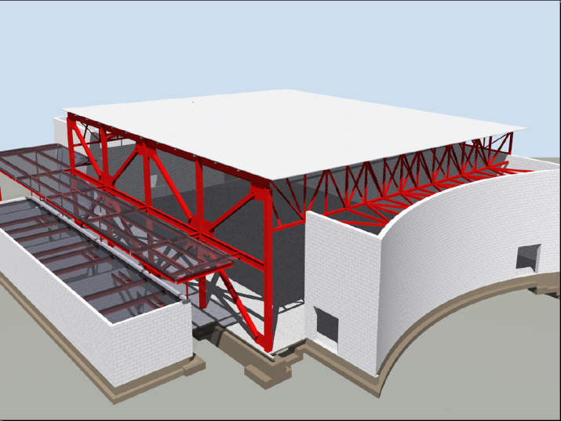
Basic Revit SDK Samples
ArchSample All
BrowseBindings All
CreateShared All
FireRating All
HelloRevit All
MoveLinear All
PhysicalProp All
RevitCommands All
StructSample All
TypeSelector All
ElementViewer All
RoomViewer All
AnalyticalViewer Rst
Notes:
These samples existed before Revit 9.0. Many of them were originally written using a COM API, which is no longer supported by Revit. They are all migrated to .NET now. With each sample, we also list the flavours of Revit it applies to, either Rac, Rme, Rst or All.
The samples listed above are often introductory in nature and provide a good starting point for initial exploration of the API. They are comparable to the Revit API Introduction labs, which constitute an alternative place to start such an exploration (cf. Learning More). The labs are more systematic than the basic samples, whereas the basic samples provide useful stand-alone functionality and more or less complete coverage. The basic samples often demonstrate access and analysis functionality, whereas creation of new element was added later and was a focus of the Revit 9.0 and 9.1 API releases. The following paragraphs highlight some of the important topics to explore when starting work with the Revit API. Remember that all the information presented here as well as a complete overview of all samples including a categorisation listing the basic samples is also available in SamplesReadMe.htm.

Slide 22
Revit 9.0 SDK Samples
AllViews All
AnalyticalSupportData_Info Rst
AreaReinCurve Rst
AreaReinParameters Rst
BarDescriptions Rst
BeamAndSlabNewParameter Rst
CreateBeamsColumnsBraces All
CreateComplexAreaRein Rst
CreateDimensions All
CreateSimpleAreaRein Rst
CreateViewSection Rst
CreateWallinBeamProfile Rst
CreateWallsUnderBeams Rst
DeleteDimensions All
DeleteObject All
DesignOptionReader All
GenerateFloor All
InPlaceMembers Rst
LevelsProperty All
Loads Rst
MaterialProperties All
ObjectViewer All
PhaseSample All
RotateFramingObjects All
SlabProperties Rst
StructuralLayerFunction Rst
VersionChecking All
Notes:
The sample categorisation into the different flavours of Revit is not always trivial. Some samples demonstrate features that work in all flavours of Revit, such as the creation of walls or section views, but rely on some flavour-specific detail for simplified calculation purposes, such as CreateViewSection and CreateWallsUnderBeams which make use of the RST analytical model.

Slide 23
Revit 9.1 SDK Samples
FrameBuilder All
Journaling All
ModelLines All
Openings All
ReferencePlane All
Rooms All
SharedCoordinateSystem All
BoundaryConditions Rst
CreateBeamSystem Rst
FoundationSlab Rst
Materials Rst
ObjectViewerII Rst
Reinforcement Rst
Notes:
Here is an overview of the Revit 9.1 SDK samples, sorted by Revit flavour and alphabetically. ModelLines and Materials were originally provided in two versions each, suffixed with 1 and 2. Later, in the 2008.2 update, these separate variations were united into one each. ObjectViewerII was removed in the 2008.2 SDK update, being very similar to ObjectViewer.

Slide 24
Revit 2008 SDK Samples
Described in
  SDK/Samples/Revit 2008 New Samples.doc
    APIAppStartup
    ApplicationEvents
    AutoTagRooms
    BlendVertexConnectTable
    CurvedBeam
    FamilyExplorer
    ImportExport
    InplaceFamilyAnalyticalModel3D
    NewOpenings
    NewPathReinforcement
    PathReinforcement
  Added in 2008.2
    RDBLink
    RoomSchedule
ProjectInfo
ProjectUnit
ShaftHolePuncher
SpotDimension
TagBeam
TestFloorThickness
TestWallThickness
Toolbar
TransactionControl
ViewPrinter
VisibilityControl
Notes:
The samples added in Revit 2008 and in the Revit 2008.2 SDK update are described in a separate document in the Revit 2008 SDK, "Revit 2008 New Samples.doc".
ImportExport was originally named ImportExportDWG, and renamed in the 2009 timeframe when more formats were added.

Slide 25
Revit 2009 SDK Samples
All
  CurtainSystem
  ElementsBatchCreation
  ElementsFilter
  GridCreation
  ImportExport
  NewRoof
  PlaceFamilyInstanceByFace
  RvtSamples
  SlabShapeEditing
RAC and RME (2009.1)
  RoofsRooms
RAC
  CurtainWallGrid
  DoorSwing
  NewHostedSweep
RME
  AddSpaceAndZone
  PowerCircuit
RST
  NewRebar
  Truss
Notes:
16 new samples were added to the initial release of the Revit 2009 SDK. One of these is RvtSamples, discussed above, which can be used to load all other samples into Revit.exe for testing and debugging. Another important 2009 sample that every developer should explore is ElementsFilter, because almost every application needs to make use of the new element filtering introduced in the Revit 2009 API. For the first time, we also have some RME-specific samples, as well as the RAC and RST ones. The RoofsRooms sample was added to the Revit SDK in the 2009.1 SDK update in the summer of 2008, matching the Revit 2009 web update 1.

Slide 26
Revit 2010 SDK Samples
Generic
  RaytraceBounce
  Ribbon
Revit MEP
  AutoRoute
  AvoidObstruction
  TraverseSystem
Events
  AutoStamp
  AutoUpdate
  CancelSave
  EventsMonitor
  PrintLog
FamilyCreation
  AutoJoin
  AutoParameter
  CreateAirHandler (rme)
  CreateTruss (rst)
  DWGFamilyCreation
  GenericModelCreation
  TypeRegeneration
  ValidateParameters
  WindowWizard
Massing
  DistanceToPanels
  MeasurePanelArea
  NewForm (5 commands)
  PanelEdgeLengthAngle
Notes:
The 23 new samples reflect the main focus of the API development for Revit 2010: family API and conceptual design, ribbon, events, MEP. Events, FamilyCreation and Massing are separate subdirectories, the other samples are located in the main SDK Samples folder. To compile them all, you can use the main solution file. To load them into Revit, you can use the RvtSamples external application. We already discussed the ribbon and events samples. We will look at the family, form creation, and MEP ones in the later sections of the presentation. One sample that does not fall into any of these categories is RaytraceBounce, which demonstrates a new general-purpose model inspection method.

Slide 27
Revit 2011 SDK Samples
New
  AnalysisVisualizationFramework
    DistanceToSurfaces
    SpatialFieldGradient
  ConceptualDesign (* typo)
    DividedSurfaceByIntersects
  ElementFilter
    ViewFilters
  FindReferencesByDirection
    FindColumns
    MeasureHeight
  Massing
    ParameterValuesFromImage
    PointCurveCreation
  DirectionCalculation
  DocumentChanged (ChangesMonitor)
  DynamicModelUpdate
  ErrorHandling
  ExternalCommand
  MaterialQuantities
  PanelSchedule
  Selections
  SolidSolidCut
Modified
  • HelloRevit
  • ImportExport
  • TransactionControl

Slide 28
Revit 2012 SDK Samples
CreateFillPattern
CompoundStructure
EnergyAnalysisModel
ExtensibleStorageManager
  ExtensibleStorageManager
  SchemaWrapper
PerformanceAdviserControl
PointCloudEngine
MultiplanarRebar
AnalysisVisualizationFramework
  MultithreadedCalculation
SlaveSymbolGeometry
GeometryCreation_BooleanOperation
ProximityDetection_WallJoinControl

Slide 29
Basic Revit SDK Samples
Notes:
The rest of the presentation provides a quick overview and a first impression of each sample. This information is extracted from the global readme file provided in SamplesReadme.zip and in the individual sample documentation files Readme*.rtf.

Slide 30
Basic Samples
  Introductory
  Pre-dating Revit 9.0
  Good place to start looking at API
  Comparable to Revit API Introduction labs
  Labs are more systematic
  Complete coverage
  Not much for element creation
    That became focus of later API releases

Slide 31
Interactive Element Selection
  In 2008, explicit interactive element selection functionality was added
  Current implicit selection set is passed to the command
  Selection set can be changed from the command
  If error returned, error set is highlighted
RevitCommands.Selection
ElementSet selSet = rvtApp.ActiveDocument.Selection.Elements;
Notes:
Before Revit 2008, explicit interactive element selection functionality was not available through the API. The pre-selected implicit selection set is passed in to the command. From 2008 onwards, the selection set can be changed from an external command. If an external command returns an error, the error set is highlighted and an optional message is displayed in the Revit user interface. This is demonstrated by the RevitCommands Selection sample, accessible by selecting an element and then executing Tools > External Tools > RevitCommands - Selection or RvtSamples > By Version > 8.0 > RevitCommands.Selection.

Slide 32
Object Properties
Generic properties provide access to
  Type parameters
  Instance parameters
  Both include shared parameters (more later)
RevitCommands.ElementData
Dim instanceParams As Revit.ParameterSet = elem.Parameters
Dim typeParams As Revit.ParameterSet = elem.ObjectType.Parameters
Dim loc As Revit.Location = elem.Location
Dim geomElem As Revit.Geometry.Element = elem.Geometry
Notes:
The Revit API uses generic properties to provide access to type and instance parameters. Both may include shared parameters. One sample to begin exploring this topic is the RevitCommands ElementData sample.

Slide 33
Import and Export Data
Export to file or other applications such as Excel
Element and Type Properties
Location and Geometry
Samples
  Simplest: ArchSample
  Basic: FireRating, Revit Intro Labs 4
  Advanced: RDBLink
Notes:
Exporting and importing data to or from a file or other applications such as Excel is a frequent requirement. Data such as element and type properties, location, and geometry may be exported and imported. The simplest sample demonstrating this is ArchSample, which exports to Excel. A more advanced but still basic sample is FireRating, which creates a new shared parameter for storing application specific data in the Revit model, exports it to Excel, and imports modified data from Excel back into and updates the Revit model. Finally, an advanced sample in this area is RDBLink.

Slide 34
Custom Data Addition
Use shared parameter mechanism
Add custom data, i.e. new parameters
Add to new and existing elements and types
Data can be hidden
FireRating (vb) and Lab 4-3 (cs + vb) commands
  Apply Parameter
  Export to Excel
  Import from Excel
Revit.Parameters.Definition = ... ‘ e.g. Integer
Parameters.Binding = app.Create.NewInstanceBinding(categorySet) ‘ e.g. Doors
rvtApp.ActiveDocument.ParameterBindings.Insert(definition, binding)
Notes:
Application specific custom data, i.e. new parameters, can be added to the Revit model using the shared parameter mechanism. An application can add to new and existing elements and types. The data can be hidden from the user interface. The SDK samples FireRating in VB and the Revit API Introduction Lab 4-3 in both C# and VB demonstrate this by defining three commands:
Apply Parameter
Export to Excel
Import from Excel

Slide 35
Element Modification
Move and rotate elements
Swap element types programmatically
Groups
Generic property access
Move Linear command
Type Selector command
FireRating shows parameter editing
Notes:
Some basic requirements are to move and rotate elements, swap element types programmatically, manage groups of elements, and generic property access. This is demonstrated by the Move Linear and Type Selector commands, among others.

Slide 36
Load Families and Types
Load whole family
Load specific family symbol aka type
Search for families and types loaded in doc
RevitCommands Load Family and
Load Family Symbol commands
rvtApp.ActiveDocument.LoadFamily(fileName)
rvtApp.ActiveDocument.LoadFamilySymbol(fileName, symbolName)
Notes:
Revit makes strong use of families and types. Loading a whole family and a specific family symbol or type as well as searching for already loaded families and types in the current document is demonstrated by the RevitCommands Load Family and Load Family Symbol commands.

Slide 37
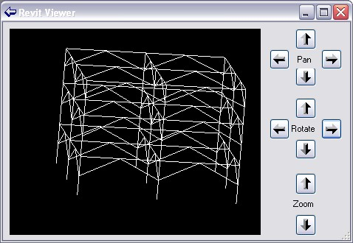
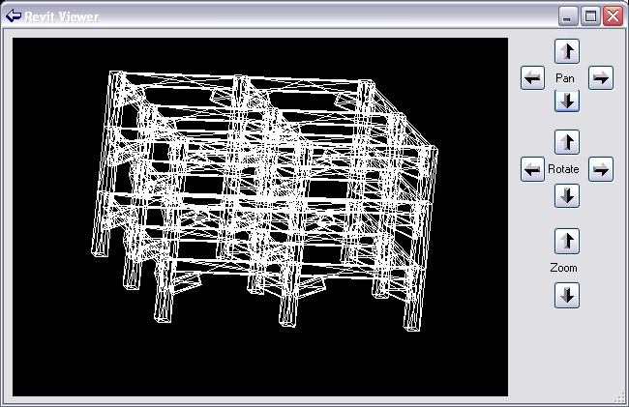
Viewers
AnalyticalViewer Rst
ElementViewer All
RoomViewer All
RevitViewer Utility
ObjectViewer All + Rst
Viewing elements
  Analytical model
  Physical model
Notes:
A good starting point for exploring the different types of geometry of Revit elements is provided by the geometry viewer samples. The Revit SDK currently includes the following viewers:
AnalyticalViewer
ElementViewer
RoomViewer
RevitViewer
ObjectViewer
All the viewers query a selected Revit element for some specific geometry, traverse it, break it down into simple line segments, and render those into a .NET System.Windows.Forms PictureBox. They can all be classified as pretty basic samples. The first four of these are all located in the subdirectory Viewers and are implemented in VB. They were introduced early on in the Revit API, with version 8.0. Of these four, the RevitViewer is a helper class, which implements the actual viewer window which is used by the other three to present three different views of certain subsets of the building model. ObjectViewer was introduced later, in the Revit 9.0 SDK, is written in C#, and defines its own rendering window. Below is an example of the form defined by RevitViewer; in this case, it is being driven by the ElementViewer sample and displaying the wall with a door and two little windows created by the external command defined by Lab2_0_CreateLittleHouse in the Revit API introduction labs. The form looks identical when driven by the AnalyticalViewer and RoomViewer samples, only the content displayed differs.
The AnalyticalViewer is for Revit Structure, to view the analytical building model. The analytical model is generally a simplified approximation of the building structure for structural analysis purposes, which is of most interest to the structural engineer. Revit Structure maintains the analytical model in parallel with the physical model, which is what architects and most other people are interested in.
ElementViewer is designed for all flavours of Revit and displays the standard element geometry.
RoomViewer is a viewer for displaying the two-dimensional outline of a room boundary.
Just like the three viewers, just discussed, ObjectViewer demonstrates viewing elements. It allows the user to select between the analytical and physical model, and also which view to display. You might thus say that it is a combination of the AnalyticalViewer and the ElementViewer with some additional features.
ObjectViewer includes both generic functionality usable in all Revit flavours, as well as some Revit Structure specific functionality. It displays a selected single element in a preview window and retrieves geometry from either the analytical or physical model. It also includes some additional useful odds and ends such as defining an own error message exception handling class and some unit handling functionality. ObjectViewer was originally introduced in Revit 9. Another very similar sample named ObjectViewerII was introduced in 9.1. ObjectViewerII was removed in the 2008.2 SDK update, being very similar to ObjectViewer.
For all of the viewers, the steps to run are similar: simply select the element whose geometry or the room whose boundary to display and start the external command. The analytical viewer will check whether any analytical model is available, which requires Revit Structure functionality. In the case of the ObjectViewer, all display views are listed, the detail level can be selected, and analytical and physical model can be switched.

Slide 38
Revit 9.0 SDK Samples

Slide 39

Revit 9 API Features
Significant API Features
  Element Creation
    Extended list of creatable elements
    All family based elements
    Wall, Floor, Level, Grid
  Track Changes
    Visually display changes performed by the 3rd party application
    Let user accept or reject the changes
Notes:
So in terms new API features displayed there on your screen, it looks like there’s not a lot to see really, but as we all know the newly added to Element creation list is a massive inclusion. We can now create Walls, Floors, Levels, Grids and all Family Based Elements which means that the Revit API is now becoming a very powerful API indeed.
We also have the new Track Changes feature, which at the moment is only available in Revit structure. What it does is to track certain changes to elements across a single API external command, allowing the user to revert the changes back to what they were before a user ran your command. The way you revert a change is by Right-clicking the element you want to revert, and you should see the reversion options displayed there.

Slide 40
Revit 9 New Objects
  Elements
    AreaReinforcement
    AreaReinforcementCurve
    Dimension
    LoadCaseArray/Iterator
    LoadUsage
    LoadUsageArray/Iterator
    View
    View3D
    ViewDrafting
    ViewSection
    ViewSet/Iterator
    ViewSheet
  Symbols
    AreaReinforcementType
    DimensionType
  Objects
    ExternalCommandData
  Geometry
    BoundingBoxXYZ
    ConicalFace
    CylindricalFace
    DoubleArray/Iterator
    HermiteFace
    PlanarFace
    Reference
    ReferenceArray/Iterator
    RevolvedFace
    RuledFace
  Structural
    AnalyticalSupportData
    AnalyticalSupportInfo
    AnalyticalSupportInfoArray/Iterator
    BarDescription

Slide 41
New Creation Methods
  AreaReinforcement
  Dimension
  Structural family instances
  Floor
  Grid
  Level
  LoadCase
  LoadCombination
  LoadNature
  LoadUsage
  View3D
  ViewDrafting
  ViewSection
  ViewSheet
  Wall
Notes:
LoadNature is used to define the type of load as Dead, Live, Seismic, Wind etc.
LoadUsage is used for visibility of loads only.

Slide 42
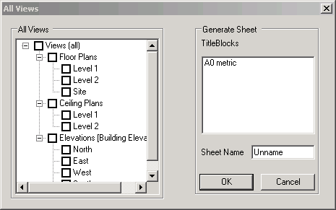
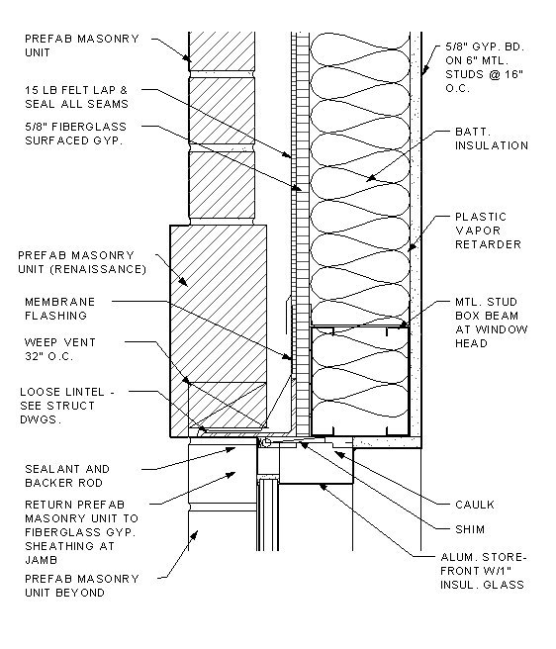
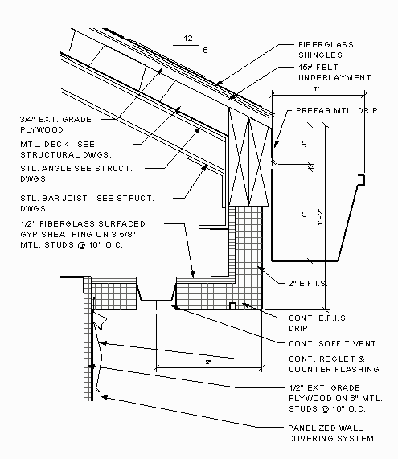
Sheets and Views
AllViews – All
  Find all views in project and display in tree view
  Create a new sheet with selected views
  Demonstrate creating a ViewSheet via NewViewSheet()
Notes:
This sample finds all the views in a project and displays the names in a tree view hosted by the modal dialog that is displayed. The user can select several of the views and when OK is clicked a new sheet is generated that has all the selected views placed in it correctly sized, scaled and aligned.
When the command is executed a dialog appears that contains the following:
a) A tree view represents all the views’ names.
b) A list of all title blocks.
c) An edit box for the sheet’s name.
Note: All views should represent by category, not including schedules, sheets.
Loading the drawing Training\Metric\m_RST_SAVE DETAIL.rvt allows me to produce new sheets of all the elevations.
Extra Usage Notes:
draw a simple model.
check the current status of views and sheet. If there is no sheet, fine.
run the command.
choose views. Click ok.
check under Sheets. You can see a sheet where the selected views are placed.

Slide 43
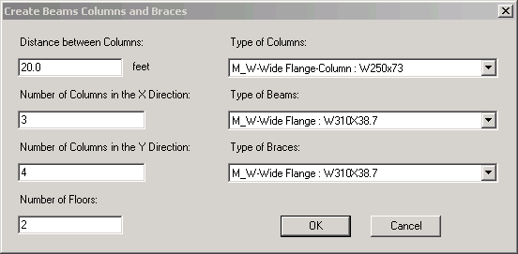
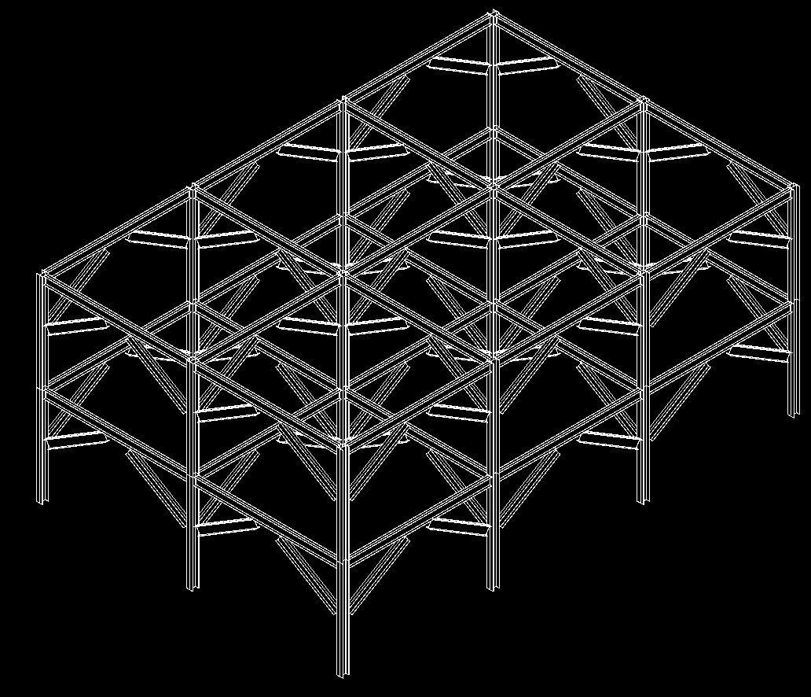
Beams, Columns and Braces
CreateBeamsColumnsBraces – All
  Use NewFamilyInstance() to create structural elements
STRUCTURALTYPE stType = StructuralType.Beam;
// create the beam
FamilyInstance beam = doc.Create.NewFamilyInstance( ref pt, beamType, topLevel, stType );
// assign the location curve to the beam
LocationCurve beamCurve = beam.Location as LocationCurve;
if( null != beamCurve )
{
Line line = app.Create.NewLineBound( ref startPoint, ref endPoint );
beamCurve.Curve = line;
}
Notes:
This sample demonstrates the creation of new objects, in particular the NewFamilyInstance(). Notice that there’s some code below which shows how it’s done.
So lets take a look at the sample to see what it does exactly. Create a new project. Pick elevations to create 5 new levels, run the program.

Slide 44
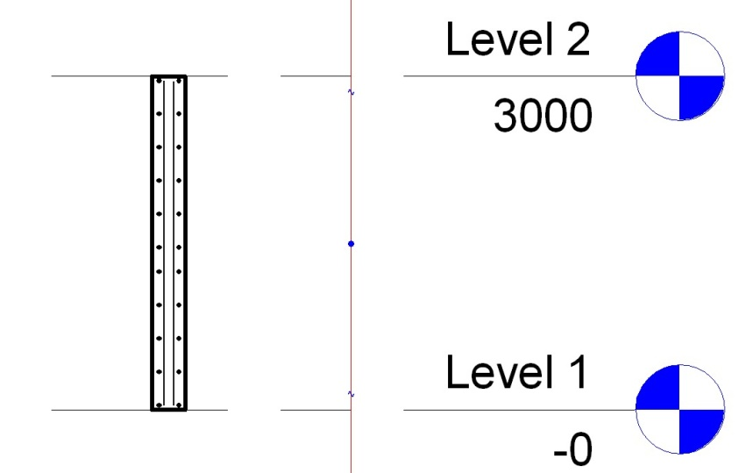
Area Reinforment
CreateSimpleAreaRein – Rst
  Demonstrate creation of AreaReinforcement element
    Uses NewAreaReinforcement()
    Works on slab or wall
AreaReinforcementType symbol = dataOnWall.AreaReinType as AreaReinforcementType;
DocCreator creator = m_revit.Application.ActiveDocument.Create;
// create the area reinforcement
AreaReinforcement areaRein = creator.NewAreaReinforcement( symbol, wall, refer, curves );
Notes:
This sample creates an Area Reinforcement in a rectangular shape on a slab or wall.
Go to 3d view, then draw a wall/floor.
Select it, and execute the command. Accept default and ok. It will add a rebars to the wall/floor. (But it may not be visible.)
Move the cursor to the centre of the wall. You will see a "x" mark with "structural area reinforcement". This is what is added.
Goto Level1, then try creating a section. (View --> New --> Section). if you zoom in the section of a wall, you will see rebars placed inside of the wall.

Slide 45
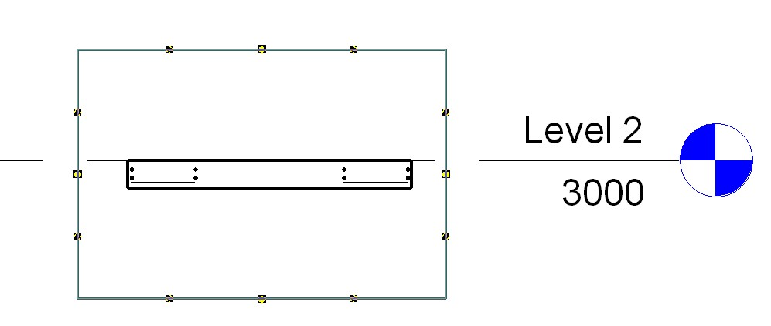
Area Reinforcement
CreateComplexAreaRein – Rst
  Demonstrate creation of AreaReinforcement element
    Uses NewAreaReinforcement()
    Defines opening/cutout in slab
    Only works on slab
Notes:
This sample is very similar CreateSimpleAreaRein, except that it generates a much more complex reinforcement detail and only works for a slab or floor.
The detail is created with all four layers of reinforcement defined and with two nested rectangular curve loops so that it defines a rectangular cutout opening.
On the interior 4 curves, set the override flag and flip the hooks on the top 2 layers to ‘up’, so the bars can hook into some walls around that opening.

Slide 46
Dimensions
CreateDimensions – All
DeleteDimensions – All
  Demonstrate creation and deletion of a dimension
  Uses NewDimension()
// create dimension line geometry
Line newLine2 = new Line( ref point1, ref point2, true );
// create the actual dimension
Dimension newDimension = doc.Create.NewDimension(
doc.ActiveView, newLine2, referenceArray );
Notes:
This sample requires a basic wall to be drawn and selected in order to function.
NOTE: If you are going to use this same inside Structural be aware that, by default, Basic Walls are NOT displayed unless you turn them on. Goto View properties -> Discipline, here it will be set to either Structural or Analytical (this excludes anything not having that model type property) – simply change it to "Architectural" .

Slide 47
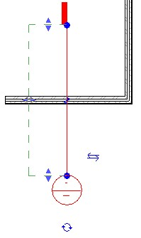
Section View
CreateViewSection – All
  Demonstrate creation of a detail view
  Uses NewViewSection()
  Creates detail view across the midpoint of selected element
  Works on linear element such as slab, wall or beam
// Create a section view:
ViewSection section = m_project.Create.NewViewSection( box );
Notes:
Next we have the CreateViewSection sample; this sample provides a tool for generating a section view across the mid point of a selected element. Draw a wall, beam or floor then select it to run the application.

Slide 48
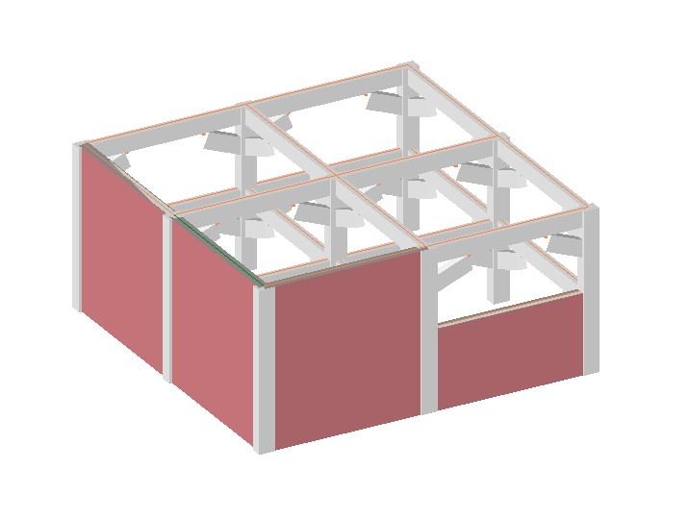
Walls
CreateWallsUnderBeams – All
  Demonstrates creation of walls under selected beams
  Uses NewWall()
  Illustrates the AnalyticalModelFrame class
  How to convert from physical model
Notes:
Create Beams Columns and Braces in Revit Structure. Select one or more of the beams and run the CreateWallsUnderBeams sample. This will create the walls, to show them, switch the shade mode to shaded.

Slide 49
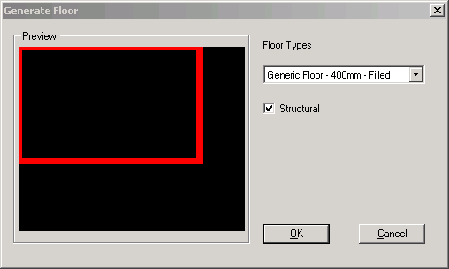
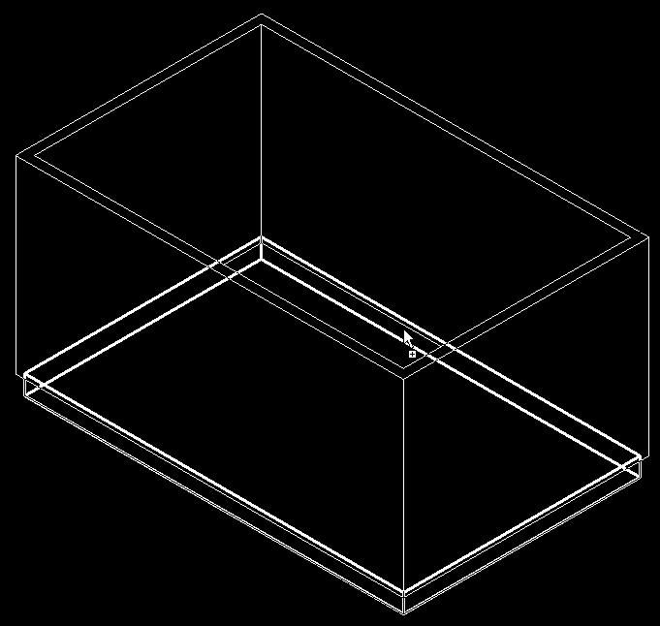
Floors
GenerateFloor – All
  Demonstrates the creation of a floor or slab
  Analyses wall geometry
  Lists applicable floor types
  Uses NewFloor()
// Create a new floor
Floor f = doc.Create.NewFloor( data.Profile,
data.FloorType, data.Level, data.Structural );
Notes:
This sample is very straight forward, you draw a closed room and run the command. You may get the Floor drawn on Level2 so set the properties of each of the walls so that the top constraint is level1 with a base offset of 0.0. Draw a wall, beam or floor then select it to run the application.

Slide 50
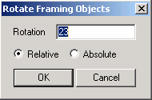
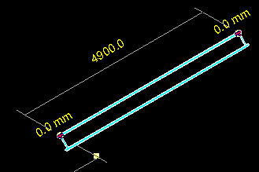
Rotation
RotateFramingObjects – All
  Demonstrates how to rotate elements
  Uses parameter access
// in case of a column
bool result = pointLocation.Rotate( rotateAxis, rotateDegree );
Notes:
This sample is a minimal sample which simply shows how to rotate objects selected from a Revit model via the API. It’s minimal, but answers a frequently asked question. Use Create Beams Columns and Braces to generate some test geometry, now you can run RotateFramingObjects nicely.

Slide 51
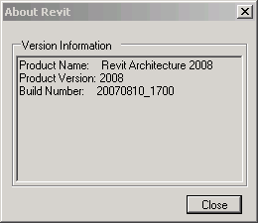
Product Version
VersionChecking - All
  Demonstrates how to access the running product version
  The most requested API feature!
  Allows developers to channel functionality
  Data is built into the Application class
    Version name
    Version number
    Version build

Slide 52
Revit 9.1 SDK Samples

Slide 53
Revit 9.1 API Features
Access to journal file
  Regression testing
Improved handling of units
  Conversion between user interface and internal Revit database units
Ability to suspend updating
  Model can be changed or updated through the API with minimal impact on speed
  Significant performance improvements to element transformations
New Elements
  ModelLine, Material, Opening, ReferencePlane, SketchPlane
Notes:
The information in this presentation has been extracted from the SDK document “Getting Started.doc” and from analysis of the Revit 9.1 SDK samples themselves.
Here are the new features common to both architecture and structure.
There are additional features specific to either one of the two as well. More new elements have been added for structure, we will see those in a moment.
Journal file:
The journal file records all input parameters obrtained from the user during a session. These can be used to rerun a similar session later on without any user interaction. This feature is useful for regression testing, both for Revit itself and for external programs. Therefore, external programs now have read and write access to the data in the Revit journal file.
Units:
DisplayUnitSystem = Is Revit set up to show units in metric or Imperial
DisplayUnitType = Returns the display units for a value
AsValueString = Returns the value properly formatted in the same way that Revit would format the text

Slide 54
Rac 9.1 API Features
Access to rooms
  Find
  Tag
Notes:
Access to rooms have been added which will provide the user with the ability to find rooms that have been defined by the user and number of tag them.
Rooms:
Autodesk.Revit.Elements.Room.Number
Autodesk.Revit.Elements.RoomTag
Autodesk.Revit.Creation.Document.NewRoom
Autodesk.Revit.Creation.Document.NewRoomTag

Slide 55
Rst 9.1 API Features
Define and access boundary conditions
New elements
  Boundary Conditions
  Beam systems
  Path Reinforcement
  Ability to define reinforcement bar sets

Slide 56
Revit 9.1 API Fixes
  NewArc() added to API
  Improved Span Direction API
  Track changes no longer highlights type changes to the same type
  Delete methods now return the ids of the elements deleted
  Grid lines are now available immediately after creation
  Significant performance improvements to element transformations through SuspendUpdating functionality
Notes:
Here is a list of some of the improvements made to existing functionality. Nothing really important if you have not happened to run into a problem with this in an earlier release.

Slide 57
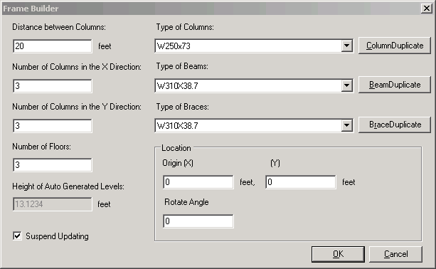
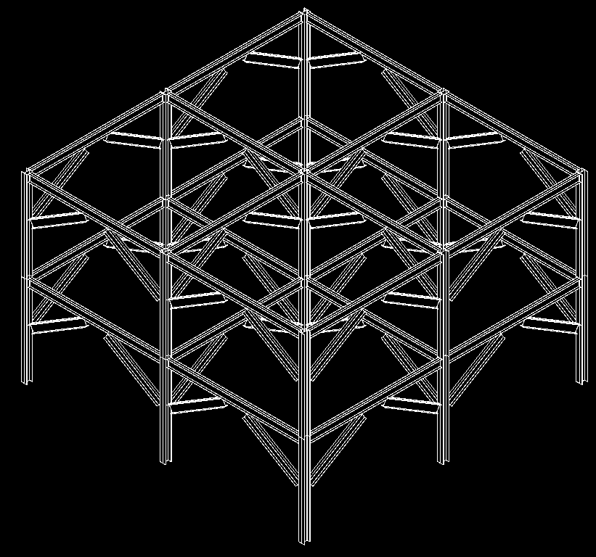
FrameBuilder
FrameBuilder – All
  Composed of floors, levels, columns, beams, braces
  Demonstrates methods
    NewLevel(), NewFamilyInstance()
  Illustrates the SuspendUpdating mechanism
    New SuspendUpdating( doc ), SuspendUpdating.Dispose()
Notes:
This sample is very similar to CreateBeamsColumnsBraces sample. It is enhanced with SuspendUpdating. Also, it creates its own levels if some are missing.
SuspendUpdating mechanism is used to avoid display updating within an operation so as to improve performance. It’s usually used when many entities are created in a single command. Simply run the command in an empty or non-empty drawing, either in architecture or structure.
As far as I know, following is all the API operations SuspendUpdating covers currently:
1. apiRotate (4 overloads)
2. apiMove (4 overloads)
3. apiMirror (5 overloads)
For above transformation operations, SuspendUpdating can benefit performance much when operating on a single element many times in a loop.
But please notice: for batch operation — perform such operations on an ElementSet, because it calls regen only once, suspendupdating do not promote performance any more.
4. Leader
Revit::Leader::End::set
Revit::Leader::Elbow::set
5.FamilyInstance
Revit::Elements::FamilyInstance::StructuralUsage::set
Revit::Elements:: FamilyInstance::flipHand()
Revit::Elements::FamilyInstance:: flipFacing()
Revit::Elements:: FamilyInstance:: Rotate()
6.IndependentTag
Revit::Elements::IndependentTag::TagHeadPosition::set
Revit::Elements::IndependentTag::LeaderElbow::set
Revit::Elements::IndependentTag::LeaderEnd::set
7.TextNote
Revit::Elements::TextNote::Coord::set
Revit::Elements::TextNote::Width::set
8.Wall
Revit::Elements::Wall::WallType::set
Set some parameter may call regen. But parameter change is not covered by suspendupdating currently.

Slide 58
Journaling Mechanism
Journaling – All
  All user actions in Revit are recorded in the journal file
    C:\Program Files\Autodesk Revit Structure 4\Journals
  To rerun journal file
    Drag it onto Revit icon
    Drag it onto open session
    Pass it as command line parameter
  Integrating an external application
    Add and retrieve information to and from journal file
      StringStringMap Autodesk.Revit.ExternalCommandData.Data
      StringStringMap.Insert()
      StringStringMap.Item()
  Example application adds a wall and saves its data
  VBScript-like, work around missing API issues
Notes:
This sample demonstrates the journaling mechanism, integrating an external application into the Revit journaling environment and adding and retrieving information to and from the Revit journal file.
Demonstrates NewLine(), NewWall(), StringStringMap.Insert() used by ExternalCommandData.Data property, the data map that can be used to read and write data to the Autodesk Revit journal file.
1. Run this sample in Revit for the first time. It will ask the user for some data to create a wall, and then record the data into the revit journal file.
Select any wall type, level 2, (0,0,0), (10,0,0).
The journal data is written to
C:\Program Files\Autodesk Revit Building 9.1\Journals\
2. Start Revit from the command line with the path to the journal file as a parameter, or drag and drop the file onto Revit. This sample reads the data in the journal file and recreates a same wall in Revit.
"C:\Program Files\Autodesk Revit Building 9.1\Program\Revit.exe" "C:\Program Files\Autodesk Revit Building 9.1\Journals\journal.0031.txt"
Case ID 1211118 [How to use the journal file]
Revit SPR #122247 some of Journal files in Structure Test Models won't re-play
C:\Program Files\Autodesk Revit Building 9.1\Journals\ >..\Program\Revit.exe journal.0036.txt
Regression Testing
Unknown to many, Autodesk Revit records the operations that the user performs into a text file known as a Journal file. These files can then be used to playback the same operations if Revit is started with the journal filename as part of the command line. If the results of the operations in Revit differ from those that were previously recorded the application will stop and note the failure in the resulting journal file. This process of creating a journal file and then playing it back to ensure that operations remain the same is known as Regression Testing and is quick and simple way of ensuring that you application does not differ from previous known to work versions.
User interface interaction during the external command are not recorded in the journal file so a mechanism has been provided to store a limited mount of data within the journal file when the command finishes so that that data can be passed to the external command when executed via the journal file. The commandData object that is passed to the external command now has a Data property that contains a String to String map to hold such data. If your application sets values in this map they will become stored in the journal file. If this data member contains data when your command is executed then your application should read this data and assume it is being operated from a journal file without user interaction and hence should not pause for any user input at any time thus ensuring that the command can be played back completely programmatically.
Note: currently there is a limitation on the amount of data that can be placed in the Data map.
How to use the Journal File for Regression Testing
All the user actions in a Revit session are recorded to a journal file.
The Journal file is usually located in the Journal folder of the Revit Installation. (Example C:\Program Files\Autodesk Revit Structure 4\Journals)
To rerun the journal file simply drag the file on top of the Revit icon on your desktop or into an open session of Revit.

Slide 59
Model Lines
ModelLines – All
  Report the number of instances of each model line type
  Create new model lines
    Arc, Ellipse, Line, NurbSpline
  New and Modified Classes and Methods
        Autodesk.Revit.Elements.ModelCurveArray
        Autodesk.Revit.Elements.ModelCurveArrayIterator
        Autodesk.Revit.Elements.ModelCurve
        Autodesk.Revit.Elements.ModelArc
        Autodesk.Revit.Elements.ModelEllipse
        Autodesk.Revit.Elements.ModelLine
        Autodesk.Revit.Elements.ModelHermiteSpline
        Autodesk.Revit.Elements.ModelNurbSpline
        Autodesk.Revit.Creation.Document.NewModelCurve
        Autodesk.Revit.Creation.Document.NewModelCurveArray
        Autodesk.Revit.Creation.Application.NewArc
Notes:
In Revit 9.1, we have the possibility to create model lines and curves through the API. In order to create a model line, we have to create the underlying geometry line or curve first. For some of the complex curve types, there is no method available to create the geometry curve from scratch, so those types of model curves have to obtain their underlying geometry corve from some existing object.
The model curve types supported are arc, ellipse, line and hermite and nurb splines.
The hermite spline is required in order to import certain geometry from AutoCAD, it is normally not used by Revit itself.
The two samples are very similar. In ModelLines1, a new sketch plane is created for the new model lines, whereas in ModelLines2, the user may select an existing sketch plane.
Model Lines:
Autodesk.Revit.Elements.ModelCurveArray
Autodesk.Revit.Elements.ModelCurveArrayIterator
Autodesk.Revit.Elements.ModelCurve
Autodesk.Revit.Elements.ModelArc
Autodesk.Revit.Elements.ModelEllipse
Autodesk.Revit.Elements.ModelLine
Autodesk.Revit.Elements.ModelHermiteSpline
Autodesk.Revit.Elements.ModelNurbSpline
Autodesk.Revit.Creation.Document.NewModelCurve
Autodesk.Revit.Creation.Document.NewModelCurveArray
Autodesk.Revit.Creation.Application.NewArc

Slide 60
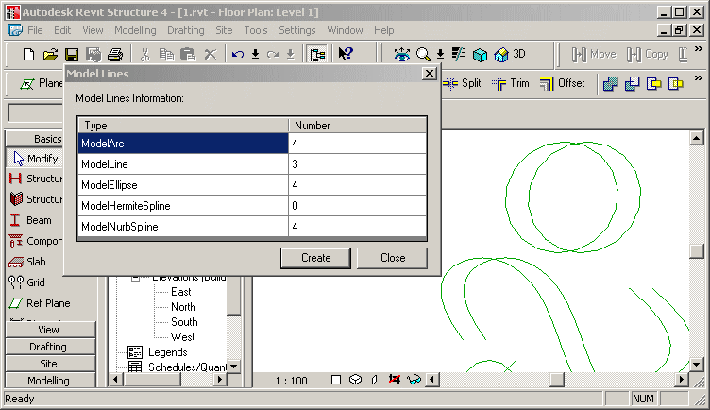
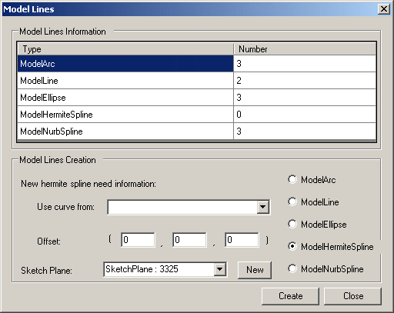
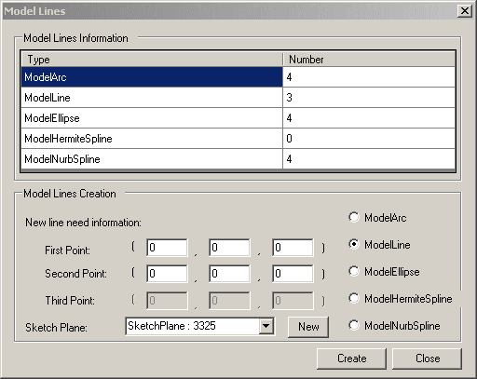
Model Lines
ModelLines – All
  ModelLines1 - creates a new sketch plane for drawing the new model lines on
  ModelLines2 - allows the user to select which existing sketch plane to draw the new lines on and data to use
  You need to draw some ellipses and nurb splines before invoking the command. (these underlying geometry curves cannot be created with Revit API, yet.)
Notes:
Report the number of each model line type and allow the user to create one of each of the following in revit - Arc, Ellipse, Line, HermiteSpline and NurbSpline.
Makes use of Autodesk.Revit.Elements.ModelCurveArray.cs and an own helper class ModelCurveCounter.
Demonstrates the API calls NewSketchPlane(), NewArc(), NewLine(), NewModelCurve(), NewCurveArray(), NewModelCurveArray(),
Draw some ellipses, hermite and nurb splines before invoke the command, because the geometry curves of these cannot be created with Revit API.
Creates a new sketch plane for drawing the new model lines on.
ModelLines2 is similar to ModelLines1, but allows the user to select which existing sketch plane to draw the new lines on.

Slide 61
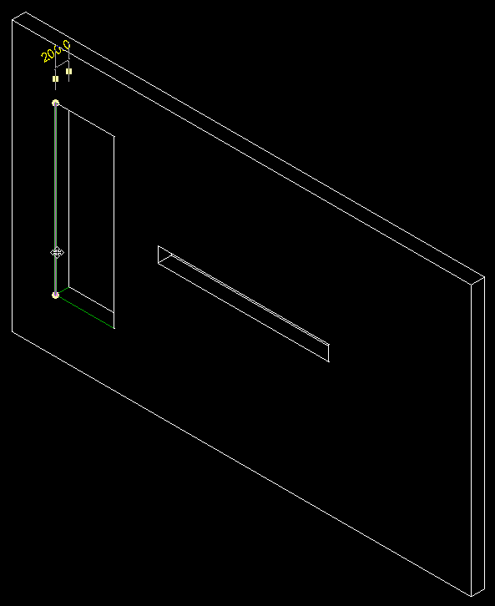
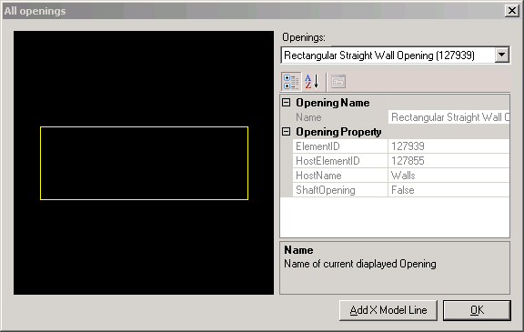
Openings
Openings – All
  New API calls to access openings
    Using family based elements or shafts
  Sample displays openings and creates model lines on edges
    Generic and Opening-specific helper classes
    Vector, UCS, Line2D, Line3D, LineSketch, ObjectSketch
    WireFrame to implement an own little mini graphics system
    OpeningProperty, OpeningInfo
Notes:
Draw a wall, add one tall narrow and one low wide opening, run the command.
In the dialogue box, you can select any one of the openings in the model. It is displayed in a preview window. Clicking ‘Add X Model Line’ causes the application to draw model lines on the edges of the opening. For a rectangular opening in a planar wall, this will draw 12 model lines.
Bug: the model lines are in the wrong place if the wall is not axis aligned.
How to see the model lines created by this sample after running it? Use the tooltips on the 12 edges of the selected opening.
Description: Display openings in project and create X model lines on them.
Readme:
Autodesk Revit API application: Openings
This is a really minimal sample that shows how to get the property of an opening, show its profile in preview a window and create model lines on it. All the interesting code is in Openings project. Openings.cs contains the code to implement drawing. The WireFrame class retrieves the element profile.
To build the *.dll, edit project properties and make sure additional reference component include the Revit.dll in Revit Structure 4 installation directory. Then, paste the contents of Revit.ini into Revit.ini. Launch Revit, note the Tools -> External Tools -> Openings Commands menu.
This sample implements some generic helper classes Vector, UCS, Line2D, Line3D, LineSketch, ObjectSketch, WireFrame to implement an own little mini graphics system:
Vector: Point class use to store point coordinate value and get the value via (x, y ,z)property.
UCS: User coordinate system.
Line2D, Line3D: Line classes to represent a geometry segment line.
ObjectSketch: base class of sketch object to draw 2D geometry object, manages bounding box, pen and transformation.
LineSketch: sketch line and any tag on it.
WireFrame: class to generate the model lines and fit the picture box's size to display.
This sample implements some Opening-specific helper classes OpeningProperty, OpeningInfo
bug:
start revit
open 1.rvt
start openings
select one opening
select create x lines
close the dialogue
--> one opening is displayed on the revit screen with a black background
click View > Refresh
--> the whole screen turns black
it only happened once, when i was debugging a lot, and suspended the computer midway.

Slide 62
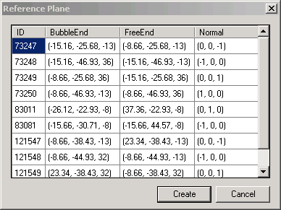
Reference Plane
Reference Plane – All
  Report all reference planes in the current project
  Show their ID, bubble end, free end, and normal
      ReferencePlane class
  Create a new reference plane at the left face of the selected wall or at the bottom of selected slab
      NewReferencePlane() method
Notes:
I ran this in C:\a\j\adn\train\revit\mep\test\Urban House MEP.rvt.
Reference Planes and Sketch Planes
Autodesk.Revit.Creation.Application.NewPlane
Autodesk.Revit.Creation.Application.NewPlane
Autodesk.Revit.Creation.Document.NewReferencePlane
Autodesk.Revit.Creation.Document.NewReferencePlane2
Autodesk.Revit.Creation.Document.NewSketchPlane

Slide 63
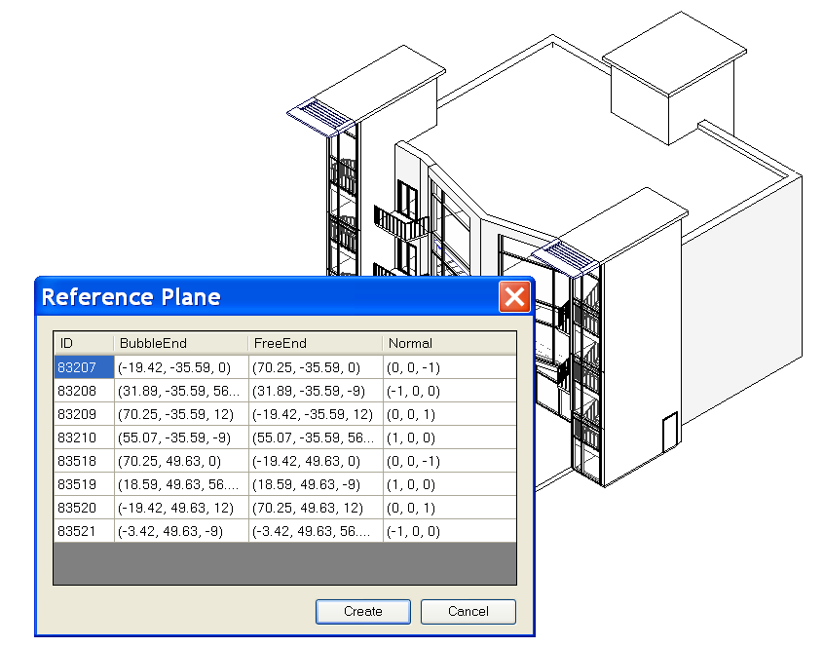
Reference Plane
Reference Plane – All
Notes:
Steps:
0. Open a .RVT file containing reference plane objects, e.g m_CoHouse.rvt in the training folder.
1. Run the external command.
2. A dialog will appear to report all reference planes in the current project, showing its ID, bubble end, free end, and normal.
3. If a wall or a slab is selected before the command is run, when Create button is clicked, a reference plan will be created at the left face of the wall or at the bottom of the slab.
4. After the new reference plan is created, we can list it out by running the command again.

Slide 64
Accessing Room Elements
Rooms – All
  Report room information: ID, Name, Number, Level, Department, Area, Have tag
    Room class
  Create a tag for a room if it has none
      NewRoomTag() method
Notes:
Rooms:
Autodesk.Revit.Elements.Room.Number
Autodesk.Revit.Elements.RoomTag
Autodesk.Revit.Creation.Document.NewRoom
Autodesk.Revit.Creation.Document.NewRoomTag

Slide 65
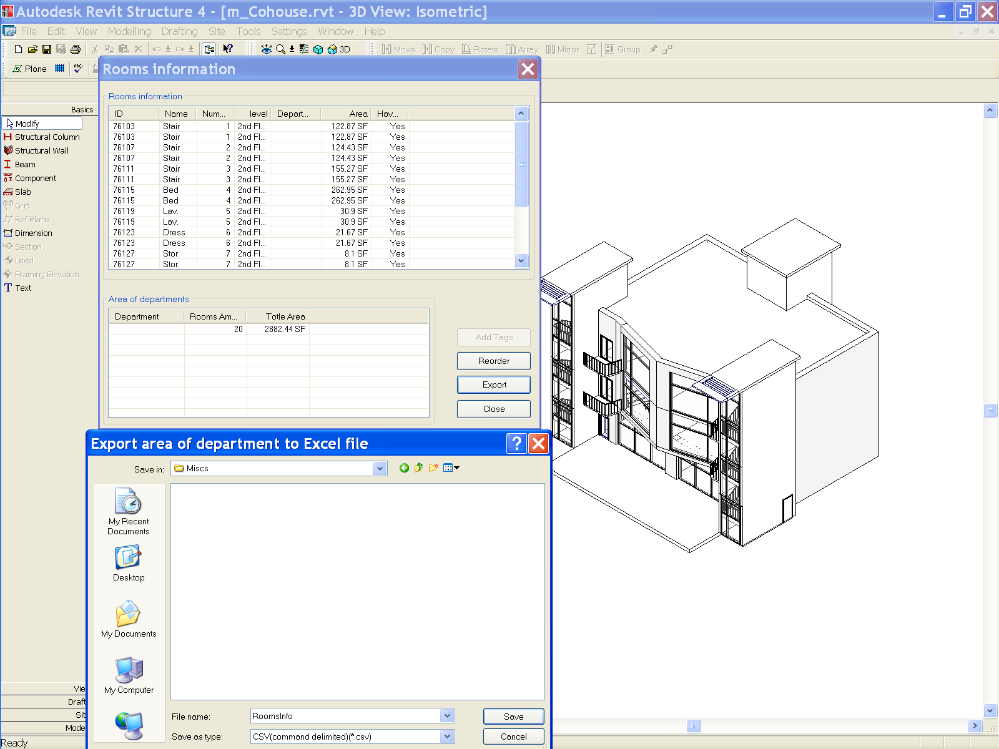
Accessing Room Elements
Rooms – All
Notes:
Steps:
0. Open a .RVT file containing room objects, e.g m_CoHouse.rvt in the training folder.
1. Run the command. A dialog will display the information of all rooms.
2. Create room tags and add them to the rooms which are lack of tags.
3. Reorder the number of all rooms by ascending order from ground floor to high floor, from left to right.
4. Calculate the rooms area for each department and export the result to an Excel document.
Why are there duplicates in the list above?

Slide 66
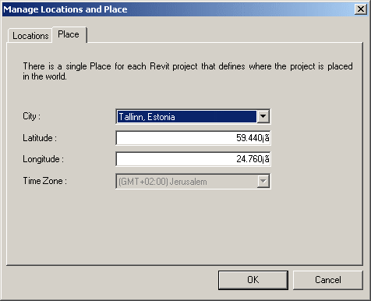
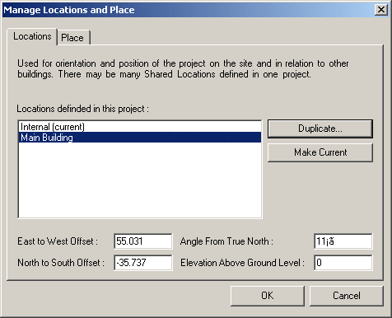
Location and Place
SharedCoordinateSystem – All
  Display project location and site information
  Similar to UI access, now API is available as well
    [Settings] --> [Manage place and locations...]
Notes:
Display the locations and site information of the project.
1. Show the project location and site information for current project.
2. Users can set the values to change the location.
3. In the Project Browser, open a 2D plan view of the project. Click View menu and select View Properties, set the view orientation to True North.
4. On the Tools menu, click Shared Coordinates and select Acquire Coordinates.
To avoid the warning that timezone.txt could not be found, copy
R:\Samples\SharedCoordinateSystem\CS\timezone.txt
to
R:\Samples\SharedCoordinateSystem\CS\bin\Debug\timezone.txt
(1) where do you see this in UI.
This sample seems to be duplicating a two dialogs that you see in:
[Settings] menu --> [Sun and Shadows settings...] --> [Still] tab in [Name] --> click on the right-down arrow next to the [Place] under [By Date, Time and Place] toggle button,
You will see the very similar dialog there.
Actually, a better place to reach this info in UI is
[Setting] --> [Manage place and locations]
(2) what you see with External command?
If you duplicated the site location in the external command, you will see it there in the UI, too.
(3) implications
This is added for the Japanese developer who is developing Sun and Shadow Analysis. (Mikako logged this wish for GSA) In Japan, Sun and Shadow Analysis is the Must document. While revit has a long list of locations in ww, you couldn't have a more precise locations in earlier versions. (I think this is enhancement in UI, too. I don't remember exactly how it looked though...) So the developer can add more cities in Japan for exact locations.
The UI seems the same as 9.0, but there was no API to access this in the past.

Slide 67
Boundary Conditions
BoundaryConditions – Rst
  Define and access boundary condition in the model
  New and modified classes and methods
        Autodesk.Revit.Elements.BoundaryConditions
        Autodesk.Revit.Creation.Document.NewPointBoundaryConditions
        Autodesk.Revit.Creation.Document.NewLineBoundaryConditions
        Autodesk.Revit.Creation.Document.NewLineBoundaryConditions
        Autodesk.Revit.Creation.Document.NewAreaBoundaryConditions
        Autodesk.Revit.Creation.Document.NewAreaBoundaryConditions
Notes:
Now we come to the structure-only samples.

Slide 68
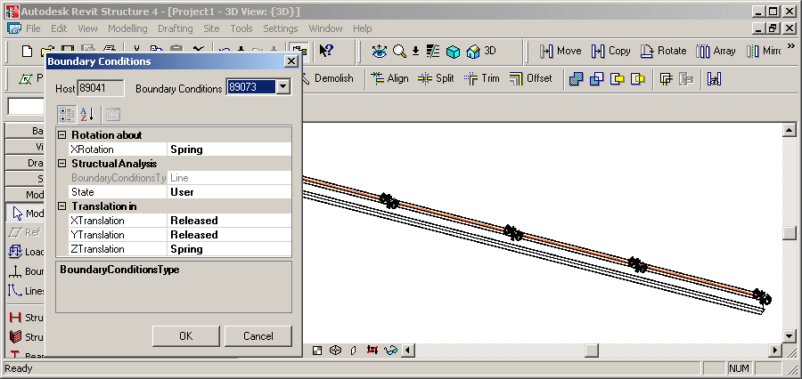
Boundary Conditions
BoundaryConditions – Rst
  Display boundary conditions parameters
  Create new boundary conditions
Notes:
Create a Structural Wall or Beam element.
Open a 3D view to see the analytical model, pointing out that no boundary conditions are set.
Select it.
Invoke the command.
Since it has no boundary conditions to start with, new ones are created and can be modified through the dialogue.
Set some boundary conditions.
Close the dialogue and point out that BCs have been added.
Autodesk Revit API application: BoundaryConditions
1. Firstly, user should select a structure element.
2. Invoke external command.
3. If the selected element has boundary conditions the parameters of the boundary conditions (BC) are presented. And users are also allowed to set these parameters with other valid values.
4. If the selected element does not have a BC then create one.
The sample set the conversion between the internal value and display value fit to Imperial unit.
Create a few walls in structural. Select one of them. Start the command.
The command checks whether exactly one element has been preselected and exits with an error message otherwise.
The method IsStructuralElement() determines whether the selected element is structural. To do so, it checks whether its class is one of FamilyInstance, Wall, Floor, or ContFooting, and whether it has a non-null AnalyticalModel property.
The boundary conditions for the selected element are collected from the database and saved in a dictionary in a BoundaryConditionsData instance, which also knows the host element, the dictionary key BC id.
If no boundary conditions have been set for the selected element, a suitable set of BCs are created when loading the form, in BoundaryConditionsForm_Load().
New boundary conditions are created by CreateBoundaryConditions(): point, line, and area.
Exercise the new API calls NewPointBoundaryConditions(), NewLineBoundaryConditions(), NewAreaBoundaryConditions().
The BoundaryConditionsData class has a member data object BCProperties which determines the data displayed by the ui PropertyGrid.
BCProperties knows about certain BC parameter values rules according to the Revit main program as well.
This sample also includes some sample boundary condition families: Boundary Conditions Fixed.rfa, Boundary Conditions Pinned.rfa, Boundary Conditions Roller.rfa, Boundary Conditions User.rfa
These families seems to be similar to the built-in boundary conditions?
This sample seems to be similar to the built-in boundary conditions command?

Slide 69
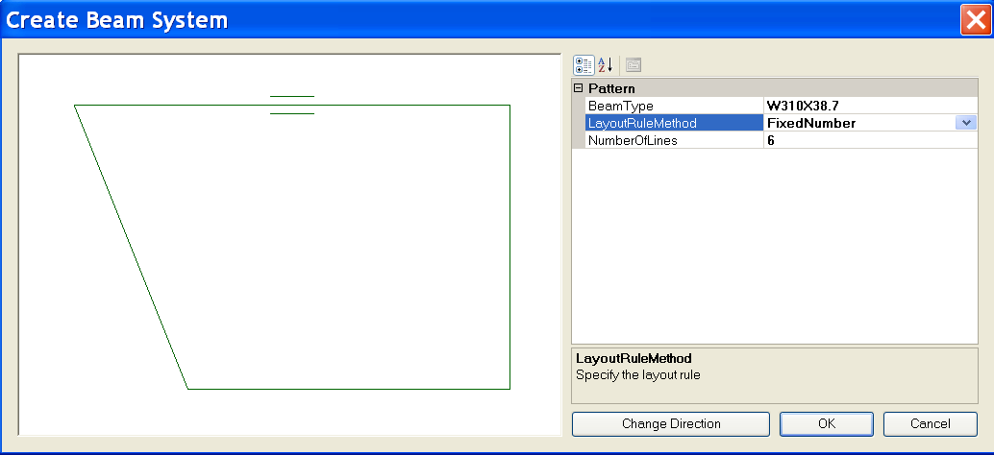
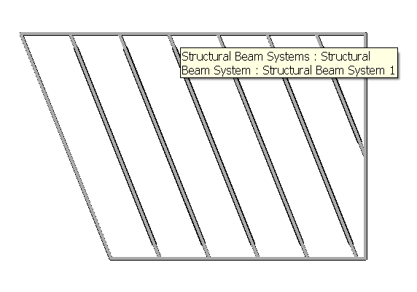
Create Beam System
CreateBeamSystem – Rst
  Demonstrate creation of a beam system
  Based on some connected framing beams
  Uses NewBeamSystem()
  Illustrates the BeamSystem class
  How to convert from physical model
Notes:
Steps:
0. Create a few beams connecting to each other to form a loop.
1. Select all these beams before running the command.
2. Invoke the external command.
Choose layout method and beam type in the dialog.
Change the direction of the beam system if necessary.
Click OK button to create the beam system.
Note: The spacing of the beam system may not be easy to specify especially when you create the beams on the fly. You can choose FixedNumber LayoutRuleMethod in the Create Beam System dialog to make things easier.
Beam Systems:
Autodesk.Revit.Elements.BeamSystem
Autodesk.Revit.Elements.LayoutRule
Autodesk.Revit.Elements.LayoutRuleFixedDistance
Autodesk.Revit.Elements.LayoutRuleFixedNumber
Autodesk.Revit.Elements.LayoutRuleMaximumSpacing
Autodesk.Revit.Elements.LayoutRuleClearSpacing
Autodesk.Revit.Creation.Document.NewBeamSystem

Slide 70
Create Foundation Slab
FoundationSlab – Rst
  Create octagonal foundation slabs for selected floors at the base of the building
  Demonstrate Autodesk.Revit.Creation.Document.NewFloor()
  Parameter BuiltInParameter.STRUCTURAL_FLOOR_ANALYZES_AS
    '4' suggests foundation slab
Notes:
This sample requires a floor at the lowest level of the building.
In a new drawing, draw three structural walls forming a closed triangle. Draw a slab by walls on level 1, pick the three walls. Run the command.
(1) New drawing.
(2) Basics > Structural Wall > Click, Click, Click, Click.
(3) Double click Structural Plans > Level 1.
(4) Basics > Slab > Pick Walls > Click, Click, Click, Finish Sketch.
(5) Tools > External Tools > Foundation Slab.
This sample iterates over the current building model and assembles the following data:
// A set of levels to find out the lowest level of the building.
SortedList<double, Level> m_levelList = new SortedList<double,Level>();
// A set of views to find out the regular slab's bounding box.
List<View> m_viewList = new List<View>();
// A set of floors to find out all the regular slabs at the base of the building.
List<Floor> m_floorList = new List<Floor>();
// A set of regular slabs at the base of the building.
// This set supplies all the regular slabs' datas for UI.
List<RegularSlab> m_allBaseSlabList = new List<RegularSlab>();
// A set of the types of foundation slab.
// This set supplies all the types of foundation slab for UI.
List<FloorType> m_slabTypeList = new List<FloorType>();
It defines a helper class Sketch for drawing slabs and floors profiles into a WinForms PictureBox instance.
It calculates the bounding box of each floor, calculates an octagonal slab shape enclsing its bounding box.
On clicking OK, the original floor is replaced by an octagonal foundation slab.
Demonstrates the API call NewFloor().
Deletes the original floor.

Slide 71
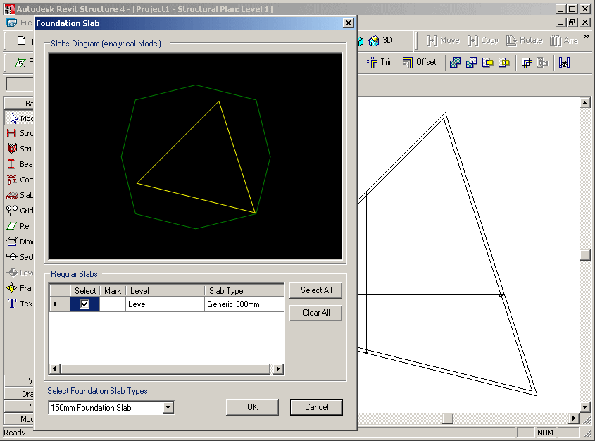
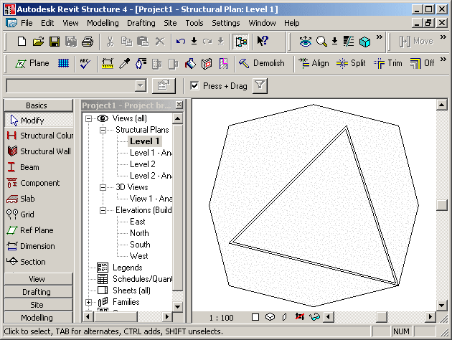
Foundation Slab
FoundationSlab – Rst
  Extracts all floors and levels, determines lowest ones
  Determines existing regular slab’s bounding box
  Determines available foundation slab types
  Implements a helper class Sketch for drawing slabs and floors profiles into a WinForms PictureBox instance
  Calculates an enclosing octagonal slab shape

Slide 72
Structural Element Material
Materials – Rst
  All available materials can be obtained by the property Materials of Setting object
  All material parameters can be retreived using
        Autodesk.Revit.Parameters.BuiltInParameter parameterId;
        get_Parameter( parameterId );
  One BuiltInParameter couples with one parameter
  Structural Units are demonstrated as well
  Materials2 is very similar to Materials1. No identity, misc. properties
  Works with Structure – uses analytical model and “Beam Material”, “Column Material” properties
  Currently, it won’t work with wall and floor:
  SPR #122487: Material API - doesn't reflect after changed
Notes:
Materials:
Autodesk.Revit.Color
Autodesk.Revit.FillPatternSet
Autodesk.Revit.FillPatternSetIterator
Autodesk.Revit.MaterialSet
Autodesk.Revit.MaterialSetIterator
Autodesk.Revit.Materials
Autodesk.Revit.Elements.FillPattern
Autodesk.Revit.Elements.Material
Autodesk.Revit.Elements.MaterialConcrete
Autodesk.Revit.Elements.MaterialGeneric
Autodesk.Revit.Elements.MaterialOther
Autodesk.Revit.Elements.MaterialSteel
Autodesk.Revit.Elements.MaterialWood
Autodesk.Revit.Settings.FillPatterns
Autodesk.Revit.Settings.Materials
Autodesk.Revit.Creation.Application.NewFillPatternSet
Autodesk.Revit.Creation.Application.NewColor
Autodesk.Revit.Creation.Document.NewMaterialSet

Slide 73
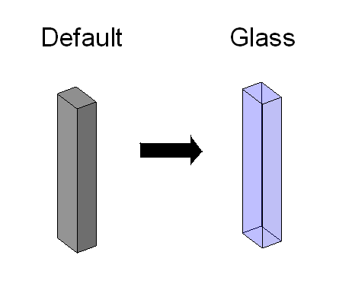
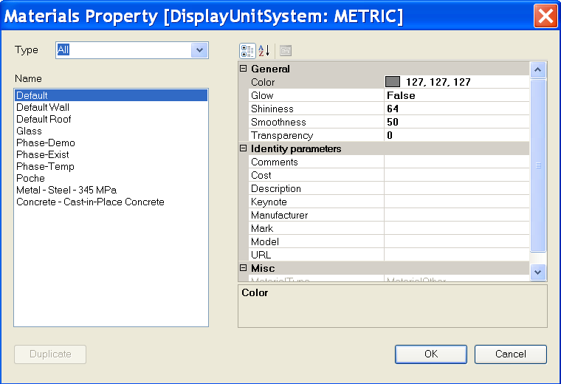
Structural Element Material
Materials – Rst
Notes:
Steps:
0. Create a structure element such as a column.
1. Select the structure element.
2. Run the external command.
3. All available materials in the current project will be listed out in a form.
4. Choose a material other than the previous one and press OK button.
5. The material of the structure element will be changed.
Note: Users can duplicate a concrete material which is not light weight.
Materials:
Autodesk.Revit.Color
Autodesk.Revit.FillPatternSet
Autodesk.Revit.FillPatternSetIterator
Autodesk.Revit.MaterialSet
Autodesk.Revit.MaterialSetIterator
Autodesk.Revit.Materials
Autodesk.Revit.Elements.FillPattern
Autodesk.Revit.Elements.Material
Autodesk.Revit.Elements.MaterialConcrete
Autodesk.Revit.Elements.MaterialGeneric
Autodesk.Revit.Elements.MaterialOther
Autodesk.Revit.Elements.MaterialSteel
Autodesk.Revit.Elements.MaterialWood
Autodesk.Revit.Settings.FillPatterns
Autodesk.Revit.Settings.Materials
Autodesk.Revit.Creation.Application.NewFillPatternSet
Autodesk.Revit.Creation.Application.NewColor
Autodesk.Revit.Creation.Document.NewMaterialSet

Slide 74
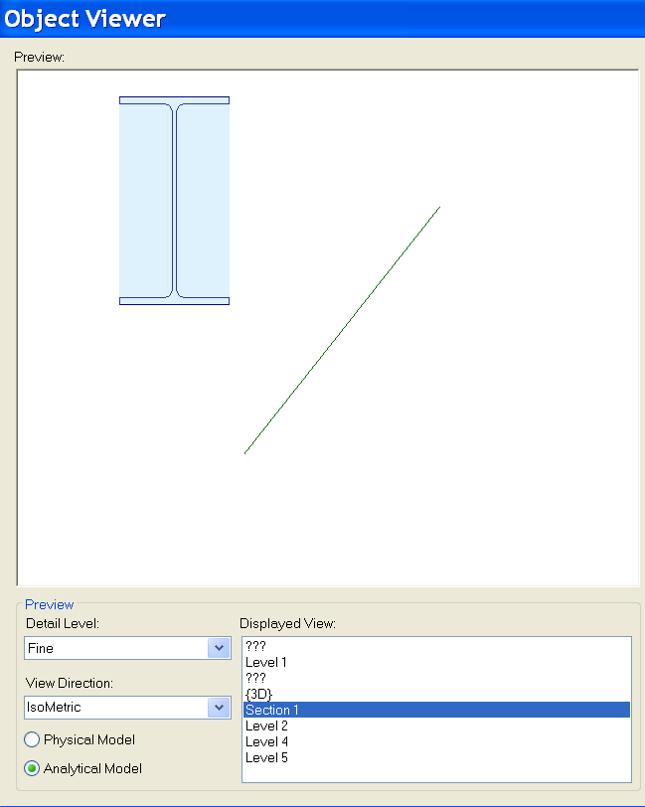
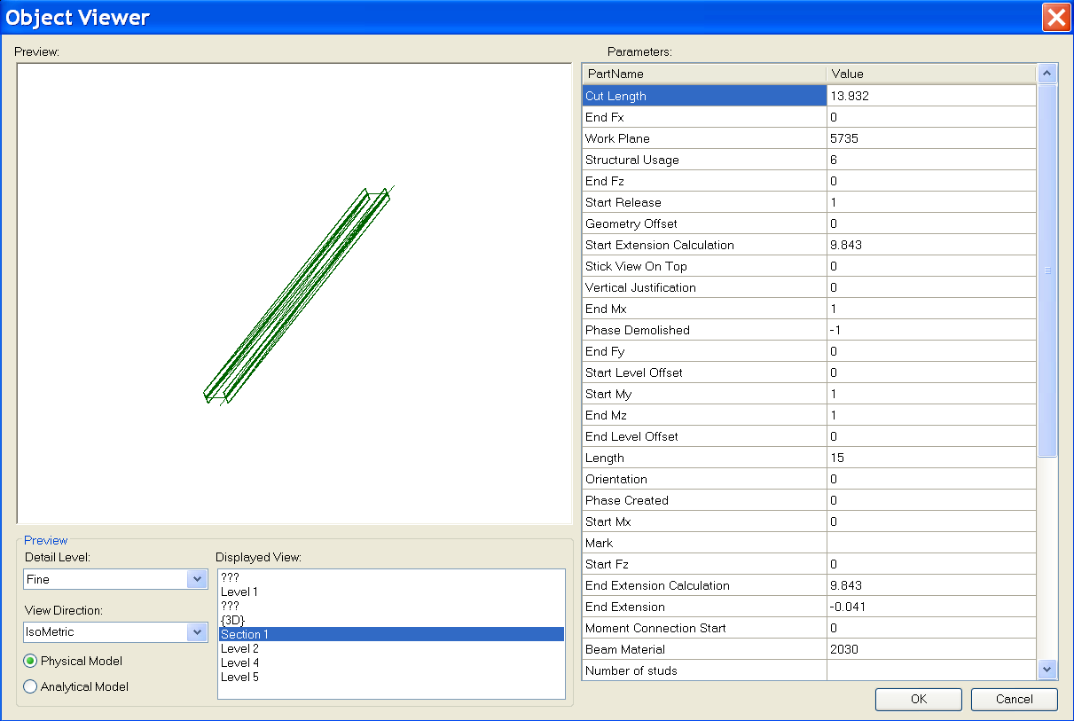
ObjectViewer
ObjectViewer – was ObjectViewerII – All + Rst-specific functionality
Display a selected single element in a preview window
Retrieve geometry from both physical and analytical model
Define an own error message exception handling class
Demonstrate unit handling
Notes:
Steps:
1. Select a structure element such as a beam.
2. Run the external command.
3. All Display Views are listed out. Detail Level can be chosen; Physical Model and Analytical Model can be switched.

Slide 75
Rebar in a Beam or Column
Reinforcement – Rst
  Path reinforcement classes and methods
        Autodesk.Revit.Elements.PathReinforcementCurve
        Autodesk.Revit.Elements.PathReinforcement
        Autodesk.Revit.Symbols.PathReinforcementType
        Autodesk.Revit.Elements.SketchPlan
        Autodesk.Revit.Elements.ReferencePlane
        Autodesk.Revit.Elements.Opening
        Autodesk.Revit.Geometry.Plane

Slide 76
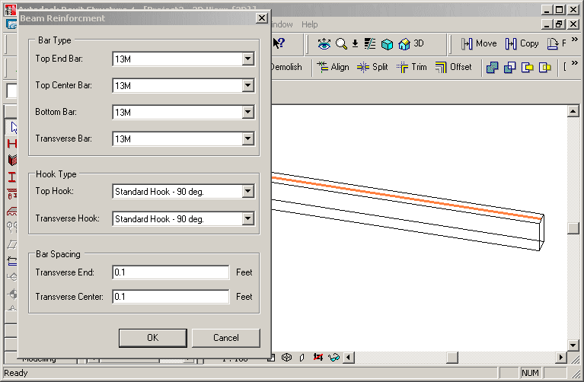
Rebar in a Beam or Column
Reinforcement – Rst
  Create reinforcement rebars in selected non-reinforced concrete beam or column
    Beam rebar: top, bottom or transverse
    Column rebar: transverse or vertical
Notes:
Start Revit Structural, create a concrete beam, run the command.
Create reinforcement rebars on the selected concrete beam or column without reinforcement.
Create bar set in a selected concrete element (beam or column) that does not have any reinforcement.
1. Create bar set in a selected concrete element (beam or column) that does not have any reinforcement.
2. Beam rebar should be three kinds: top rebar, bottom rebar and transverse rebar.
3. Column rebar should be two kinds: transverse rebar and vertical rebar.
The class FrameReinMakerFactory does all the work, such as perform precondition testing
and create a corresponding FrameReinMaker and the reinforcement rebars.
Precondition checks include: is the selected object a beam or column, is it made of concrete, does it already contain any Rebar elements.
Two further classes do the work depending on host type: BeamFramReinMaker and ColumnFramReinMaker.
GeomUtil: basic geometric utility methods.
GeometrySupport: base class for BeamGeometrySupport and ColumnGeometrySupport, manages the solid of beam or column, the extend or sweep path of the beam or column, the director vector of beam or column, lists to store the edges and points, the transformation etc.
ParameterUtil: utility methods find or set certain parameter.

Slide 77
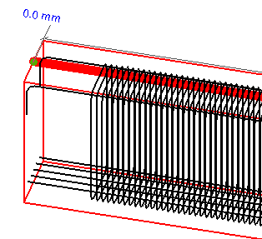
Rebar in a Beam or Column
Reinforcement – Rst
FrameReinMakerFactory class does all the work
  Precondition checks
    Is the selected object a beam or column?
    Is it made of concrete?
    Does it already contain any rebar elements?
  Create a corresponding FrameReinMaker and the reinforcement rebars
Host-dependant working classes
  BeamFramReinMaker and ColumnFramReinMaker
GeomUtil
  Basic geometric utility methods
GeometrySupport
  Base class for BeamGeometrySupport and ColumnGeometrySupport, manages the solid of beam or column, the extend or sweep path of the beam or column, the director vector of beam or column, lists to store the edges and points, the transformation etc.
ParameterUtil
  Utility methods find or set certain parameter
Notes:
Start Revit Structural, create a concrete beam, run the command.
Create reinforcement rebars on the selected concrete beam or column without reinforcement.
Create bar set in a selected concrete element (beam or column) that does not have any reinforcement.
1. Create bar set in a selected concrete element (beam or column) that does not have any reinforcement.
2. Beam rebar should be three kinds: top rebar, bottom rebar and transverse rebar.
3. Column rebar should be two kinds: transverse rebar and vertical rebar.
The class FrameReinMakerFactory does all the work, such as perform precondition testing
and create a corresponding FrameReinMaker and the reinforcement rebars.
Precondition checks include: is the selected object a beam or column, is it made of concrete, does it already contain any Rebar elements.
Two further classes do the work depending on host type: BeamFramReinMaker and ColumnFramReinMaker.
GeomUtil: basic geometric utility methods.
GeometrySupport: base class for BeamGeometrySupport and ColumnGeometrySupport, manages the solid of beam or column, the extend or sweep path of the beam or column, the director vector of beam or column, lists to store the edges and points, the transformation etc.
ParameterUtil: utility methods find or set certain parameter.

Slide 78
Units
New and updated methods
  Autodesk.Revit.Document.DisplayUnitSystem
  Autodesk.Revit.Parameter.DisplayUnitType
  Autodesk.Revit.Parameter.AsValueString
Notes:
Improved handling of units
Shelter the user from the internal Revit database units
DisplayUnitSystem = Is Revit set up to show units in metric or Imperial
DisplayUnitType = Returns the display units for a value
AsValueString = Returns the value properly formatted in the same way that Revit would format the text
Units:
Autodesk.Revit.Document.DisplayUnitSystem
Autodesk.Revit.Parameter.DisplayUnitType
Autodesk.Revit.Parameter.AsValueString

Slide 79
Revit 2008 SDK Samples

Slide 80
APIAppStartup
Demonstrates start up and shut down events (C#)
  Interface IExternalApplication
        public class AppSample : IExternalApplication
  IExternalApplication.OnStartup() event
        IExternalApplication.Result
        IExternalApplication.OnStartup(ControlledApplication application)
        {
        String version = application.VersionName;
        // display splash window for 10 seconds
        SplashWindow.StartSplash();
        SplashWindow.ShowVersion(version);
        System.Threading.Thread.Sleep(10000);
        SplashWindow.StopSplash();
        return IExternalApplication.Result.Succeeded;
        }
  IExternalApplication.OnShutdown() event
        IExternalApplication.Result
        IExternalApplication.OnShutdown(ControlledApplication application)
        {
        MessageBox.Show("Quit External Application");
        return IExternalApplication.Result.Succeeded;
        }
Notes:
Note:
Please do not forget to use the latest version of the APIAppStartup sample. Its beta version is INCOMPLETE!
It works with both Architecture and Structure.
In the callback of the IExternalApplication.OnStartup() event, displays a splash screen.
In the callback of the IExternalApplication.OnShutdown() event, displays a dialog box.

Slide 81
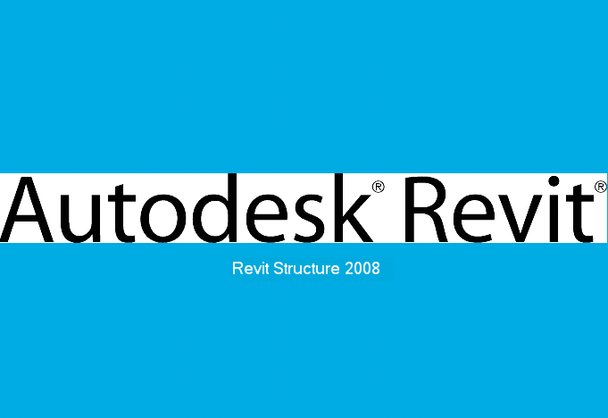
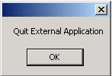
APIAppStartup Demo
Notes:
Steps:
1. Make sure the sample is registered as an external application. For example:
[ExternalApplications]
EACount=1
EAClassName1=APIAppStartup.AppSample
EAAssembly1=C:\Revit\SDK\Samples\APIAppStartup\bin\Debug\APIAppStartup.dll
2. Launch Revit 2008. Notice the splash screen will show up.
3. Quit Revit. Notice the dialog will show up.
4. Click OK to exit.

Slide 82


ApplicationEvents
Subscribe to application events and create custom menus (C#)
Modeless dialogue handling
  Classes
        Autodesk.Revit.Events.ApplicationEvents
        Autodesk.Revit.MenuItem
        Autodesk.Revit.Application
        Autodesk.Revit.Document
  Events
        DocumentClosedEventHandler
        DocumentOpenedEventHandler
        DocumentSavedEventHandler
        DocumentSavedAsEventHandler
  Interface
        public class RevitApplicationEvents : Autodesk.Revit.Events.ApplicationEvents
  Event callbacks
        public RevitApplicationEvents(Application app)
        {
        if (null != app)
        {
        app.OnDocumentClosed += new DocumentClosedEventHandler(OnDocumentClosed);
        app.OnDocumentOpened += new DocumentOpenedEventHandler(OnDocumentOpened);
        app.OnDocumentSaved += new DocumentSavedEventHandler(OnDocumentSaved);
        app.OnDocumentSavedAs += new DocumentSavedAsEventHandler(OnDocumentSavedAs);
        }
        m_eventsLog = CreateEventsLogTable();
        }
Notes:
The sample creates one custom top level menu and one sub-menu when Revit application starts up and uses this sub menu to show or hide a modeless window which displays the Revit application object events’ history log.
This sample will subscribe to Application’s document open, close, save and save as events.
This sample lists document’s opened, closed, saved or saved as information in a modeless window when the document is opened, closed, saved or saved as.
This sample creates a custom top level menu named "MyCustomTopMenu". And below this top menu a menu named "Track Revit Application Events" is created too to show and hide the modeless window.
Implementations:
The class which answers for adding custom menus must implement IExternalApplication interface. And the custom menus should be created in OnStartup method.
Application.CreateTopMenu method and MenuItem.Append method can be used to create custom menu.
OnDocumentOpened, OnDocumentClosed,OnDocumentSaved and OnDocumentSavedAs event handlers of Application class can be used to subscribe to relevant events.

Slide 83
Toolbar
Demonstrates how to create a toolbar (C# and VB.NET)
  Derive from the IExternalApplication interface
        class CreateToolbar : IExternalApplication
  Implement the OnStartup method
        public IExternalApplication.Result OnStartup(
        ControlledApplication application )
  Create a toolbar
        Application.NewToolbar()
  Add a button
        Toolbar.AddItem(MenuItem)
  Toolbar commands are implemented with the interface
        IExternalCommand
Notes:
This sample provides the following functionalities:
Add a custom toolbar with three buttons into Revit and Use Application.NewToolbar() to create the Toolbar via API.
Between the second button and the third button there is a separator.
Every button should have a corresponding command to execute. The command should implement the interface of IExternalCommand.
The first button will create a wall. Use Toolbar.AddItem(MenuItem) to add this button .
The second button will delete all walls in current project. Use Toolbar.AddItem(String, String) to add this button .
The third button will pop up a dialog box and show some information about Customer Toolbar.
There are two types of ToolbarItem, the third button has image only and the others two have both image and text.
Every button has a ToolTip when mouse on it.
Every button has a tip in Revit status bar to describe the button usage when it gets focus.
Implementation Notes
The command, which will be executed when the ToolbarItem button is clicked, should derive from IExternalCommand.
The Toolbar can be created via API: Application.NewToolbar().
The ToolbarItem button can be added via API: Toobar.AddItem(MenuItem) or Toobar.AddItem(String, String).
The separator is a ToolbarItem too, we can use AddItem(nullptr) to create this separator; or we can set the ToolbarItem’s ToolbarItemType property with ToolbarItemType::BtnSeparator.
The Image property of toolbar will affect the image of each ToolbarItem. Besides, the ImageIndex of toolbar will affect the image of ToolbarItem too.
ToolbarItem.ToolTip can set the tip when mouse move on the ToolbarItem button.
ToolbarItem.StatusbarTip can set the tip in Revit status bar when the ToolbarItem button gets focus

Slide 84

AutoTagRooms
  C# Sample
  Get all rooms in a specified level
  Get all room tags in the current document
  Create new room tags with specified type
  Auto tag all rooms in a specified level
  Classes
        Autodesk.Revit.IExternalCommand
        Autodesk.Revit.Elements.Room
        Autodesk.Revit.Elements.RoomTag
        Autodesk.Revit.Symbols.RoomTagType
        Autodesk.Revit.Creation.Document
  Code
        RoomTag newTag = doc.Create.NewRoomTag(
        tmpRoom, ref point );
Notes:
This sample demonstrates three main features:
How to get all rooms in a specified level.
How to get all room tags in current document.
How to create new room tags with specified room tag type to auto tag all rooms in a specified level.
Add these lines to revit.ini file.
[ExternalCommands]
ECCount= 1
ECName1= Rooms Tag
ECClassName1= Revit.SDK.Samples.RoomsTag.CS.Command
ECAssembly1= RoomsTag.dll
ECDescription1= Auto tag all rooms in a specified level.
Steps:
Draw some rooms in different levels.
Run this command.
A dialog will be shown to display all the levels that have rooms, all the room tag types, all rooms in the selected level and the count of room tags of each type.
Select a level and a room tag type. Click the "Auto Tag All" to auto tag the rooms in the level.
Click "OK" button to accept the new created room tags or click "Cancel" button to abort them.

Slide 85

BlendVertexConnectTable
  Retrieve all vertices and vertex connection edges of blend family (C#)
  Classes
        Autodesk.Revit.IExternalCommand
        Autodesk.Revit.Elements.GenericForm
        Autodesk.Revit.Elements.Blend
        Autodesk.Revit.Elements.View
        Autodesk.Revit.Elements.FamilyInstance
        Autodesk.Revit.Geometry.Transform
        Autodesk.Revit.Geometry.Curve
        Autodesk.Revit.Geometry.XYZ
Notes:
This sample uses Autodesk.Revit.Elements.GenericForm, Blend and View classes mostly to get the blend family from selected solid blend mass, to retrieve the vertex connect edges and sketches of blend, to display the vertex connect information in form.
The blend object can be retrieved from FamilyInstance.Symbol.Family.SolidForms.
Top sketch and bottom sketch can be retrieved from Blend.TopSketch and Blend.BottomSketch properties.
Blend.FirstEnd and Blend.SencondEnd can be used to get Z coordinate values of bottom sketch and top sketch.
The Geometry.Element can be retrieved from Blend.get_Geometry(Geometry.Options).
GeometryObjectArray can be retrieved from Gometry.Element.Objects.
Geometry.Solid can be retrieved from Geometry.GeometryObject.
Geometry.Edge objects can be retrieved from Geometry.Solid.Edges.
To get projection matrix of current view, use properties RightDirection, UpDirection, ViewDirection of View and method Inverse of Transform.
Steps:
Register the command:
[ExternalCommands]
ECCount = 1
ECName1 = Blend Vertices and Vertex Connection Table
ECClassName1 = Revit.SDK.Samples.BlendVertexConnectTable.CS.Command
ECAssembly1 = C:\Revit\SDK\Samples\BlendVertexConnectTable\bin\Debug\BlendVertexConnectTable.dll
ECDescription1 = Get Blend Vertices and Vertex Connection Table.
Draw a solid blend form mass (Revit Structure 2008 User's Guide > Creating Your Own Components (Families) > Family Editor > Solid Geometry Tools > Creating Solid Blends).
Select the mass, and then run the command.
In the popped up form the PictureBox control paints the vertex connect edges of blend in blue color, paints all edges of sketch in black color, marks the top and bottom vertexes with "Tn" and "Bn" strings; the DataGridView control shows the vertex connect information.
User can reorder the DataGridView columns to see the connection information in different orders.

Slide 86


CurvedBeam
  Create curved beams (C#)
  Classes
        Autodesk.Revit.IExternalCommand
        Autodesk.Revit.Elements
        Autodesk.Revit.Creation.Document
        Autodesk.Revit.Symbols.FamilySymbol
        Autodesk.Revit.Elements.FamilyInstance
        Autodesk.Revit.Elements.Level
        Autodesk.Revit.LocationCurve
        Autodesk.Revit.Geometry.Arc
        Autodesk.Revit.Geometry.Ellipse
        Autodesk.Revit.Geometry.NurbSpline
        Autodesk.Revit.Geometry.XYZ
  Code
        m_revit.Create.NewArc( ref center, radius, startAngle, endAngle, ref xAxis, ref yAxis );
        m_revit.Create.NewEllipse( ref center, radX, radY, ref xVec, ref yVec, param0, param1 );
        NurbSpline detailNurbSpline = m_revit.Create.NewNurbSpline( ctrPoints, weights, knots, 3, false, true );
        beam = m_revit.ActiveDocument.Create.NewFamilyInstance( ref center, fsBeam, level, StructuralType.Beam ); // Beam according to curve
Notes:
This sample uses FamilySymbol, FamilyInstance, LocationCurve, Arc, Ellipse and NurbSpline classes mostly to get all structural framing types and levels from Revit project, create new beam and change the curve of new beam.
To get all structural framing types and levels of Revit, use ActiveDocument.Elements property.
To get all symbols of one family, use Family.Symbols property.
To get category of family symbols, use FamiySybol.Category property.
To create arc, ellipse and nurbspline, use NewArc, NewEllipse and NewNurbSpline methods of Autodesk.Revit. Creation.Document class respectively.
To create new beam instance, use NewFamilyInstance method of Autodesk.Revit.Creation.Document class.
To get location and curve of beam, use Location property of FamilyInstance class.
To change the curve of beam, use Curve property of LocationCurve class.
Steps
[ExternalCommands]
ECCount = 1
ECName1 = CurvedBeam
ECDescription1 = Create Curved Beam...
ECClassName1 = Revit.SDK.Samples.CurvedBeam.CS.Command
ECAssembly1 = CurvedBeam.dll
1) Build the *.dll, edit project properties and make sure additional reference component include the RevitAPI.dll in Revit installation directory.
2) Paste the contents of Revit.ini into Revit.ini. Launch Revit, execute the "Curved Beam..." command.
3) Select the type of beam, the level. Edit the position where you want to put the curved beam. Then click button "Arc", "Partial Ellipse" or "Nurbspline" to create corresponding type of beam.

Slide 87

FamilyExplorer
  Display the profile (if applicable) of all families (C#)
  Classes
        Autodesk.Revit.Elements.Family
        Autodesk.Revit.Elements.GenericForm
        Autodesk.Revit.Geometry.Edge
        Autodesk.Revit.Geometry.Transform
Notes:
Functionality:
List all families in the current document, including the in-place family.
Display the profile of the selected family with different colors, black for components, gray for others, green for solid forms, and yellow for void forms.
List all parameters of the selected family.
Implementation:
All families can be retrieved from method get_Elements(Type) of class Document, it provides access to all elements of specified type within the Document.
The family profile can be retrieved from the four properties of object Family:
Components, Others, SolidForms and VoidForms.
Components is an element set of all components that belong to a Family.
Others is an element set of all other components that belong to a Family.
SolidForms is a generic form set of all solid forms that belong to a Family.
VoidForms is s generic form set of all void forms that belong to a Family.
The geometry can be retrieved from the property Geometry of object Element or object GenericForm.
The components should be transformed according to UCS.
The viewer supports pan by click and drag and rotate by shift-click and drag.

Slide 88


Framing Builder
Create a frame composed of columns, beams and braces (C#)
    private void NewBeam( UV point2D1, UV point2D2, Level baseLevel, Level topLevel )
    {
    // calculate the start point and end point
    // of Beam's location line in 3D
    double height = topLevel.Elevation;
    XYZ startPoint = new XYZ( point2D1.U, point2D1.V, height );
    XYZ endPoint = new XYZ( point2D2.U, point2D2.V, height );
    // create Beam and set its location
    FamilyInstance beam = m_docCreator.NewFamilyInstance(
    ref startPoint, m_data.BeamSymbol, topLevel,
    StructuralType.Beam );
    SetLocationLine( beam, startPoint, endPoint );
    }
Notes:
This sample creates a frame.
It presents a dialog to the user asking for the following information:
Distance between columns
Number of Columns in the X direction
Number of Columns in the Y direction
The type of the columns
The type of the beams
The type of the braces
Number of Floors
The codes should verify that the number of floors is not more than the number of levels since columns will be inserted from the level below to the level above. For example if the number of floors requested is 3, then there must be 4 levels and the columns will go from Level 1 to 2, Level 2 to 3 and Level 3 to 4. If there are not enough levels tell the user the number of levels that must be added and exit the command with a failure.
Starting with the lowest level and progressing to higher levels, insert columns with the specified type into the project programmatically in an array format based on the number of columns specified in the X and Y directions with the correct specified distance between them. Do this for each floor specified.
Insert beams of the specified type between the tops of each adjacent column in the X and Y direction to form a square grid of beams. Beams are not needed between diagonal columns.
Insert braces of the specified type between the mid point of each column and the mid point of each adjoining beam.
User can create a new concrete element type through duplicating specified type. The work flow is as follows:
Press the Duplicate button in the dialog;
Change name of column’s type and press OK;
Change value for b and h of section in another dialog and press OK;
Similar steps can be followed for concrete/wood beams and braces.

Slide 89




ImportExportDWG
Export the current project to DWG files
Import a DWG file into Revit (C#)
  Methods
        exported = doc.Export(folder, name, views, dwgExportOptions);
        imported = doc.Import(m_importFileName, dwgImportOption, ref element);
Notes:
//parameter : DWGExportOptions dwgExportOptions
DWGExportOptions dwgExportOptions = new DWGExportOptions();
dwgExportOptions.ExportingAreas = m_exportOptionsData.ExportAreas;
dwgExportOptions.ExportOfSolids = m_exportOptionsData.ExportSolid;
dwgExportOptions.FileVersion = m_exportFileVersion;
dwgExportOptions.LayerMapping = m_exportOptionsData.ExportLayerMapping;
dwgExportOptions.LineScaling = m_exportOptionsData.ExportLineScaling;
dwgExportOptions.MergedViews = m_exportMergeFiles;
dwgExportOptions.PropOverrides = m_exportOptionsData.ExportLayersAndProperties;
dwgExportOptions.SharedCoords = m_exportOptionsData.ExportCoorSystem;
dwgExportOptions.TargetUnit = m_exportOptionsData.ExportUnit;
//parameter: DWGImportOptions
DWGImportOptions dwgImportOption = new DWGImportOptions();
dwgImportOption.ColorMode = m_importColorMode;
dwgImportOption.CustomScale = m_importCustomScale;
dwgImportOption.OrientToView = m_importOrientToView;
dwgImportOption.Placement = m_importPlacement;
dwgImportOption.ThisViewOnly = m_importThisViewOnly;
dwgImportOption.Unit = m_importUnit;
dwgImportOption.View = m_importView;
dwgImportOption.VisibleLayersOnly = m_importVisibleLayersOnly;
//parameter: Element
Element element = new Element();
In terms of the last parameter of the function Import, we don’t have to care much about it. And, we do not have to create a new element prior calling an Import method. We can simply pass a variable of Element type and it could be a nullptr. It is just a way if giving you back the element that was just imported. For example, say you import an image, since the import method does give you no scaling nor rotating option, if you happen to need such things you would have to do that manually after the image is imported.

Slide 90
InplaceFamilyAnalyticalModel3D
Display in-place family instance information
  Instance name
  Family name and type
  Analytical model 3D curve
Notes:
Description:
Iterate through the selection, picking out family instances that have a 3D analytical model.
Output family instance information.
Family name (use FamilyInstance.Symbol.Family.Name).
Family Symbol name (use FamilyInstance.Symbol.Name).
Family Instance name (use FamilyInstance.Name)
Use FamilyInstance.AnalyticalModel property to access the analytical model and judge if the type is AnalyticalModel3D. And output the curve of this AnalyticalModel3D.
Instructions:
Create an in-place structure column that has AnalyticalModel.
Select some elements in which the in-place structure column is included.
Run this sample.
Expected result: the selected column’s basic information and the AnalyticalModel3D curves information will be dumped to output window.

Slide 91



NewOpenings
  Demonstrates how to create openings (C#)
  Classes
        Autodesk.Revit.Creation.Application
        Autodesk.Revit.Creation.Document
        System.Drawing.Graphics
        Autodesk.Revit.Elements.Wall
        Autodesk.Revit.Elements.Floor
  Code
        // draw opening on wall with two points
        Autodesk.Revit.Creation.Document doc;
        doc.NewOpening( m_data, ref p1, ref p2 );
        // create opening on floor according to curves
        doc.NewOpening( m_data, curves, true );
Notes:
This sample uses Document.NewOpening method to create openings on the selected Wall or Floor. The profile can be created with NewCurveArray, NewArc and NewLine methods of Application.
Steps:
Register the command:
[ExternalCommands]
ECCount=1
ECName1=New Openings
ECClassName1=Revit.SDK.Samples.NewOpenings.CS.Command
ECAssembly1=NewOpenings.dll
ECDescription1=create openings on the selected floor or wall
Select a wall or a floor.
Run the command.
Draw the opening profile on the preview panel. Click the mouse middle button to switch tools, to draw a line, rectangle, arc or circle.
Click "Ok" button, openings will be created on the wall or floor.

Slide 92


NewPathReinforcement
  Create PathReinforcement (C#, for Structure only)
  Classes
        Autodesk.Revit.Elements.PathReinforcement
        Autodesk.Revit.Symbols.PathReinforcementType
        Autodesk.Revit.Geometry.Face
        Autodesk.Revit.Geometry.Edge
        Autodesk.Revit.Geometry.Solid
        Autodesk.Revit.Geometry.Element
  Code
        Options = Autodesk.Revit.Creation.Application.NewGeometryOptions();
        Geometry.Element geoElem = elem.get_Geometry( options );
        GeometryObjectArray geobs = geoElem.Objects;
        PathReinforcementType pathReinforcementType = m_docCreator.NewPathReinforcementType();
        m_docCreator.NewPathReinforcement( pathReinforcementType, host, CurveArray, bool );
Notes:
This sample demonstrates creating a PathReinforcement
1. Get geometrical data from FamilyInstance
Autodesk.Revit.Geometry.Element geoElem = Element.Geometry(Options);
GeometryObjectArray gObjects = Autodesk.Revit.Geometry.Element.Objects
2. How to create PathReinforcement.
NewPathReinforcement(PathReinforcementType, Element, CurveArray, bool) method:
Use Document.Create.NewPathReinforcementType() method to create one PathReinforcementType if there is no PathReinforcementType in current document.
Element here stands for the host of the PathReinforcement, a wall or a floor.
CurveArray stores the Path of the PathReinforcement.
bool value indicates the PathReinforcement lies to which side of Path.
[ExternalCommands]
ECCount = 1
ECName1 = NewPathReinforcement
ECClassName1 = Revit.SDK.Samples.NewPathReinforcement.CS.Command
ECAssembly1 = NewPathReinforcement.dll
ECDescription1 = Create PathReinforcement on wall or slab.
Steps:
Draw a Structure Wall or Slab and select it.
Run this command.
Draw the path of PathReinforcement you want to create, user can click right mouse button to finish drawing.
Click the "Preview" will preview the path reinforcement will be created.
Select or unselect "Flip" check box to create PathReinforcement on the left or right side of the path which you drawn.
Click "Create" button will create PathReinforcement when you finish the path.
User can clean and redraw the sketch of path when click "Clean" button.

Slide 93

PathReinforcement
  Retrieve curves, profile and properties of path reinforcement object (C#)
  Classes
        Autodesk.Revit.IExternalCommand
        Autodesk.Revit.Elements.PathReinforcement
        Autodesk.Revit.Symbols.RebarBarType
        Autodesk.Revit.Elements.ModelCurve
Notes:
This sample will get path reinforcement from active document and display its properties in a dialog. Curves of path reinforcement will be displayed in picture box and other data be displayed in property grid. The geometry data can be got by "Curves" property of path reinforcement and other properties can be got by "get_Parameter" and "Parameters" methods.

Slide 94

ProjectInfo
Demonstrate how to get and set the current project information (C#)
  Classes
        Autodesk.Revit.Document
        Autodesk.Revit.Elements.ProjectInfo
        Autodesk.Revit.Elements.gbXMLParamElem
        Autodesk.Revit.Parameters.BuildInParameter
        Autodesk.Revit.Parameters.BuildingType
  Properties
        Document.ProjectInformation
        ProjectInfo.gbXMLSettings
Notes:
This program displays a form with all information of the current project information, including gbXml Settings, and allows the user to modify them.
1. Display the current project information including gbXml Settings.
2. Allow the user to modify all the information.
3. User can change the buildingType by choosing one from a list of available types.

Slide 95

ProjectUnit
  C#
  List project units and format information
  Set decimal separator and slope type
  Classes
        Autodesk.Revit.IExternalCommand
        Autodesk.Revit.Elements.ProjectUnit
        Autodesk.Revit.FormatOptions
Notes:
Display the decimal symbol type of current project units and users can set it to comma or dot.
Display the slope type of current project units and users can set it to Rise or Angle.
List all the units in current project and display each unit’s format information.
List all the available Unit Discipline of current project in a list box
Classify the project units by the Unit Discipline
When users select one Unit Discipline in the list box to display the corresponding project units name (such as Length or Area) and its format information. The format information includes the display unit type (such as DUT_KIP_FEET_PER_DEGREE_PER_FOOT), the unit suffix type (such as UST_NONE), and the rounding (such as 0.2).

Slide 96
RDBLink
  C#
  Export and import Revit data to/from ODBC database
  Modify or create Revit elements
  Extensive documentation in ReadMe_RDBLink.rtf
Notes:
This sample demonstrates how to export Revit model data into ODBC database and how to import data from database into Revit to modify or create Revit models, getting and setting Revit parameter values. The sample takes advantage of DataSet, DataAdapter and CommandBuilder to implement database inserting, updating and deleting operations. There is only one external command. Import and export data function are triggered by clicking dialogue buttons.

Slide 97
RoomSchedule
  C#
  Retrieve spread sheet data
  Create rooms without placing them
  Update spreadsheet data with room data
  Uses OleDb.OleDbConnection and OleDb.OleDbCommand to synchronize spreadsheet based room schedule with Revit rooms
  Implements two commands: import room schedule from spreadsheet and update room area fields in spreadsheet by using data from Revit
  Classes
    Room, Level, Phase, Category, BuiltInParameter, Definition, DefinitionGroup, InstanceBinding, DocumentSaveEventHandler, DocumentSaveAsEventHandler, DocumentCloseEventHandler
    System.Data.OleDb.OleDbConnection, OleDbCommand, DataTable
Notes:
This sample demonstrates how to retrieve spreadsheet data in excel, how to create rooms programmatically in Revit and how to update spreadsheet data with room properties. It also demonstrates how to create shared parameters, how to get all rooms in each PlanTopology and how to use the document event handler.
The sample uses OleDb.OleDbConnection, OleDb.OleDbCommand, DataTable and relevant Revit classes to synchronize spreadsheet based room schedule with Revit rooms. It implements two commands: import room schedule from spreadsheet and update room area fields in spreadsheet.

Slide 98


ShaftHolePuncher
Create shaft opening on a wall, floor or beam
        NewOpening()

Slide 99

SpotDimension
  Retrieve all spot dimensions and properties in all views (C#)
  Classes
        Autodesk.Revit.IExternalCommand
        Autodesk.Revit.Elements.SpotDimension
        Autodesk.Revit.Parameter
        while (elementIterator.MoveNext())
        {
        object obj = elementIterator.Current;
        //find all the SpotDimensions and views
        SpotDimension tmpSpotDimension = obj as SpotDimension;
        if (null != tmpSpotDimension)
        {
        m_spotDimensions.Add(tmpSpotDimension);
        if (m_views.Contains(tmpSpotDimension.View.ViewName) == false)
        {
        m_views.Add(tmpSpotDimension.View.ViewName);
        }
        }
        }
Notes:
Steps:
Register the command:
[ExternalCommands]
ECCount=1
ECName1=SpotDimension
ECClassName1 = Revit.SDK.Samples.SpotDimension.CS.Command
ECAssembly1 = C:\Revit\SDK\Samples\SpotDimension\CS\bin\Debug\SpotDimension.dll
ECDescription1 = Get all the spot dimensions in the all views and show each spot dimension's properties.
First draw an element (for example a wall), and then draw some spot dimensions with Revit Menu Command: Drafting->Spot Dimension tool in Revit UI.
Load and run the SpotDimension.dll.
Select a view to show all the spot dimensions in that selected view. And then select a spot dimension to show its properties in a DataGridView at the bottom of the dialog.
Select a spot dimension, and then close the dialog to return Revit, then the spot dimension will be highlighted afterwards.

Slide 100



TagBeam
  Create tags at the start and end of selected beams (C#)
  Classes
        Autodesk.Revit.IExternalCommand
        Autodesk.Revit.Elements.FamilyInstance
        Autodesk.Revit.LocationCurve
        Autodesk.Revit.Elements.Family
        Autodesk.Revit.Symbols.FamilySymbol
        Autodesk.Revit.Creation.Document
        Autodesk.Revit.Elements.IndependentTag
  Methods
        FamilyInstance.Location.Curve.EndPoint()
        IndependentTag tag = docCreator.NewTag(
        m_view, beam, leader, tagMode,
        tagOrientation, curve.get_EndPoint(0) );
Notes:
This sample demonstrates how to create tags at the start and end of selected beams.
Tags’ Properties of leader 、TagMode、TagOrientation can be changed through the dialog.
The selected beam object is retrieved from Document.Selection.
The available Family belonging to the three tag mode--tag by Category, Multi-Category Tag and Material tag is retrieved from Document.Elements by judging familySymbol’s category.
The start point and the end point can be retrieved from FamilyInstance.Location.Curve.EndPoint[] property.
Use Autodesk.Revit.Creation.Document.NewTag(View, Element, Boolean, TagMode, TagOrientation, XYZ) method to create tag.
[ExternalCommands]
ECCount = 1
ECName1 = TagBeam
ECClassName1 = Revit.SDK.Samples.TagBeam.CS.Command
ECAssembly1 = TagBeam.dll
ECDescription1 = "Tag beam's start and end."
Steps:
1. Draw some beams and select them.
2. Run this command.
3. Select tag mode--tag by Category, Multi-Category Tag or Material tag, and then select the tag family symbol of this mode. Select the tag orientation and chooses whether tags have leaders.
4. Click "OK" button to tag beam‘s start and end or click "Cancel" button to abort them.

Slide 101


TestFloorThickness
  Retrieve and change floor thickness (VB.NET)
  Classes
        Autodesk.Revit.Elements.Floor
        Autodesk.Revit.Symbols.FloorType
  Code
        If TypeOf element Is Autodesk.Revit.Elements.Floor Then
        Dim floor As Autodesk.Revit.Elements.Floor = element
        Dim layer As Autodesk.Revit.Structural.CompoundStructureLayer
        For Each layer In floor.FloorType.CompoundStructure.Layers
        layer.Thickness = layer.Thickness * 10
        Next
        End If
Notes:
Logic:
Find the first selected floor.
Go through each layer of the compound structure of the floor, set its thickness as 10 times as itself.

Slide 102


TestWallThickness
  Retrieve and change wall thickness (VB.NET)
  Classes
        Autodesk.Revit.Elements.Wall
        Autodesk.Revit.Symbols.WallType
  Code
        If TypeOf element Is Autodesk.Revit.Elements.Wall Then
        Dim wall As Autodesk.Revit.Elements.Wall = element
        For Each layer In wall.WallType.CompoundStructure.Layers
        layer.Thickness = layer.Thickness * 10
        Next
        End If
Notes:
Logic:
Go through each selected wall.
Go through each layer of the compound structure of the type of the wall, set thickness of the corresponding layer 10 times as original.
Note:
The sample changes the wall type thickness actually, so all walls with the same type will be thickened.

Slide 103


TransactionControl
  Begin, end and abort transactions (C#)
  TransactionForm
  Three buttons to begin, end or abort a transaction
  Three buttons to create, move or delete a wall
  Tree view display all operations and transactions and their relationships
  Methods
        Application.ActiveDocument.BeginTransaction();
        Application.ActiveDocument.EndTransaction();
        Application.ActiveDocument.AbortTransaction();
Notes:
This sample demonstrates how to use transaction control.
Three buttons in a group box provide following operations: beginning a transaction, ending a transaction, aborting a transaction.
Three buttons in another group box provide following operations: creating a wall, moving a wall, deleting a wall.
Provide a tree view to display transactions, operations and the relationship between them.
Allow user to use nested transactions. User can do one or more of the operations listed above during a transaction.
When user clicks "Ok" and there are some transactions which are not over, show a message box to ask user whether to end all transactions.

Slide 104
ViewPrinter
Demonstrates Revit printing API functionality (C#)
  Print the printable views
        Autodesk.Revit.Elements.View.Print
  Access elements within document
        while (itor.MoveNext())
        {
        RView view = itor.Current as RView;
        if (null != view && view.CanBePrinted)
        {
        m_printableViews.Insert(view);
        }
        }
  Open a project file on disk
        m_commandData.Application.OpenDocumentFile(fileName);
  Classes
        Autodesk.Revit.Elements.View
        Autodesk.Revit.Document

Slide 105



ViewPrinter Demo
Notes:
Steps:
Register the command:
[ExternalCommands]
ECCount = 1
ECName1 = ViewPrinter
ECClassName1 = Revit.SDK.Samples.ViewPrinter.CS.Command
ECAssembly1 = C:\Revit\SDK\Samples\ViewPrinter\CS\bin\Debug\ViewPrinter.dll
ECDescription1 = Print the printable views
Make sure the printer is available.
Run Revit.
Run this command.
In the first page of the wizard, choose to print from the currently opened project or from a file on disk. In the latter case pick a Revit project with the file browser.
In the second page, choose the views you want to print from the tree view.
In the third page, make a confirmation of the views selected in the previous step. Click the "Settings…" button to set the printer and the "Print" button to print all the selected views.

Slide 106

VisibilityControl
  C# sample
  Control visibility by category
  Pick one single or multiple elements
  Classes
        Autodesk.Revit.Elements.View
        Autodesk.Revit.Document
        Autodesk.Revit.Selection
        Autodesk.Revit.Settings
        Autodesk.Revit.Categories
  Methods
        m_document.ActiveView.setVisibility(cat, visible);
        m_document.Selection.PickOne();
        m_document.Selection.WindowSelect();
Notes:
This sample demonstrates how to control visibility by category, and how the API supports the options to pick a single element or pick multiple elements.
Control the visibility of elements in active view by category. A checked list box allows the user to choose the categories to be visible. After that, the active view will display elements belonging to the checked categories, and elements belonging to the unchecked categories will be invisible. The user can select one or multiple elements, and the elements belonging to the same categories as the selected elements will be isolated in active view.
Steps:
Register the command:
[ExternalCommands]
ECCount= 1
ECName1= Visibility Controller
ECClassName1= Revit.SDK.Samples.VisibilityController.CS.Command
ECAssembly1= VisibilityController.dll
ECDescription1= Control the visibility by category
Run Revit 2008.
Run this external command.
You can get and change the visibility of all categories in the active view.
You can choose PickOne or WindowSelect mode to isolate element(s).

Slide 107
Revit 2009 SDK Samples

Slide 108

CurtainSystem
2009 Samples
  All, C#
  Create curtain systems
    Create curtain systems on specified faces
    Delete the selected curtain systems
    Add curtain grids to curtain systems
    Remove curtain grids from curtain systems
Notes:
written in C# and applies to all the three platforms.
demonstrates how to create curtain system.
Note:
Autodesk.Revit.Creation.Document.NewCurtainSystem(…) has two different signatures:
NewCurtainSystem(Revit.Geometry.ReferenceArray faces, Revit.Symbols.CurtainSystemType symbol)
NewCurtainSystem(Revit.Geometry.FaceArray faces, Revit.Symbols.CurtainSystemType symbol)
The test element must be a paralleliped mass.
Steps to run the command:
1. Prepare your Revit project.
2. Open or new a Revit project and make sure it contains a mass in the shape of paralleliped. A sample project file CurtainSystem.rvt is available in 3. the sample’s folder;
4. Select the mass in the document;
5. Run this command, the main dialog pops up;
6. Click “Create Curtain System” button, a new dialog will pop up, this dialog is used for users to create curtain systems;
7. Exercise other buttons in the dialog …

Slide 109

ElementsBatchCreation
2009 Samples
  All, C#
  Create new elements
    Area NewAreas(List<AreaCreationData>)
    FamilyInstance NewFamilyInstances(List<FamilyInstanceCreationData>)
    Room NewRooms(List<RoomCreationData>)
    TextNote NewTextNotes(List<TextNoteCreationData>)
    Wall NewWalls(List< ProfiledWallCreationData>)
    NewWalls(List<RectangularWallCreationData>)

Slide 110


ElementsFilter
2009 Samples
  All, C#
  Retrieve elements using atomic filters
    category name, built-in category, family name, symbol name, type, structural classification, parameter value eq, gt, ge, lt, le, ne
  Boolean combinations of atomic filters
    and, or, not
  Demonstrates how to use, populate and display
    ResourceManager, DataTable and ProgressBar

Slide 111




GridCreation
2009 Samples
  All, C#
  Create grid and modify its properties
  Generate based on selected lines and arcs
  Orthogonal linear, radial and arc
  Specify origin, spacing, span, number of lines, labels, bubble locations

Slide 112


ImportExport
2009 Samples
  All, C#
  ImportExportDWG was enhanced to handle additional file formats
    Export - dwg, 2D and 3D dwf and dwfx, gbxml and FBX
    Import - dwg and image file
    New API classes added
Notes:
One sample was changed after beta1 build.
The ImportExportDWG sample was renamed to ImportExport in the RTM build.
More file formats rather than just DWG format were supported in this sample. That is why the DWG suffix has been removed from the sample name.
This sample is written in C# and applies to all Revit platforms.
The changed name was changed from ImportExportDwg to ImportExport. It supports not only DWG format but also DWF, FBX, and gbXml.
More specifically, it demonstrates how to export the current Revit model to … and import … into …
Many import/export related classes are used in the sample. For example, …
Instructions:
1. Open Revit application and execute the command.
2. To export, check the radio button “export”, select the format to export and click “OK” button. The 3D DWF(x) and fbx formats will be available only when current view is a 3D view.
3. To export dwg or 2D DWF(x) formats Specify the file name to export to, set the common options and click “Option…” button to set the lower priority options, click “Select…” button to select multi-views to export. Then click “Save” button to perform export.
4. To export 3D DWF(x), gbxml or fbx formats
Specify the file name to export to and click “Save” button to perform export.
[NOTE]To export fbx format successfully, the Revit render appearance library must have been installed.
To import, check the radio button “import” and click “OK” button. The image format will be available only when current view is not 3D view.
To import dwg format, Specify the dwg file to import and set the other options. Then click “Open” button to perform import.
To Import image format, Specify the image file to import and click “Open” button to perform import.

Slide 113

NewRoof
2009 Samples
  All, C#
  Create or edit footprint or extrusion roof
  Sloped roof is not in the SDK sample, but see Labs
    The last parameter of NewFootPrintRoof is an ElementIdSet
    It maps the footprint profile curves to model curves in the Revit sketch
    You need to set DefinesSlope and SlopeAngle properties
Geo.CurveArray profile = new Geo.CurveArray();
for( int i = 0; i < 4; ++i ) {
Geo.Line line = _createApp.NewLineBound( corners[i], corners[3 == i ? 0 : i + 1] );
profile.Append( line );
}
List<Element> roofTypes = LabUtils.GetAllTypes( app, typeof( RoofType ), BuiltInCategory.OST_Roofs );
RoofType roofType = roofTypes[0] as RoofType;
ElementIdSet footPrintToModelCurvesMapping = new ElementIdSet();
FootPrintRoof roof = _createDoc.NewFootPrintRoof( profile,
levelTop, roofType, footPrintToModelCurvesMapping );
double slopeAngle = 30 * LabConstants.DegreesToRadians;
foreach( ElementId id in footPrintToModelCurvesMapping ) {
ElementId id2 = id;
ModelCurve line = doc.get_Element( ref id2 ) as ModelCurve;
roof.set_DefinesSlope( line, true );
roof.set_SlopeAngle( line, slopeAngle );
}
Notes:
The last parameter of NewFootPrintRoof() “footPrintToModelCurvesMapping” is a ElementIdSet to map the footprint(GeometryCurveArray) to Ids of according model curves(in sketch).
From UI, if you select a roof, and click “Edit”, there are some curves there, the “footPrintToModelCurvesMapping” is the Ids of these curves.
The property FootPrintRoof.SlopeAngle .set(Revit::Elements::ModelCuve^ pCurve, double slopeAngle) is used to set slopeAngle for one model curve, so if you want to create a sloped roof via API, you should set SlopeAngle for each model curve.
It’s written in C# and applies to all the three platforms.
It demonstrates how to create roofs. There are two kind of roofs, footprint roof and extrusion roof.
This sample shows us how to create and edit the two kinds of roofs. For example, …
Three important classes are demonstrated in the sample, …
Two main methods are demonstrated as well, …
What this sample does:
1. Get all footprint roofs and extrusion roofs in the active document and list them in two separate tabs.
2. Create a footprint roof with default properties by specifying a curve loop, or a wall loop, or loops combination of walls and curves, a level and a roof type.
3. Create an extruded roof by providing a profile which is a series of connected lines or arcs (not closed in a loop), a roof type, a reference plane, an extrusion start value and an extrusion end value. Note that the reference plane should be a vertical plane.
4. Select a footprint roof in the list, then user can define a footprint roof line is slope-defining and can change the slope angel of the selected roof, also other properties of roof line can be changed respectively, such as overhang, offset from base, extend into wall. The roof’s type can be changed just by selecting a different type.
5. Select an extrusion roof in the list, and then user can change the value of extrusion start, extrusion end, and the roof type and the reference level of the extrusion roof.
Note:
Please switch to 3D view and choose the non-closed arc or line segments so as to create extrusion roofs successfully.

Slide 114



PlaceFamilyInstanceByFace
2009 Samples
  All, C#
  Create a family instance on a face
  Before running, load Line-based.rfa and Point-based.rfa
  Select an element with faces, e.g. a wall
  Line-based on wall face 1 worked for me

Slide 115



RoofsRooms
2009 Samples
  Added in the 2009 SDK update
  RAC and RME, C#
  Determine roof elements bounding a room or space from above
  Separate sample files provided for RAC and RME
  All rooms and spaces are found
  Their roofs are determined and listed
  Compare room or space closed shell and roof solid using AreSolidsCut()
Notes:
Please have a look at the new RoofsRooms sample in the Revit 2009 SDK update 1. If you have not yet downloaded this version of the SDK, it is available from the Revit download page on the ADN web site.
It demonstrates how to check whether a room or space has a bounding roof. To do so, it queries the roof and the room or space for its geometry and then checks for intersections between the various elements. It retrieves the room or space closed shell as a GeometryObjectArray, and extracts every solid element from it. It also extracts the roof solid, then feeds the two pairs of solids into the method AreSolidsCut(). This checks whether any of the solid faces overlap each other.

Slide 116

RvtSamples
2009 Samples
  All, C#
  Provides access to all other external command samples
  Generates menu structure from text file
  Menu definition
        /RvtSamples/By Flavour/Rme/AddSpaceAndZone
        Create space/zone elements and edit zone in Revit MEP.
        Z:\SDK2009\Samples\AddSpaceAndZone\CS\bin\Debug\AddSpaceAndZone.dll
        Revit.SDK.Samples.AddSpaceAndZone.CS.Command
        /RvtSamples/By Flavour/All/All Views
        Generate a new sheet for user selected views
        Z:\SDK2009\Samples\AllViews\CS\bin\Debug\AllViews.dll
        Revit.SDK.Samples.AllViews.CS.Command
Notes:
This sample provides following functionalities.
Extract samples information from a provided text file and parse them into menu items. The file can be customized and it must follow a fixed format.
Every menu item consists of four lines.
The first line represents the popup menu hierarchy. Each item in the hierarchy is separated by “/” or “\”. If the line starts with “external tools” (case-sensitive free), this menu item will be added under the menu [Tools] – [External Tools], otherwise a new top menu will be added to Revit following the hierarchy.
e.g. “/external tools/RvtSamples/By Flavour/All/About Revit” will add menu item [RvtSamples] – [By Flavour] – [All] – [About Revit] under Revit’s [Tools] – [External Tools] menu.
However, “/RvtSamples/By Flavour/All/About Revit”” will Add a new top menu [RvtSamples] to Revit and add [By Flavour] – [All] – [About Revit] under it.
The second line represents the description of the menu item.
The third line represents the path of the assembly location of the menu item.
The last line represents the class name of the menu item.
Add all menu items to Revit menu.

Slide 117

SlabShapeEditing
2009 Samples
  RAC and RST, C#
  Edit slab shape by SlabShapeEditor class
    Creates SlabShapeVertex and SlabShapeCrease
Notes:
This sample is written in C# and applies to the RAC and RST platforms.
It demonstrates how to edit slab shape through adding more vertex and/or crease to the slab surface. More specifically, …
Many slab shape related classes are used in the sample. E.g.
Some methods of the SlabShapeEditor are demonstrated. They are …
The UI of the sample looks like this. We can add more vertex and more crease to the selected slab and specify the distance from the vertex/crease to the slab surface.
Steps to test the sample:
1. Draw a slab in, and then select the slab.
2. Run this command.
3. Click “create vertex” button and click mouse in picture box to create a vertex on slab.
4. Click “create crease” button and click mouse in picture box to create a crease on slab.
5. Click “select” button, then move mouse and click in picture box to select new created vertex or crease, when new vertex or crease turn red, it means you have selected it successfully.
6. Then input the distance user want to move in the textbox (just input number, unit is feet), click “Update” button.
7. Click “Reset” button to restore the original shape of slab.
8. If user wants to observe slab in different direction, just click right mouse button down and move mouse in picture box.

Slide 118



CurtainWallGrid
2009 Samples
  RAC, C#
  Create a curtain wall with specified level and wall type
  Retrieve curtain grid, edit its properties, grid lines and segments: add new, lock, unlock, move; add, delete, add all
  Mimics part of the UI operations on segments, but only supports simple cases
  Retrieve and manipulate attached mullions: add and remove

Slide 119


DoorSwing
2009 Samples
  RAC, C#
  Create, maintain and schedule door opening parameters
  Customize for country standards
  Update schedule information from geometry and vice versa

Slide 120



NewHostedSweep
2009 Samples
  RAC, C#
  Create/modify hosted sweep (Fascia, Gutter and SlabEdge)
Notes:
This sample is written in C# and applies to the RAC platform.
It demonstrates how to create hosted sweep and modify their properties. There are three types of hosted sweep, fascia, gutter, and slab edge. All the three types of hosted sweep can be created.
Many hosted sweep related classes are used in the sample. E.g.
Some creation methods of hosted sweep are demonstrated as well. For example, …
Limitations:
In order to filter out the edges which hosted sweep can be created on, this sample uses below methods which may not be supported in future version:
Fascia fascia = NewFascia (null, new ReferenceArray ());
Gutter gutter = NewGutter (null, new ReferenceArray ());
SlabEdge slabEdge = NewSlabEdge (null, new ReferenceArray ()).
Instructions:
Note: through testing, the sample works in RME as well.
Steps:
1. Open or new a Revit project and make sure some Roofs or Floors are placed. A sample project file NewHostedSweep.rvt is available in the sample’s folder.
2. Run this Command, the main dialog will be presented. (Note: no need to select any roof or slab before running the command.)
3. In the main dialog, select a hosted sweep type in the combo-box list and click the button Create. A dialog will be presented for the user to fetch edges and select a type in the combo-box list for the hosted sweep creation. After fetching some edges and selecting a type, click OK button will create a hosted sweep, otherwise Cancel button will cancel this creation operation.
Edge fetching operation details:
If the user mouse-over an edge where a hosted sweep can be created, the edge will be highlighted in yellow.
If the user clicks on the highlighted edge, the edge will be selected with red color or click again to un-select.
Edge selection from preview box will be reflected in the edge list and vice versa.
The geometry displayed in the picture box can be rotated by holding down the left mouse button and turning, or zoom by holding down the right button to move.
Pressing arrow keys will also rotate the geometry round X-axis or Y-axis.
To modify, select a hosted sweep type in the combo-box list and select a created hosted sweep in the list box from the main dialog, Then click the button Modify to popup the form to modify the properties of the selected sweep. In the modification form, user can change the value in the property grid and the changes will reflect in Revit immediately.
User can create more than one hosted sweep, and each created hosted sweep will be listed in the list box based on category and grouped by their type. After user click OK button in the main form, this command will exit.

Slide 121




PowerCircuit
2009 Samples
  Operate power circuits, similar to RME Circuit Editor toolbar
    Also handle interactive element selection, use ResourceManager, implement toolbar user interface for external command
  Create a new power circuit with selected elements
  Edit circuit and add and remove circuit elements
  Select or disconnect a circuit panel
  Explore Autodesk.Revit.MEP namespace and MEPModel and ElectricalSystem classes
Notes:
This RME electrical sample shows how to operate power circuits, as well as how to handle interactive element selection in Revit, use a ResourceManager to manage images and localisable string resources, and implement a toolbar user interface for an external command. It mainly exercises classes from the Autodesk.Revit.MEP namespace. It provides the following functionality:
- Create a power circuit with selected elements, edit a power circuit, or add or remove an element to or from a circuit. The elements should have unused electrical connectors with same voltage definition and pole numbers.
- Select a panel for a circuit, or disconnect panel from a circuit if the circuit has a panel.
Creating a new circuit is achieved by the creation document method NewElectricalSystem(), passing in a list of circuit elements and an electrical systm type from the ElectricalSystemType enum, which can currently be one of Data, PowerCircuit, Telephone, Security, FireAlarm, NurseCall, Controls, and Communication.
For editing the circuit, the elements make use of the FamilyInstance MEPModel property, which provides access to the elements connector manager and electrical systems.
Instructions:
Open or new a Revit project and make sure needed electrical elements are placed. A sample project file PowerCircuit.rvt is available in the sample folder. Then execute the command.
- Create a power circuit: Select elements which all have unused electrical connectors within same voltage definition and pole numbers in current project, execute the command and click the button. Expected result: A power circuit is created with the selected elements and highlighted. Note: 1. Currently the API provides no good way to check whether the connectors have the same voltage definition or pole numbers, therefore the sample skips validating this information and just displays a message if the creation fails. User must know whether the selected elements' connectors' voltage and pole numbers match. 2. In this sample it is not allowed to create a power circuit with elements which are all lighting devices.
- Edit a power circuit: Select a power circuit or an element belongs to one or more circuits, execute the command and click the button. If the selected element belongs to more than one power circuits, select a circuit from its circuits to edit in the 'Select a Circuit' dialog. If not, go to next step. Choose an option to edit the circuit in the 'Edit Circuit' dialog:
- Click button to add an element to the circuit. Then select an element which has unused electrical connectors within same voltage definition and pole numbers as the other circuit elements. The sample skips validating the voltage and pole numbers and provides message if creation fails. Expected result: The selected element is added to the circuit and the circuit is highlighted.
- Click button to remove an element from the circuit. Then select the element to remove. Expected result: The selected element is removed from the circuit and the circuit is highlighted.
- Click button to select a panel for the circuit, select a power circuit or an element belongs to one or more circuits, execute the command and click button to select a panel for the circuit. If the selected element belongs to more than one power circuits, select a circuit from its circuits to edit in the 'Select a Circuit' dialog. If not, go to next step: Select a panel to assign it to the circuit. The panel must be assigned to distribution system with the same voltage definition as the other circuit elements. Also the panel must have same pole numbers as the other circuit elements. For the same reason as Note in step 1, the sample just skips validating the voltage and pole numbers and provides message if creation fails. Expected result: The selected panel is assigned to the circuit and the circuit is highlighted.
- Disconnect the panel from a circuit: Select a power circuit or an element belongs to one or more circuits, execute the command, and click button to disconnect the panel from the circuit. If the selected element belongs to more than one power circuits, select a circuit from its circuits to edit in the 'Select a Circuit' dialog. If not, go to next step. Expected result: The panel of the circuit is removed from the circuit and the circuit is highlighted.

Slide 122



NewRebar
2009 Samples
  RST, C#
  Create a Rebar
  Define a custom Rebar shape

Slide 123


Truss
2009 Samples
  RST, C#
  Create a truss of a selected truss type
  Change beam types
  Edit the profile of the truss

Slide 124
Revit 2010 SDK Samples

Slide 125
SDK Samples in Revit 2010
Generic
  RaytraceBounce
  Ribbon
Revit MEP
  AutoRoute
  AvoidObstruction
  TraverseSystem
Events
  AutoStamp
  AutoUpdate
  CancelSave
  EventsMonitor
  PrintLog
FamilyCreation
  AutoJoin
  AutoParameter
  CreateAirHandler (rme)
  CreateTruss (rst)
  DWGFamilyCreation
  GenericModelCreation
  TypeRegeneration
  ValidateParameters
  WindowWizard
Massing
  DistanceToPanels
  MeasurePanelArea
  NewForm (5 commands)
  PanelEdgeLengthAngle
Notes:
The 23 new samples reflect the main focus of the API development for Revit 2010: family API and conceptual design, ribbon, events, MEP. Events, FamilyCreation and Massing are separate subdirectories, the other samples are located in the main SDK Samples folder. To compile them all, you can use the main solution file. To load them into Revit, you can use the RvtSamples external application. We already discussed the ribbon and events samples. We will look at the family, form creation, and MEP ones in the later sections of the presentation. One sample that does not fall into any of these categories is RaytraceBounce, which demonstrates a new general-purpose model inspection method.

Slide 126


RaytraceBounce
Execute FindReferencesByDirection()
New general-purpose model inspection method
Implements ray trace bounce for one single ray
Find intersection between ray and face
Calculate reflection angle and launch next ray recursively
Create connecting lines as model lines and log to file

Slide 127
Revit 2011 SDK Samples

Slide 128
New Revit 2011 SDK Samples
New
  AnalysisVisualizationFramework
    DistanceToSurfaces
    SpatialFieldGradient
  ConceptualDesign (* typo)
    DividedSurfaceByIntersects
  ElementFilter
    ViewFilters
  FindReferencesByDirection
    FindColumns
    MeasureHeight
  Massing
    ParameterValuesFromImage
    PointCurveCreation
  DirectionCalculation
  DocumentChanged
    Also known as ChangesMonitor
  DynamicModelUpdate
  ErrorHandling
  ExternalCommand
  MaterialQuantities
  PanelSchedule
  Selections
  SolidSolidCut
Modified
  HelloRevit
  ImportExport
  TransactionControl

Slide 129






New SDK samples
  Analysis Visualization Framework
    SpatialFieldGradient
  DistanceToSurfaces
  Conceptual Design DividedSurfaceByIntersects
ElementFiltering
ViewFilters
Notes:
DistanceToSurfaces: external application reacts to changes in walls and sphere object. calculates the distance from a family instance to several points on each face.
SpatialFieldGradient: display analysis results in a Revit model. On selection of a face, this sample displays numeric data on that face. includes legend and colour definition.
DividedSurfaceByIntersects: demonstrates how to add and remove intersection elements such as Level, ReferencePlane, ModelCurve on a DividedSurface.
ViewFilters: demonstrates how to create and modify view filters by 2011 new element iteration API, and show that the API can support more than the three filter maximum imposed by the user interface.

Slide 130




New SDK samples
  FindReferencesByDirection
  FindColumns
  MeasureHeight
  Massing
  ParameterValuesFromImage
  PointCurveCreation
Notes:
FindColumns: demonstrates how to find all walls that have embedded columns in them by shooting a ray along the wall center. Based on Scott's AU 2009 presentation on analysing building geometry.
MeasureHeight: demonstrates how to calculate the height of a selected skylight above the ground floor by shooting a ray with FindReferencesByDirection.
ParameterValuesFromImage: computes a grayscale value for each pixel in an image file. Use this value to set a parameter that will change the model geometry. From Harry's AU 2009 presentation on conceptual design and massing.
PointCurveCreation: seven different examples of using equations and external data files to create point, curve and loft form surface massing geometry.

Slide 131





New SDK samples
  DirectionCalculation
DynamicModelUpdate
  ChangesMonitor
ErrorHandling
Notes:
DirectionCalculation: determine south facing walls and windows by geometrical analysis, with and without considering the project location. Part of Scott's AU 2009 presentation.
ChangesMonitor: demonstrates how to subscribe the DocumentChanged event in an external application and log all modified elements in a modeless dialogue.
DynamicModelUpdate: demonstrates how to maintain relative position between elements by moving a section marker to maintain relative position with a window.
ErrorHandling: implements both a command and an application in the same class to demonstrate how to create failure definition id, failure definition, failure message and how to resolve failures in the failure processing steps.

Slide 132




New SDK samples
  ImportExport
  HelloWorld
  ExternalCommand
    RevitAddInUtility executable
    ExternalComandRegistration
  MaterialQuantities
Notes:
ExternalCommand: a separate solution not included in SDKSamples2011.sln demonstrating how to use the new external command registration and the RevitAddInUtility functionality. it defines an add-in application with two external commands and an external application, as well as a stand-alone installation exe using the Revit add-in utility DLL to read and write a manifest file and analyse the revit installation.
HelloWorld: shows how a basic ExternalCommand can be added to the Revit user interface.
ImportExport: shows how to export current project to dwg, sat,dxf, dwf(x), gbxml, fbx, dgn, image or Civil3D files and how to import a dwg, image, GBXML or Inventor file into Revit.
MaterialQuantities: outputs an analysis of the net and gross material quantities of walls, floors, and roofs to a csv file and displays the output in Excel.

Slide 133






New SDK samples
Selections
  SolidSolidCut
  TransactionControl
  PanelSchedule
Notes:
Selections: imlements four different commands demonstrating how to perform selection operations: element, point on wall face for window placement, face to set work plane and draw a circle, and element or point from dialogue.
SolidSolidCut: shows how to use the new SolidSolidCutUtils class in a conceptual mass family, cut and uncut a sphere from a cube.
TransactionControl: demonstrates how to use transaction group, transaction and sub transaction
PanelSchedule: shows how to use the Revit MEP Panel Schedule API:
1. PanelScheduleExport - gets the panel schedule view data via the API and generate a CSV file or a HTML page from it.
2. InstanceViewCreation - Create a panel schedule view instance for an electrical panel you selected.
3. SheetImport - Place the panel schedule view(s) on a sheet view.

Slide 134



HelloRevit
Complete rewrite of existing sample
How to add an external command to the user interface
Use Revit task dialogue to provide information to user

Slide 135
ImportExport
Exports current project
  dwg, sat, dxf, dwf(x), gbxml, fbx, dgn, image or Civil3D file
Imports a dwg, image, gbxml or Inventor file into Revit
New exciting API methods in this context:
  DWG can be imported as link: Document.Link()
  Identifies if import instance is a link: ImportInstance.IsLinked
  New methods to export to ifc, dxf, sat, image files
  DWF and DWFX methods were consolidated
  Query DWF and IFC export GUID: ExportUtils.GetExportId()
Notes:
Import, export and print changes
Import DWG as link
The method Document.Link() imports a DWG into the document as a link.
Identify if import instance is linked
The property ImportInstance.IsLinked identifies if an import instance element is a link to an external file.
Export option for color mode
The new property ACADExportOptions.Colors allows the option of exporting colors matching the AutoCAD Color Index colors, or as 24-bit true color RGB values.
Export model to IFC
The new method Document.Export(string, string, IFCExportOptions) exports the document to the Industry Standard Classes (IFC) format.
Export model to DXF
The new method Document.Export(string, string, ViewSet, DXFExportOptions) exports the document or set of selected views to the DXF format.
Export model to SAT
The new method Document.Export(string, string, ViewSet, DXFExportOptions) exports the document or set of selected views to the SAT format.
Export image
The new method Document.ExportImage() exports the graphics shown in one or more views to image file(s).
Extract image of an ElementType
The new method ElementType.GetPreviewImage() extracts the preview image of an Element Type. This image is similar to what is seen in the Revit UI when selecting the type of an element. You can specify the size of the image in pixels.
Updated DWF and DWFX export methods
The four 2010 Document.Export methods for exporting of DWF-2D, DWF-3D, DWFX-2D and DWFX-3D files were consolidated into just two methods, one for exporting to DWF format, another to DWFX format. The corresponding export options classes are:
DWFExportOptions
DWFXExportOptions
Both methods can export both 2D views as well as 3D views in one call.
Export id
The static method ExportUtils.GetExportId() retrieves the GUID representing an element in DWF and IFC export. This id is used in the contents of DWF export and IFC export and it should be used only when cross-referencing to the contents of these export formats. When storing Ids that will need to be mapped back to elements in future sessions, UniqueId must be used instead.

Slide 136

TransactionControl
Completely rewritten from previous version
Demos use of transaction group, transaction and sub transaction
Interactively start, roll back, and commit t-groups and transactions
Create, move or delete walls inside transaction
Tree view displays all operations, transactions and t-groups
T-group and sub-transaction can be nested, transaction cannot

Slide 137
DistanceToSurfaces
Display analysis results in model using dynamic model update
Lives in AnalysisVisualizationFramework subdirectory with SpatialFieldGradient
External application, works with events
On startup, register DocumentOpened event, whose handler:
  Checks for the presence of the sphere family and a 3D view named “AVF”
  Creates a updater triggereded by wall, mass, or family instance geometry changes
The updater Execute method:
  Finds the XYZ location of the sphere
  Gets or creates the spatial field manager object
  Collects all faces of all walls and masses in the project, including in-place
  Calculates the distance between the sphere origin and points on each face
  Updates the spatial field primitive to displays these as analysis results on the faces
Notes:
DistanceToSurfaces: external application reacts to changes in walls and sphere object. calculates the distance from a family instance to several points on each face.
SpatialFieldGradient: display analysis results in a Revit model. On selection of a face, this sample displays numeric data on that face. includes legend and colour definition.

Slide 138


SpatialFieldGradient
Pure analysis visualization framework sample
External command to display numeric data on a selected face
  Create AnalysisDisplayColoredSurfaceSettings to show gridlines
  Create AnalysisDisplayColorSettings to set min and max colors
  Create AnalysisDisplayLegendSettings to specify legend settings
  Create analysis display style using these settings and use in active view
  Each data point can store multiple values
  Data can be displayed in multiple units
  Divide the selected face U and V parameterization into 10 segments each
  Create three values based on the U value at each point (U, U + 1, U * 10)
  Update the spatial field primitive to show this data on the face

Slide 139
DividedSurfaceByIntersects
  ConceptualDesign subdirectory (typo fixed)
  Massing folder in SDK solution file, Families group in RvtSamples
  Demonstrates how to add and remove intersects to DividedSurface
  Intersection elements can be Level, ReferencePlane, ModelCurve, etc.

Slide 140


ViewFilters
  Create and modify view filters
  Simulate functionality of UI command View > Filters
  Allows adding more than three filter rules
  Sample project contains filter with four rules and some walls fulfilling it
Notes:
ElementFilter/ViewFilters

Slide 141

FindColumns
  FindReferencesByDirection example
  Geometric analysis based on wall location line
  Shoot rays 1 foot above wall level along each side of wall
  Determine all columns intersected by ray
  Split curved walls into segments
  Handle all or pre-selected walls
  Select all columns found

Slide 142


MeasureHeight
  Another FindReferencesByDirection example
  Measure height of skylight window above ground level
    Find a 3D view to use with FindReferencesByDirection
    Check if a roof-hosted window is selected
    Calculate window height above ground floor (hard-coded element id)
    Use window bounding box center as the ray start point
    Run FindReferencesByDirection using the negative Z direction
    Find the closest reference belonging to the floor
    Report result and create a model curve to show the ray found

Slide 143

ParameterValuesFromImage
  ParameterValuesFromImage and PointCurveCreation massing samples
  Set parameter values based on image data
  Compute a grayscale value for each pixel in an image file
  Each panel's 'Grayscale' parameter is set to the corresponding value
  Geometry is updated based on this

Slide 144


PointCurveCreation
  Massing sample showing reference points and curve by points creation
  Use equations and external data files to create massing geometry
    PointsParabola - create reference points following parabolic arcs, e.g. z = x^2
    PointsOnCurve - create reference points constrained to a model curve, based on PointOnEdge elements, so they maintain their relative position if the curve is modified
    PointsFromExcel - create reference points based on XYZ data in an Excel file
    PointsFromTextFile - create reference points based on comma-delimited text file
    SineCurve - create curve based on points placed using the equation y = cos(x)
    CatenaryCurve - ditto using y=ScalingFactor * CosH(x/ScalingFactor)
    CyclicSurface - create loft form based on curves and points created using the equation z = cos(x) + cos(y)

Slide 145

DirectionCalculation
Identify orientation of building elements
Find and select all windows and exterior walls facing south
Optionally take project location into account, else use Y axis
  Find the exterior walls using the wall type Function parameter
  Determine wall direction from location curve
  Optionally transform direction by ActiveProjectLocation rotation angle
  Wall is 'south-facing' if its direction points south +/- 45 degrees
  Windows use FamilyInstance class and OST_Windows built-in category
  Direction can be determined from window instance transform and the FacingFlipped and HandFlipped properties
  Alternatively use FacingOrientation property

Slide 146
ChangesMonitor
Subscribe to the Application.DocumentChanged event
Raised after every transaction is committed, undone, or redone
Read-only event unlike dynamic model update
Important event argument properties and methods
  Operation: the operation associated with this event
  GetDocument: the document associated with this event
  GetAddedElementIds: the set of newly added elements
  GetDeletedElementIds: deleted elements
  GetModifiedElementIds: modified elements
  GetTransactionNames: associated transaction names

Slide 147


DynamicModelUpdate
Modify Revit model as a reaction to changes
Implement an updater, add a trigger, define scope and type
Scope can be specific element ids or result of an element filter
Type can be element addition, deletion, modification of geometry, parameters, or any property
Sample works in AssociativeSection.rvt
Maintains section view positioned to display a cut through a window and the host wall

Slide 148
ErrorHandling
Demonstrate use of the new Failure API
  Simplest use: suppress a specific warning message
Define and post failures from API
Respond to failures posted by Revit and API code
Create failure definition id, failure definition, failure message
  Different severities and resolution types
  Create failure message and post it
Resolve failures in failure processing steps
  During failure pre-processor
  In failure processing event
  During failure processor

Slide 149
ExternalCommand
Originally named ExternalCommand2011, renamed in 2012
Two separate applications demonstrating
  External command registration functionality
  Revit add-in utility
ExternalComandRegistration
  Visibility mode depends on product and document type, e.g.
  IAvailabilityClass: enable and disable command programmatically
  Define command icon and tooltip
  Localisation resource DLL, e.g. Chinese and English images and text
RevitAddInUtilitySample
  Retrieve Revit product installation information
  Read, create and edit add-in manifest file

Slide 150

MaterialQuantities
Material quantity data extraction using Element properties
  Materials – list materials within an element
  GetMaterialVolume – volume of a particular material
  GetMaterialArea – area of a particular material
Algorithm
  Collect all roof elements
  Iterate through each material found in each roof
  Find the net volume and area of the material
  Store the material quantities
  Write the results to the output file
  Find the gross material quantities
    Start a new transaction, delete the elements that cut the host (doors, windows, openings), find the volume and area for each material, store the material quantities, write the results to the output file, rollback the transaction
  Repeat the above steps for walls and floors
  Open the output file in Microsoft Excel

Slide 151


PanelSchedule
Data exchange sample showing use of the Panel Schedule API
  PanelScheduleExport reads data and exports it to CSV or HTML
  InstanceViewCreation creates a panel schedule view instance for a selected panel
  SheetImport places all panel schedule views on a sheet
Notes:
PanelSchedule: shows how to use the Revit MEP Panel Schedule API:
1. PanelScheduleExport - gets the panel schedule view data via the API and generate a CSV file or a HTML page from it.
2. InstanceViewCreation - Create a panel schedule view instance for an electrical panel you selected.
3. SheetImport - Place the panel schedule view(s) on a sheet view.

Slide 152


Selections
Demonstrate new selection operations
Four different commands
  Pick elements for deletion
  Pick element or point from dialogue
  Pick face to set work plane and draw a circle
  Pick point on wall face for window placement
Notes:
Selections: imlements four different commands demonstrating how to perform selection operations: element, point on wall face for window placement, face to set work plane and draw a circle, and element or point from dialogue.

Slide 153


SolidSolidCut
New SolidSolidCutUtils class
  IsAllowedForSolidCut – is element eligible?
  CanTwoElemsHaveSolidSolidCut – can cut be added to two elements?
  AddCutBetweenSolids – create the solid-solid cut for two elements
  GetCuttingSolids – return solids which cut input element
  GetSolidsBeingCut – return solids being cut by input element
  RemoveCutBetweenSolids – uncut, i.e. remove the solid-solid cut
Works in conceptual mass family
Works on generic forms, geometry combinations, family instances
  Sample add-in defines two commands, Cut and Uncut
  To be run on a sample model using hard-coded element ids
Notes:
SolidSolidCut: shows how to use the new SolidSolidCutUtils class in a conceptual mass family, cut and uncut a sphere from a cube.

Slide 154
The Idling Event and Samples
UIApplication.Idling event is raised between user interactions
Safe for API to access document, transaction may be opened
Interaction with an external application is possible
Synchronisation logic required
RevitWebcam sample
  Select a Revit element face in the model and specify image url
  In the Idling event handler, poll the internet image updates
  Display grayscale results on the face in the Revit model using AVF
RstLiveLink sample
  Export RST analytical model to external analysis application
  In the Idling event handler, check for updated file timestamp
  Import modified data back into Revit model
Journaling issue

Slide 155



RevitWebcam
Idling event and analysis visualisation sample
Implemented as an external command
Select face on BIM element using filter
Set up a spatial field primitive for face
Set greyscale analysis display style
Subscribe to Idling event with handler to
  Check minimum elapsed time interval
  Grab current image from URL
  Check whether update required
  Start transaction for write access
  Update spatial field primitive
  Set field points and values
RevitWebcam.sln

Slide 156
RstLink Dynamic Update
Idling event and Revit Structure link sample
RstLink demonstrates export of analytical model to an external application and import of modified results back into Revit
  Export from Revit to neutral exchange file format
  Import into external analysis application and recreate simplified model
  Edit and export modified model from external analysis application
  Import back into Revit
RstLiveLink automates the synchronisation
  Export command saves model to external file, remembers timestamp and installs Idling event handler
  Idling handler checks for an updated exchange file, starts transaction, imports updated data, updates timestamp

Slide 157

Modeless Loose Connector Navigation
Filter for all MEP connectors in project
  Combine all relevant classes and family instance categories
Check IsConnected property on each connector
Unable to determine whether a wire is intended to be homerun
Log results to file and display it to user
Interactively navigate through results from a modeless dialogue
Ensure that modeless dialogue remains on top of Revit
Modeless navigation interacts with Idling event
LooseConnector.sln

Slide 158
Revit 2012 SDK Samples

Slide 159
Revit 2012 SDK Samples
CreateFillPattern
CompoundStructure
EnergyAnalysisModel
ExtensibleStorageManager
PerformanceAdviserControl
PointCloudEngine
MultiplanarRebar
MultithreadedCalculation
SlaveSymbolGeometry
GeometryCreation_BooleanOperation
ProximityDetection_WallJoinControl

Slide 160




Create Fill Pattern
Create and retrieve line and fill patterns
Apply to a selected surface or grid
Main classes and methods:
      FillPattern
      FillGrid,
      FillPatternElement.Create(
      doc, fillPattern)
      LinePattern
      LinePatternSegment
      LinePatternElement.Create(
      doc, linePattern)
Notes:
This sample demonstrates how to create or retrieve a FillPatternElement or LinePatternElement and apply them to the surface or grid.
To run: open the rvt file provided in the SDK (“CreateFillPattern.rvt”).
Select a wall, and RvtSamples > Elements > Create and set Fill Pattern. You add fill pattern.

Slide 161


CompoundStructure
Create a vertical compound structure for walls
Create and assign new compound structure to wall type
Main classes and methods:
  HostObjAttributes methods: GetCompoundStructure and SetCompoundStructure
  CompoundStructure methods: SetLayers, SetNumberOfShellLayers, SetParticipatesInWrapping, GetSegmentIds, GetAdjacentRegions, GetSegmentEndPoints, SplitRegion, FindEnclosingRegionAndSegments, AddWallSweep
Notes:
RvtSamples > Element > Create CompoundStructure for wall.
CompoundStructure.rvt sample model is missing in SDK: SPR #206270 [Errors in SDK sample CompoundStructure docs and execution].
Must be run in an imperial model, because it searches for a profile family named '8" Wide'.

Slide 162



EnergyAnalysisModel
Produce analytical thermal model from physical building model
Retrieve energy analysis detail model and present as tree view
Similar to Export to gbXML and Heating and Cooling Loads
Model is composed of spaces, zones and planar surfaces
  EnergyAnalysisDetailModel.Create()
  GetAnalyticalSpaces, GetAnalyticalSurfaces, GetAnalyticalOpenings, GetAnalyticalShadingSurfaces
Notes:
Open C:\a\lib\revit\2012\SDK\Samples\GeometryAPI\EnergyAnalysisModel\EnergyAnalysisModel.rvt.
Run RvtSamples > Analysis > EnergyAnalysisModel.
EnergyAnalysisDetailModelTier specifies level of computation detail for energy analysis model.
This new API provides access to the contents of a project's detailed energy analysis model, as seen in the Export to gbXML and the Heating and Cooling Loads features.
This analysis produces an analytical thermal model from the physical model of a building. The analytical thermal model is composed of spaces, zones and planar surfaces that represent the actual volumetric elements of the building.
New classes in Autodesk.Revit.DB.Analysis namespace for the energy analysis detail model itself, creation options, openings, spaces, surfaces and loops can be used to generate and analyze the contents of the detailed energy analysis model. The EnergyAnalysisDetailModel Create method creates and populates the model with appropriate options selected. The methods GetAnalyticalSpace, GetAnalyticalSurfaces, GetAnalyticalOpenings and GetAnalyticalShadingSurfaces extract entities from the analysis model. The method Destroy cleans up the Revit database after finishing with the analysis results.

Slide 163

ExtensibleStorageManager
Two separate projects to create, read, update, and delete extensible storage data
SchemaWrapperTools
  C# library
  Encapsulates Schema, SchemaBuilder, Field, and FieldBuilder classes
  Displays data of a particular Schema in an Entity
  Serializes schema data to and from disk
ExtensibleStorageManager
  External command and application
  Launches a WPF dialog to interact with SchemaWrapper
  View data and schemata serialized into Revit elements

Slide 164



PerformanceAdviserControl
Demo usage of the PerformanceAdviser API
Select rules to be run on elements, performance and criteria tests
Show warnings for elements meeting the selected rules' criteria
Create and register custom API-based rules
  e.g.custom flipped door rule
Notes:
Allow user to select certain performance and criteria tests to be run on the elements of the active document. It also demonstrates how to create custom API-based rules and register them with PerformanceAdviser.
Open C:\a\lib\revit\2012\SDK\Samples\PerformanceAdviserControl\DoorsAndWalls.rvt.
Run RvtSamples > Elements > PerformanceAdviserControl.

Slide 165


PointCloudEngine
Point Cloud represented by 3D cells
Point Cloud Engine types for file based and non-file-based point clouds
Interfaces to implement Point Cloud engines
  IPointCloudEngine
  IPointCloudAccess
  IPointSetIterator
Register Point Cloud engine
Export Point Cloud
Notes:
This sample demonstrates how to create Point Cloud engines for Point Cloud represented by 3 dimensional cells. Engines can be categorized either file based or non-file-based. In this sample, 3D cell representation in a xml file is used for a file based engine and hard-code cells for none-file based engine. Three interfaces IPointCloudEngine, IPointCloudAccess, and IPointSetIterator must be implemented for an engine. The engine has to be registered to Revit. Revit interacts with an engine through these interfaces to display, select, snap, and perform other operations on the point cloud. The sample also shows how to export the point cloud to an external file.

Slide 166


MultiplanarRebar
Demonstrate reinforcement of sloped corbel
Create multiplanar rebar shape, straight vertical, stirrup and 3D rebar for the selected corbel

Slide 167


MultithreadedCalculation
Combination of AVF, multi-threading, Idling event, and DMU
Periodically update analysis results during computation and when model changes
Create analysis data in separate thread
Display it on a preselected element
Uses current view's SpatialFieldManager to show the analysis results
Implements IUpdater to update analysis data on element geometry changes
The type of the sender arg to the Idling event handler changed.
The first two lines in UpdateWhileIdling():
      Application app = sender as Application;
      UIApplication uiApp = new UIApplication(app);
need to be replaced with:
      UIApplication uiApp = sender as UIApplication;
Notes:
Open C:\a\lib\revit\2012\SDK\Samples\AnalysisVisualizationFramework\MultithreadedCalculation\MultithreadedCalculation.rvt.
Run RvtSamples > AnalysisVisualizationFramework > MultithreadedCalculation.

Slide 168

SlaveSymbolGeometry
Slave symbol geometry e.g. same door type used in different walls
Demonstrate access to family instance slave symbol geometry
Uses SpatialFieldManager to paint the geometry
Calls FamilyInstance methods to access geometry
get_Geometry(), GetOriginalGeometry(), GetTransformed()
Each geometry type is placed in a different view
Notes:
Open C:\a\lib\revit\2012\SDK\Samples\GeometryAPI\SlaveSymbolGeometry\SlaveSymbolGeometry.rvt.
RvtSamples > GeometryAPI > SlaveSymbolGeometry.
Q: Why do two different FamilySymbols have the same name in my Autodesk Revit document?
A: In the Autodesk Revit API, Symbols represent geometry. Consider that two window instances of the same type are inserted into walls of different types. Now, these two window instances refer to the same FamilySymbol and count as being of the same type, but it is clear that they cannot possibly use the same symbol’s geometry, since inserting them into walls of different thickness changes each window’s geometry to match. To track individual instances of FamilySymbols, Autodesk Revit employs a “master” and “slave” functionality with “slave” FamilySymbols localizing their geometry to surrounding conditions according to the “master” FamilySymbol template. If there is no door instance in a model, there is only one “master” FamilySymbol for a 36”x84” door, but if a door is inserted, Autodesk Revit will create a “slave” FamilySymbol for the new 36”x84” Door. Subsequent doors placed in the model will cause Autodesk Revit to generate additional “slave” FamilySymbols.

Slide 169


GeometryCreation_BooleanOperation
Create geometry solid
Apply geometric Boolean operations
Create constructive solid geometry
View solid using Analysis Visualization Framework (AVF) PaintSolid
Notes:
This sample demonstrates how to create the geometry solid using GeometryCreationUtils and operate the geometric Boolean operation using BooleanOperationUtils. This project creates a constructive solid geometry CSG tree and shows it in a new view using AVF, the Analysis Visualization Framework.

Slide 170


ProximityDetection_WallJoinControl
Four functionalities:
  1) find columns in walls, 2) find elements blocking door ways, 3) find walls at the end of walls, and 4) check walls join/disjoin states.
Main classes and methods:
  ElementIntersectsElementFilter, ElementIntersectsSolidFilter, GeometryCreationUtilities.CreateExtrusionGeometry(), WallUtils.IsWallJoinAllowedAtEnd(),
  WallUtils.(Dis)allowWallJoinAtEnd(),
  LocationCurve.ElementsAtJoin(),
Notes:
This sample demonstrates how to: find columns in wall, find elements blocking egress, find walls (nearly) joined to end of walls and check walls join/disjoin states using the ElementIntersectsSolidFilter, ElementIntersectsElementFilter and WallUtils classes.
To Run: RvtSamples > Geometry > Proxmity Detection and Wall Join Control.

